Slide 1
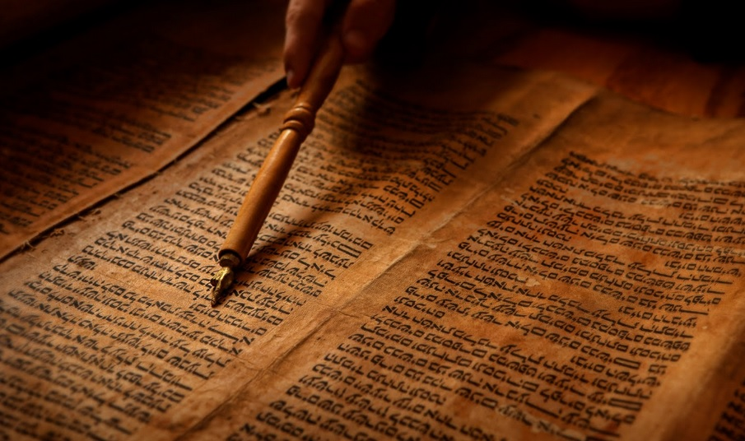
Is the New Testament Reliable?

Slide 2
2 Timothy 3:16:
“All Scripture is given by inspiration of God, and is profitable for doctrine, for reproof, for correction, for instruction in righteousness,”

Slide 3
Word of God
Word of Man
?

Slide 4
Written by mere People?
Many see the New Testament as a human product, not a divine one

Slide 5
The Merely Human Options
1. A myth written long after the fact.
2. Changed since the Apostles wrote it.
3. The Apostles Made Up the Story.

Slide 6
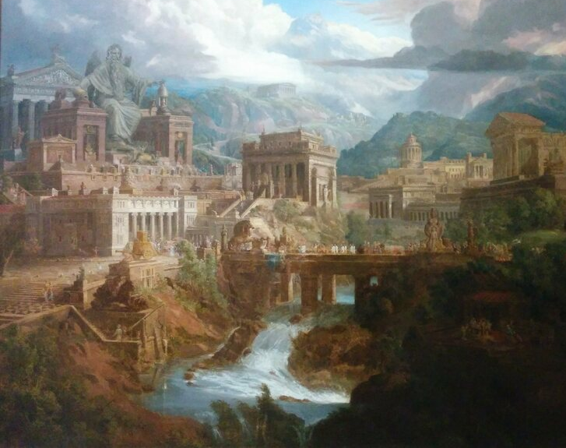
Could the books of the NT be from long after the events they record? A myth?
Many atheist try to argue this way

Slide 7
Possible Problems With The Theory?

Slide 8
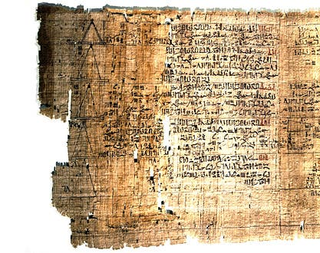
All the Evidence Says the Opposite Historically, the New Testament is the Best Document
The documents for the New Testament are also very early

Slide 10
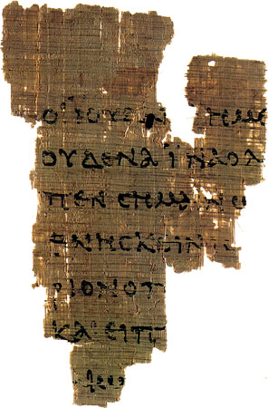
P.52: Date to 125 A.D.
John dies in the mid to late 90s, which means this is within 30 years of his life, showing people had been copying for years already

Slide 11
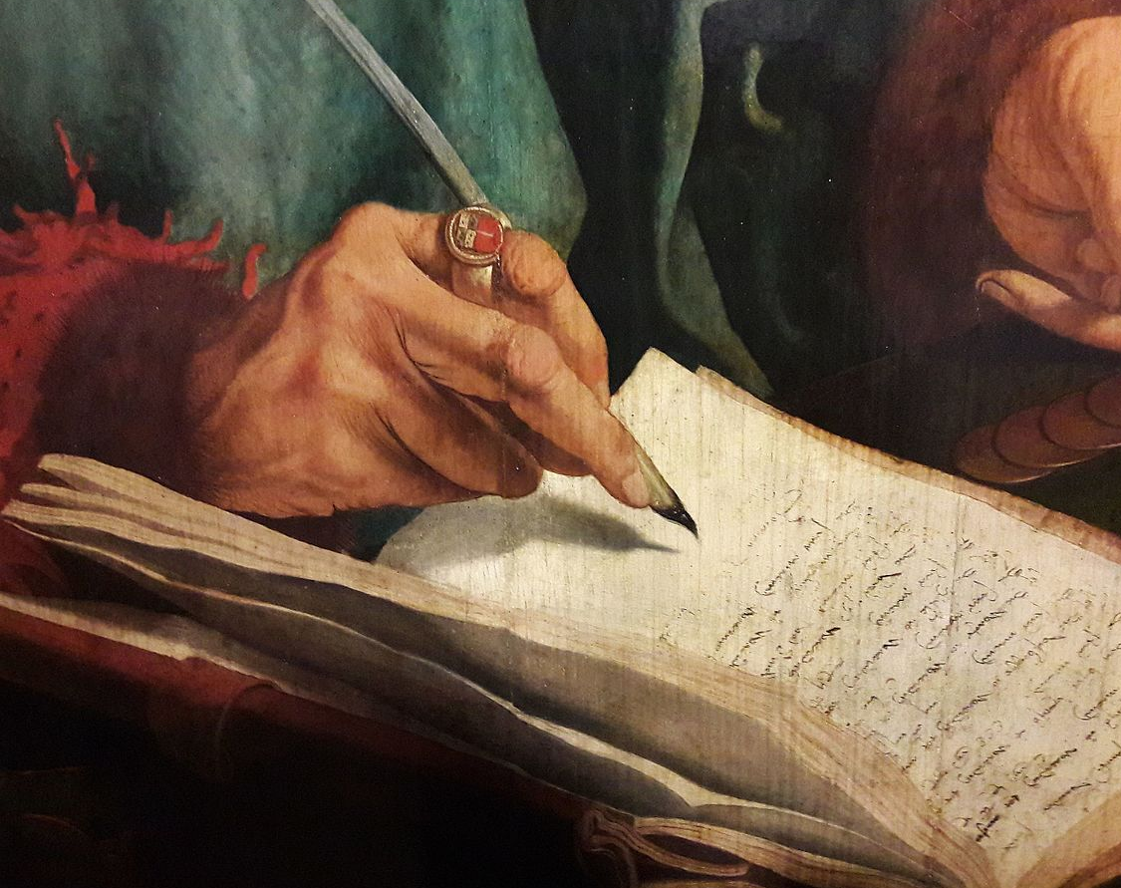
A Myth Doesn’t Make Sense for Other Reasons
Myths Are
Made to Convince

Slide 12
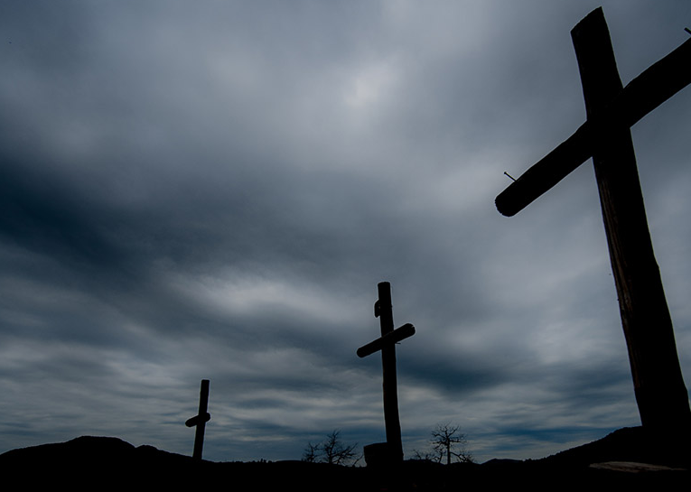
The Jewish People Are The Target
A Crucified
Messiah Was/Is
Foolish to Them.

Slide 13
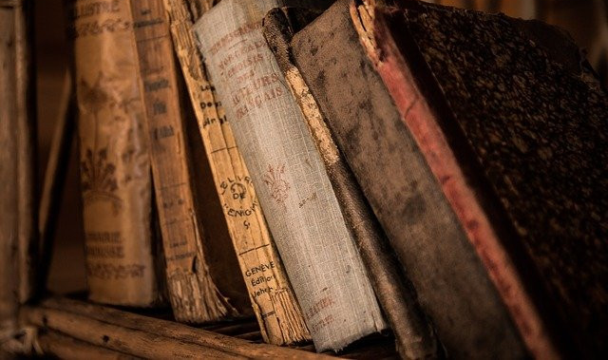
The Books Also Have Different Writing Styles
Different Styles Show Different Authors, yet all authors record the same events from different angles.

Slide 14
If it were made up, they should be the same
Detectives see the same thing today. Different witnesses, different angles, but the same event.

Slide 15
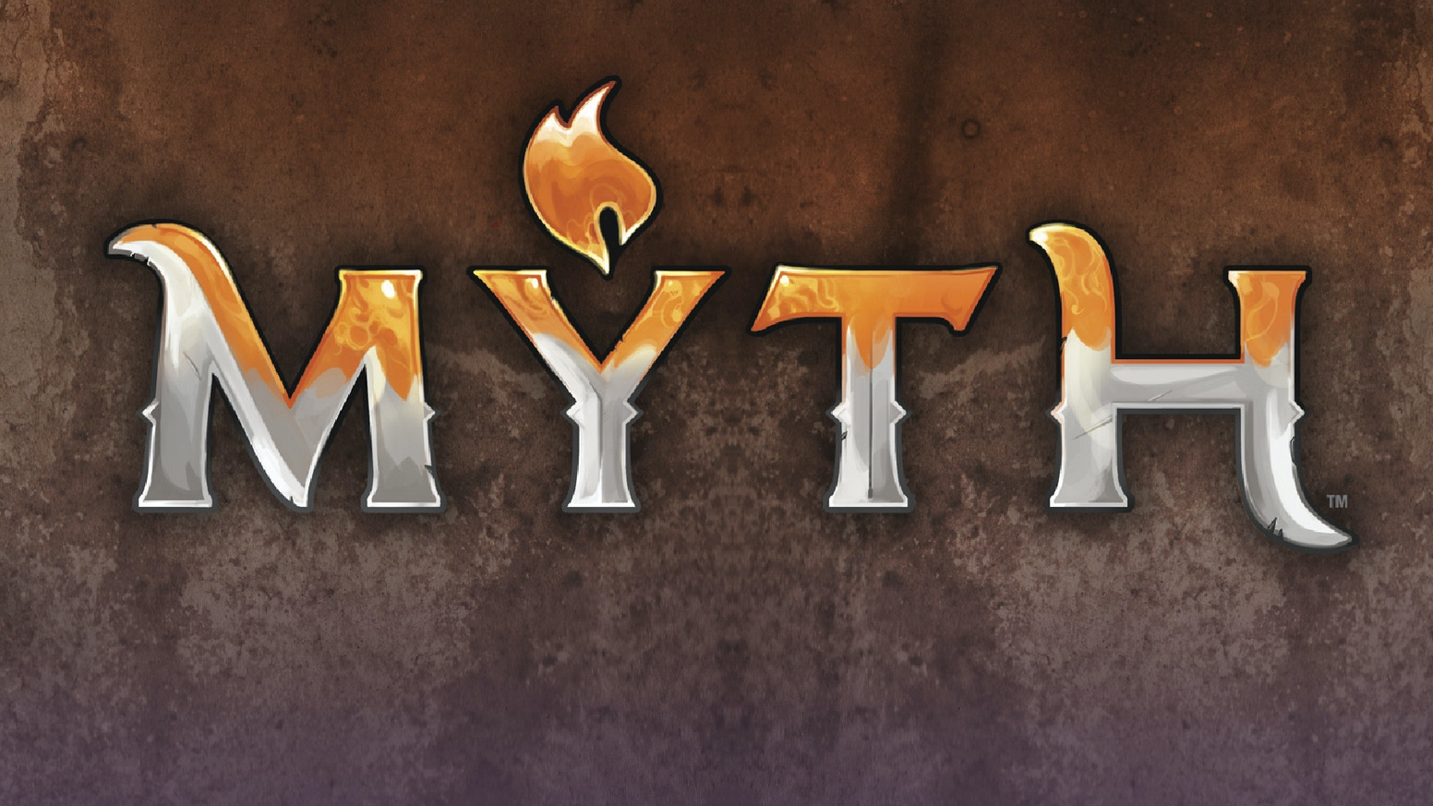

Slide 16
Intentionally or Accidentally
Could the Writings of the Apostles Been Changed Later On?

Slide 17
Possible Problems With The Theory?

Slide 18
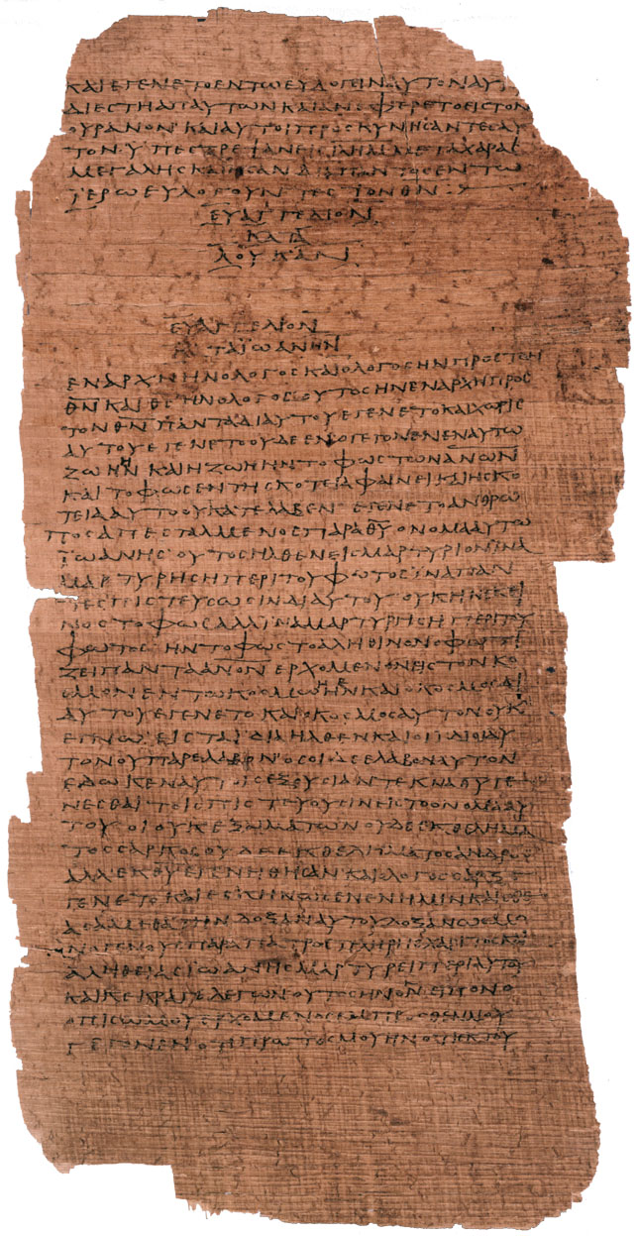
First Problem, we have many manuscripts of the New Testament, thousands.
We can see a timeline of handwritten manuscripts for 1,500 years, and they don’t indicate anyone has changed what the apostles wrote…

Slide 19
Aren’t Their Contradictions Between the Different Copies of the New Testament?
Couldn’t they mess up copying?

Slide 20
Our Investigation says yes, but that isn’t a problem because we have so many copies we can tell when an error occurs, and the errors are minor issues of grammar/spelling

Slide 21
Here are some types of errors
Writing twice what should be once.
Dividing two words that are one, or combining them.
Skipping a line.
Replacing a same sounding word.

Slide 22
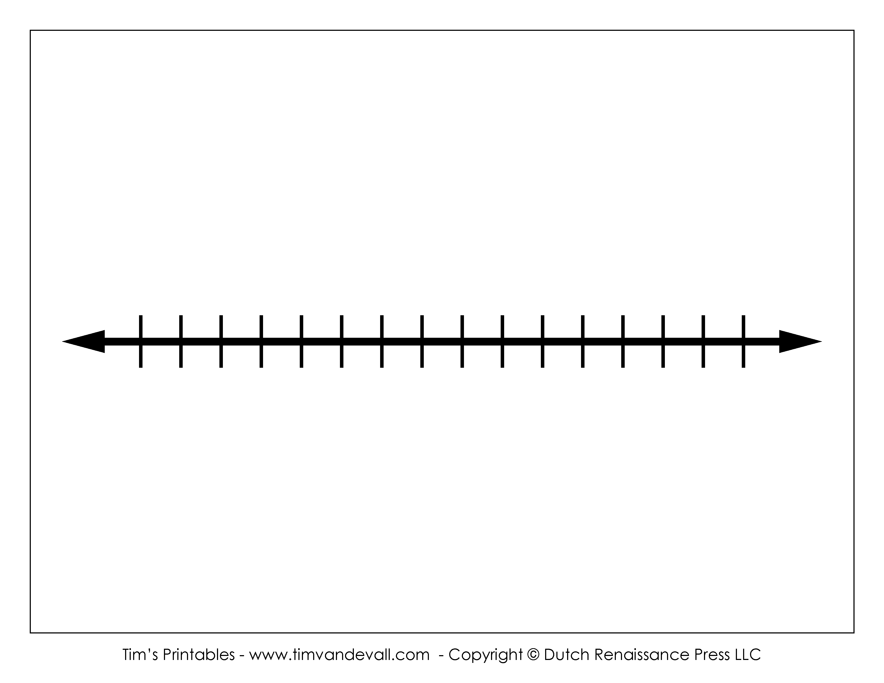
Basic Timeline Information
1,500 A.D.
95 A.D.
125 A.D.
A Thousand Years Without Distortion, We Can Trust the First 30 Years of Manuscripts

Slide 23
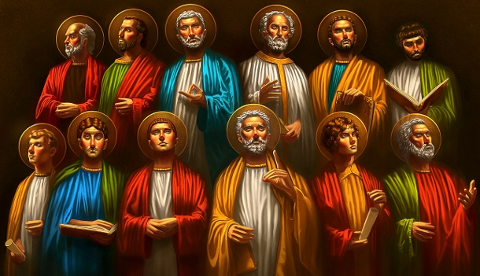
Did The Apostles Make Up The Stories?

Slide 24
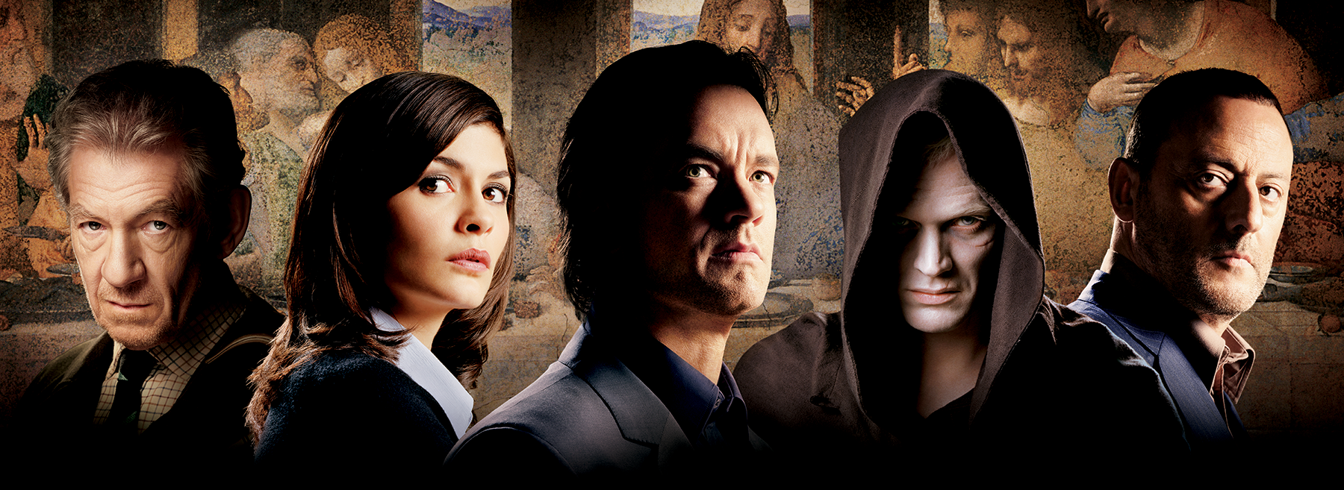
Movies and Books Make These Conspiracies Attractive
Is it possible the apostles invented these stories to gain fame, status, wealth, attention, etc.

Slide 25
Possible Problems With The Theory?

Slide 26
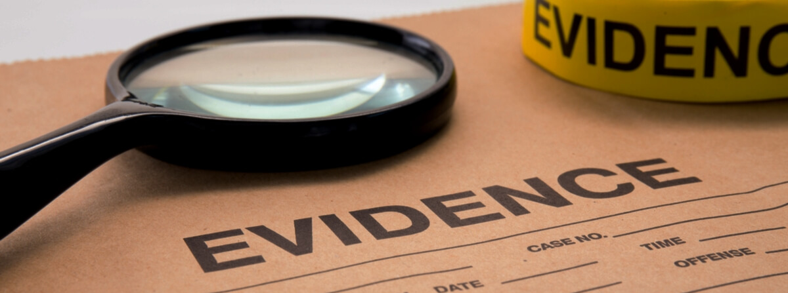
1. There is Zero Evidence from History for it.
The idea is completely modern, those against Christianity in history didn’t make these claims against it.

Slide 27
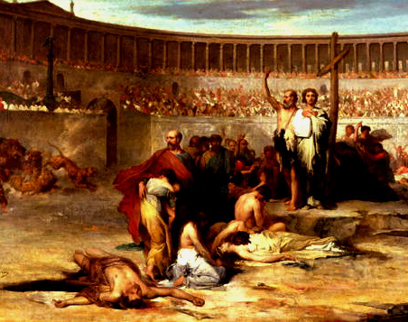
2. They died
for their faith.
The apostles, Paul, James, etc. all died painful, horrible deaths because they would not recant their faith.

Slide 28
They Died Horrible Deaths by every ancient way of execution
You don’t die
for a known lie

Slide 29
No Possible Human Option
1. A myth written long after the fact.
2. Changed since the Apostles wrote it.
3. The Apostles Made Up the Story.

Slide 30
The Bible is a Historical Document Written by Eyewitnesses of the Events

Slide 31
New Testament
Historical Books - 5 books Matthew, Mark, Luke, John, Acts
Pauline Epistles - 13 books Romans, 1 Corinthians, 2 Corinthians, Galatians, Ephesians, Philippians, Colossians, 1 Thessalonians, 2 Thessalonians. 1 Timothy, 2 Timothy,
Titus, Philemon
Non-Pauline Epistles - 9 books Hebrews, James, 1 Peter, 2 Peter, 1 John, 2 John, 3 John, Jude, Revelation

Slide 32
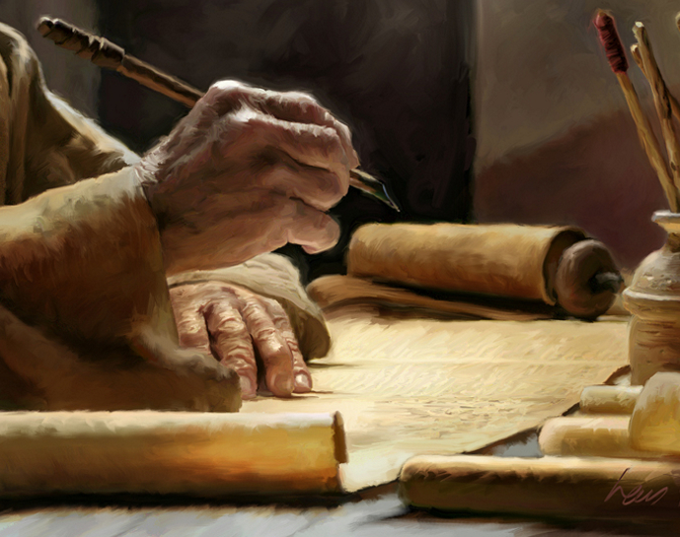
Authors List:
Matthew, Mark, Luke, John, Paul, Peter, Jude, and James.
They all died for their faith

Slide 33
“I choose to believe the Bible because it is a reliable collection of historical documents written down by eyewitnesses during the lifetime of other eyewitnesses. They report [of] supernatural events that took place in fulfillment of specific prophecies and claimed that their writing are divine rather than human in origin.” – Voddie Baucham

Slide 34
Key Question to ask…
What do the authors record and why were they willing to die for it?

Slide 35
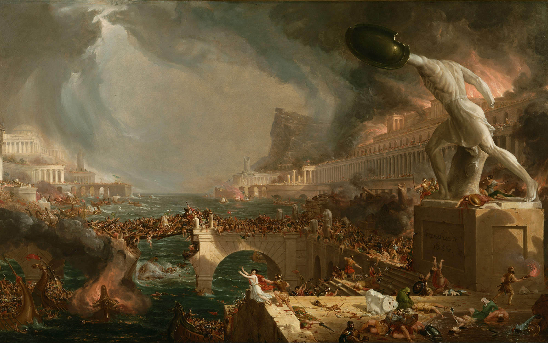
Why Do Entire Empires Try to Eradicate Christianity and Destroy the Bible?
Still Today…

Slide 36
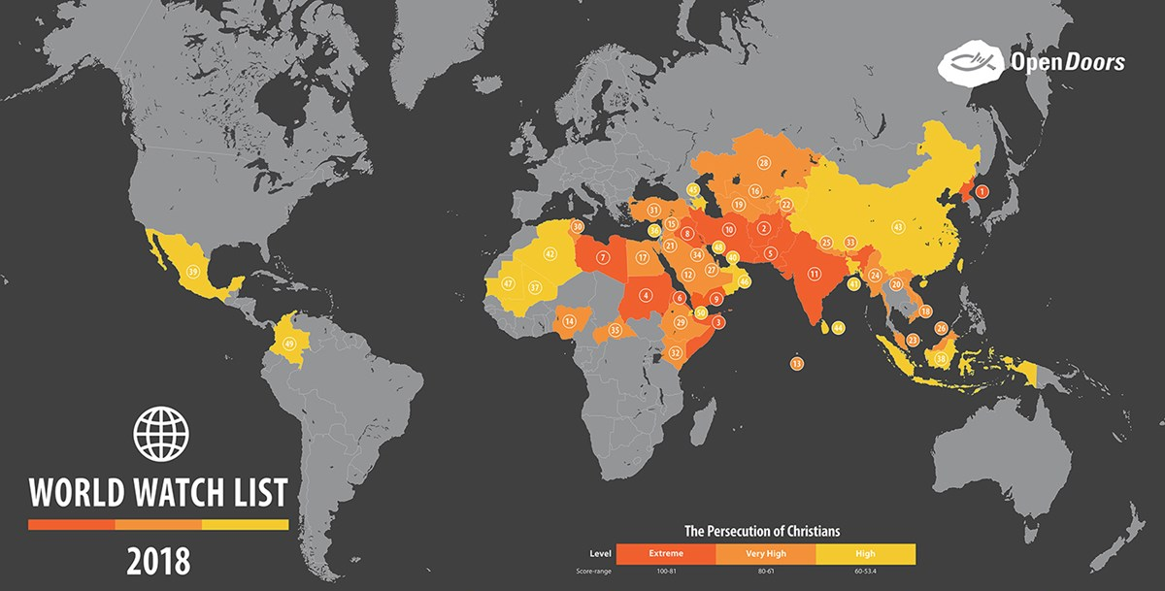

Slide 37
Now to Examine the Core Claim

