Slide 1
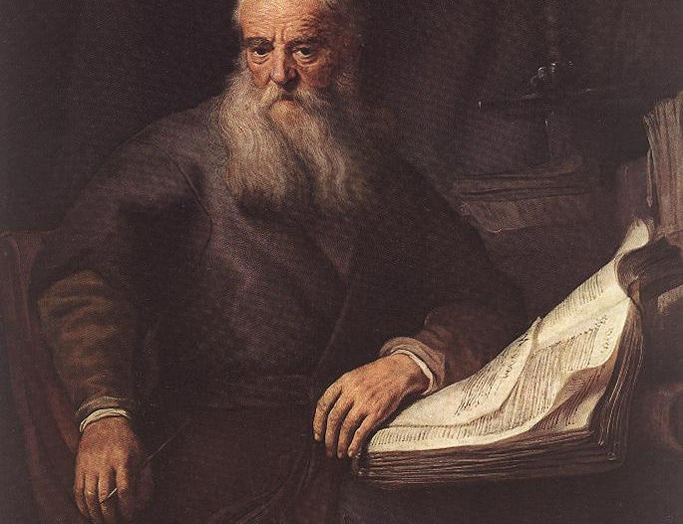
What Caught the Apostles Attention?
The Apostles saw the prophecies Jesus fulfilled as the ultimate evidence for His divine nature

Slide 2
2 Peter 1:16-19: “For we did not follow cleverly devised myths when we made known to you the power and coming of our Lord Jesus Christ, but we were eyewitnesses of his majesty...

Slide 3
…And we have the prophetic word more fully confirmed, to which you will do well to pay attention as to a lamp shining in a dark place, until the day dawns and the morning star rises in your hearts…”

Slide 4
There is something different about this book

Slide 5
Jesus lived between ~2 B.C. and 32 A.D. in Israel.
Prophecies are written between 1,200 & 500 B.C. Five Hundred Years Minimum

Slide 6
Don’t Other Religions Have Prophecies?

Slide 7
Most Other Religions Shy Away from the Topic Entirely…

Slide 8
Mormons and Jehovah Witnesses tried making prophecies
Didn’t Go Well

Slide 9
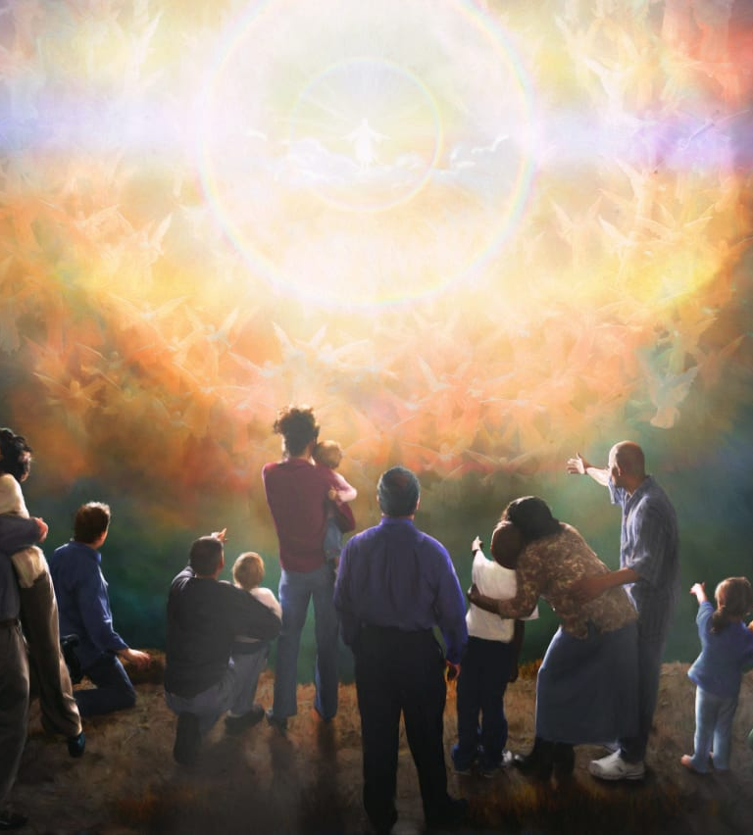
Charles Russell of the Jehovah Witnesses said Jesus Would Return in 1914
Needless to say, It didn’t Happen

Slide 10
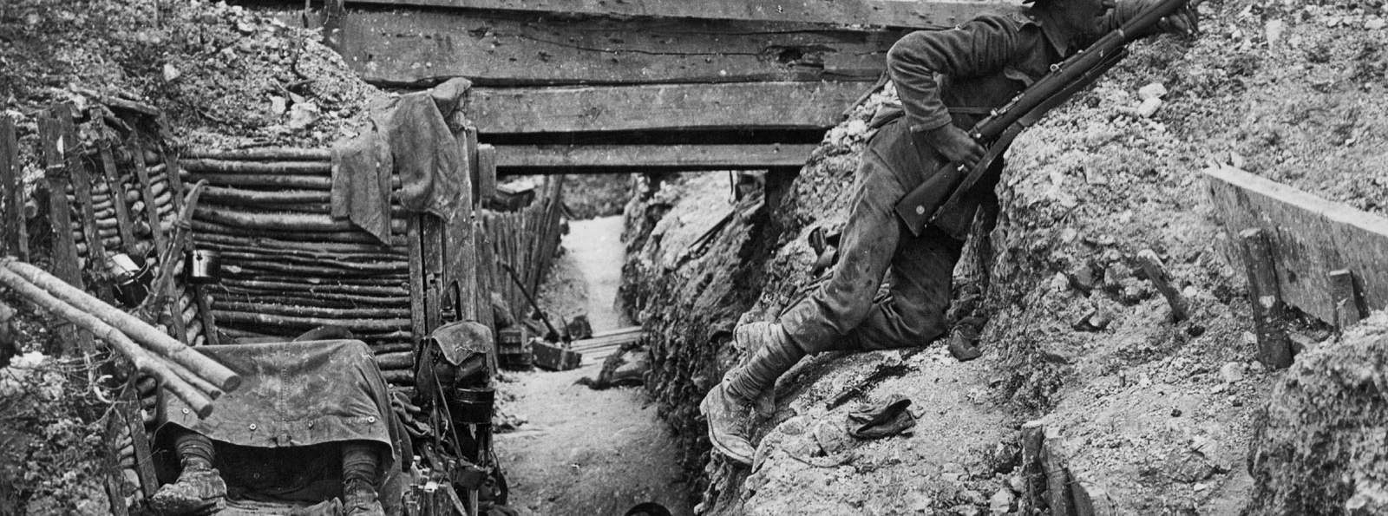
Big Problems Came in 1914
World War 1 Did Start in 1914 and the world got worse…

Slide 12
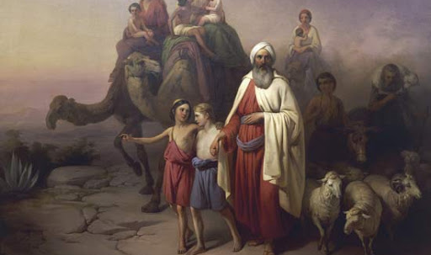
The JW’s then prophesied the return of Abraham, Isaac, and Jacob would return and help them build the kingdom of God
The prophecy failed again

Slide 13
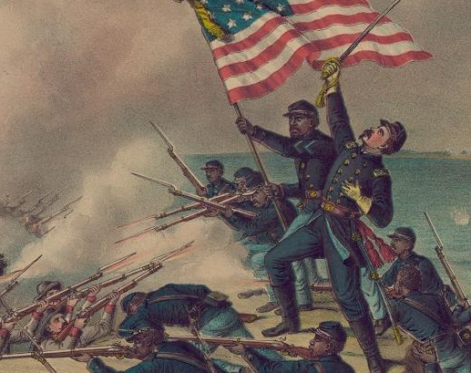
Another Group Tries
Joseph Smith (Mormonism) prophesied all nations would be involved in the American Civil War

Slide 14
The Bible is Unique in the World

Slide 15
Jesus lived between ~2 B.C. and 32 A.D. in Israel.
Prophecies are written between 1,200 & 500 B.C. Five Hundred Years Minimum

Slide 16
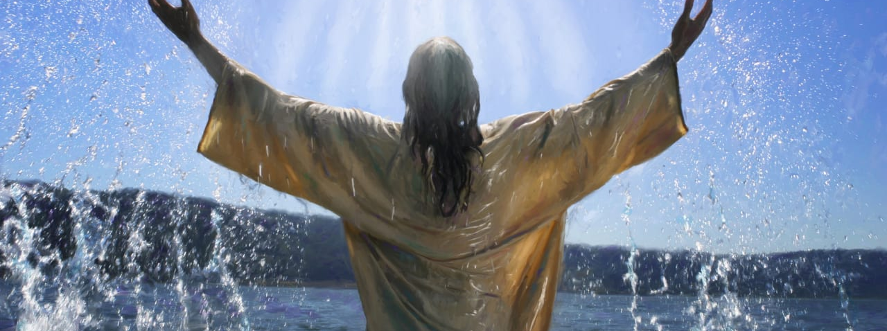
Messianic Prophecies
Here are Eight Examples of Messianic Prophecies the Bible Makes About Jesus Christ (The Messiah)

Slide 17
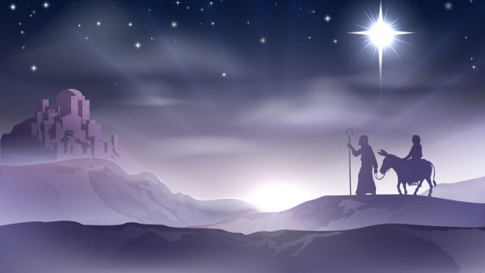
1. Jesus Would Be Born in the City of David (Bethlehem)
The Christmas story is familiar to everyone in America Today

Slide 18
Micah 5:2: “But you, O Bethlehem Ephrathah, who are too little to be among the clans of Judah, from you shall come forth for me one who is to be ruler in Israel, whose coming forth is from of old, from ancient days.”

Slide 19
Micah Written 720 B.C. Jesus Born Around 2 B.C.
Timeline: 720 Years

Slide 20
The Odds of Being Born in Bethlehem?
Less than 1 in 100,000

Slide 21
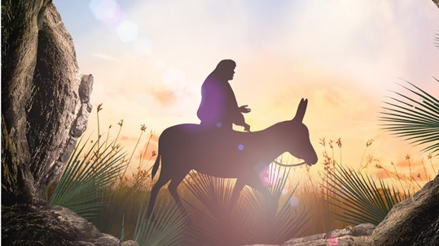
2. The Messiah Will Present Himself as King Riding a Donkey
Palm Sunday is the Holiday Celebrating it

Slide 22
Zechariah 9:9: “Rejoice greatly, O daughter of Zion! Shout aloud, O daughter of Jerusalem! Behold, your king is coming to you; righteous and having salvation is he, humble and mounted on a donkey, on a colt, the foal of a donkey.”

Slide 23
The Odds of Being Born in Bethlehem?
Less than 1 in 100,000

Slide 24
Zechariah Written 480 B.C. Palm Sunday 32 B.C.
Timeline: 500 Years

Slide 25
The Odds of Palm Sunday Donkey Scene?
Far Less than 1 in 100

Slide 26
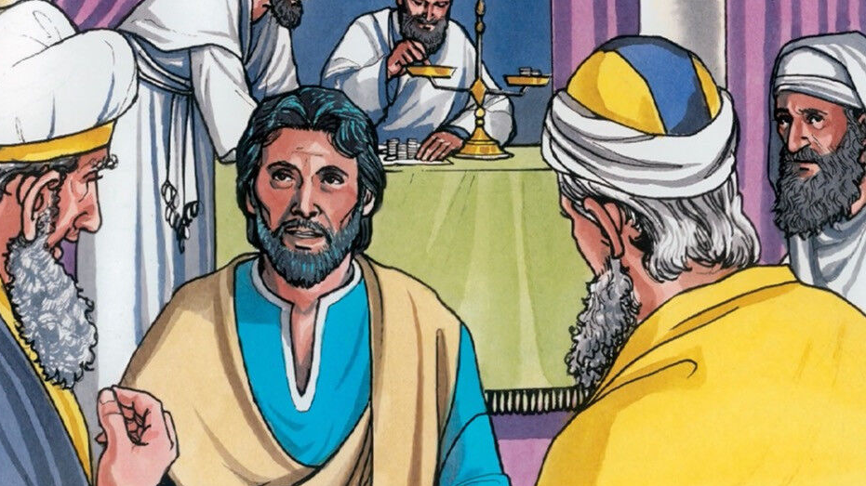
3. The Messiah Will be Betrayed for Thirty Pieces of Silver
Judas Betrayed Jesus to the Pharisees

Slide 27
Zechariah 11:13: “Then the Lord said to me, “Throw it to the potter”—the lordly price at which I was priced by them. So I took the thirty pieces of silver and threw them into the house of the Lord, to the potter.”

Slide 28
Zechariah Written 480 B.C. Betrayal Sunday 32 B.C.
Timeline: 500 Years

Slide 29
Odds of Being Betrayed for 30 Pieces of Silver?
Far Less than 1 in 1,000

Slide 30
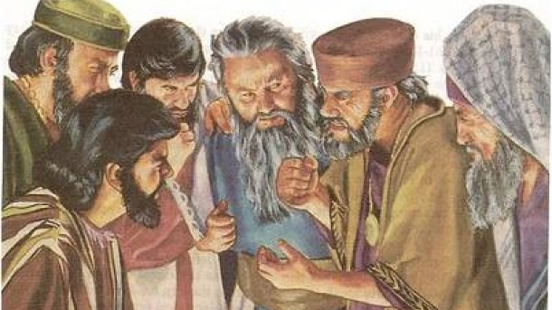
4. The Potter Will End Up with the Money in the Betrayal
Judas takes the money back due to guilt, but they can’t keep it

Slide 31
Zechariah 11:13: “Then the Lord said to me, “Throw it to the potter”—the lordly price at which I was priced by them. So I took the thirty pieces of silver and threw them into the house of the Lord, to the potter.”

Slide 32
Matthew 27:6-8: And the chief priests took the silver pieces, and said, It is not lawful for to put them into the treasury, because it is the price of blood. And they took counsel, and bought with them the potter's field, to bury strangers in. Wherefore that field was called, The field of blood, unto this day.

Slide 33
Zechariah Written 480 B.C. Betrayal Sunday 32 B.C.
Timeline: 500 Years

Slide 34
Odds of Being Betrayed for 30 Pieces of Silver?
Far Less than 1 in 100,000

Slide 35
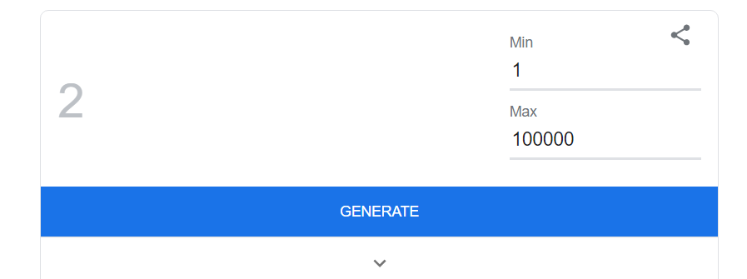
Are You Lucky Enough?
Guess a Number Between 1 and 100,000

Slide 36
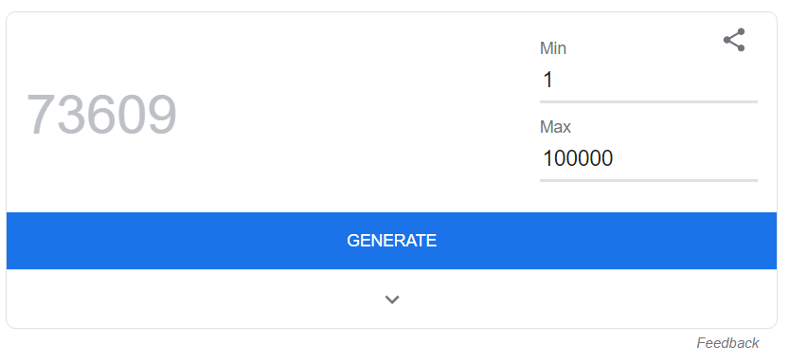
Did You Get It?

Slide 37
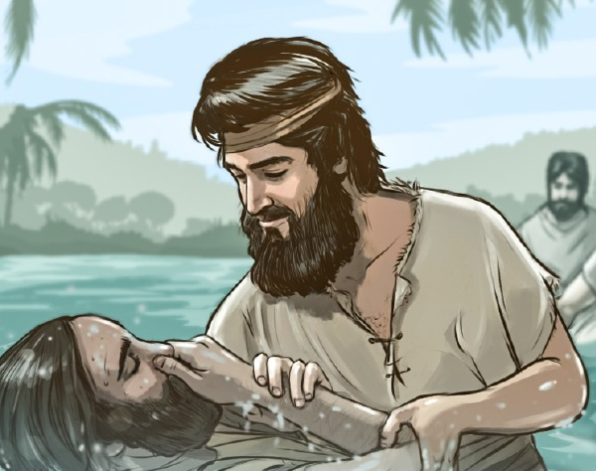
5. Announced by an Elijah-Like Herold
John the Baptist Proclaimed the Coming of Jesus like Elijah

Slide 38
Isaiah 40:3-5: “A voice cries: In the wilderness prepare the way of the Lord; make straight in the desert a highway for our God… And the glory of the LORD shall be revealed, and all flesh shall see it together, for the mouth of the Lord has spoken.”

Slide 39
Isaiah Written 700 B.C. Betrayal Sunday 30 B.C.
Timeline: 730 Years

Slide 40
Put the Pieces Together
Even the Disciples Figured this Out When They Examined Prophecy

Slide 41
Matthew 3:1-3: “In those days John the Baptist came preaching in the wilderness of Judea, “Repent, for the kingdom of heaven is at hand.” For this is he who was spoken of by the prophet Isaiah when he said, “The voice of one crying in the wilderness: ‘Prepare the way of the Lord; make his paths straight.’”

Slide 42
Odds of Being Proclaimed by a Herold?
Far Less than 1 in 1,000

Slide 43
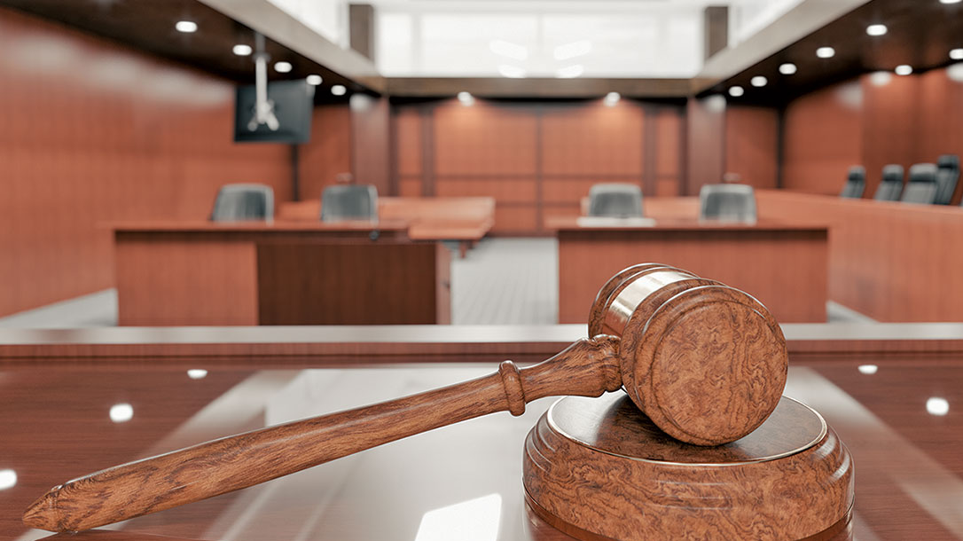
6. He was accused of a capital crime and made no defense
Jesus was given a trial and did not speak

Slide 44
Isaiah 53:7: “He was oppressed, and he was afflicted, yet he opened not his mouth; like a lamb that is led to the slaughter, and like a sheep that before its shearers is silent, so he opened not his mouth.”

Slide 45
Isaiah Written 700 B.C. Betrayal Sunday 30 B.C.
Timeline: 730 Years

Slide 46
Odds of Not Defending Yourself on Trial
Far Less than 1 in 1,000

Slide 47
7. He Will Die with the Wicked and be Buried with the Rich
Jesus died on the cross with thieves but was buried with the rich

Slide 48
Isaiah 53:9: “And they made his grave with the wicked and with a rich man in his death, although he had done no violence, and there was no deceit in his mouth.”

Slide 49
Isaiah Written 700 B.C. Betrayal Sunday 30 B.C.
Timeline: 730 Years

Slide 50
Odds of Dying with Wicked and Buried with the Rich?
Far Less than 1 in 1,000

Slide 51
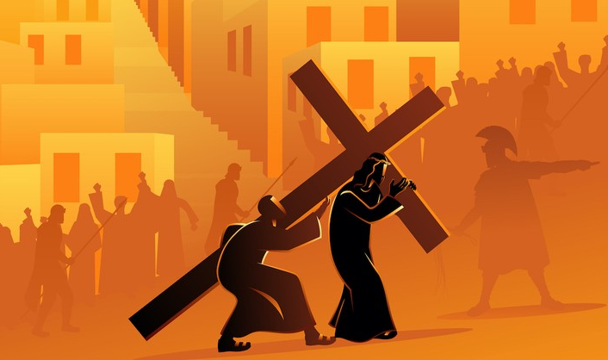
8. Crucified Without a Bone Broken
The Two Other Thieves Had Their Legs Broken While Christ Didn’t

Slide 52
Psalm 22:16 “For dogs have compassed me: the assembly of the wicked have enclosed me: they pierced my hands and my feet.”

Slide 53
Psalms Written 1,200 B.C. Betrayal Sunday 30 B.C.
Timeline: 1,230 Years

Slide 54
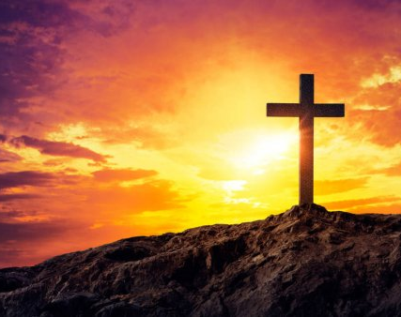
Persians Invented Crucifixion 400 B.C.
Crucifixion Wasn’t Even Invented When David Wrote the Psalm

Slide 55
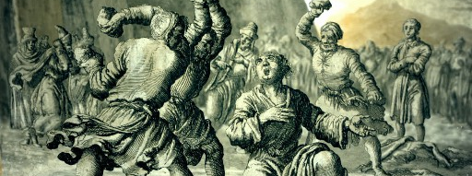
Ancient Israel Customs
Stoning Was the Primary Form of Execution

Slide 56
Odds of Dying by Crucifixion without a Broken Bone
Far Less than 1 in 10,000

Slide 57
What are the Odds of Getting All Eight Prophecies

Slide 58
Here are the Odds: 1 in 100,000,000,000,000,000
Visualizing the odds is complicated but here is an example using states and money

Slide 59
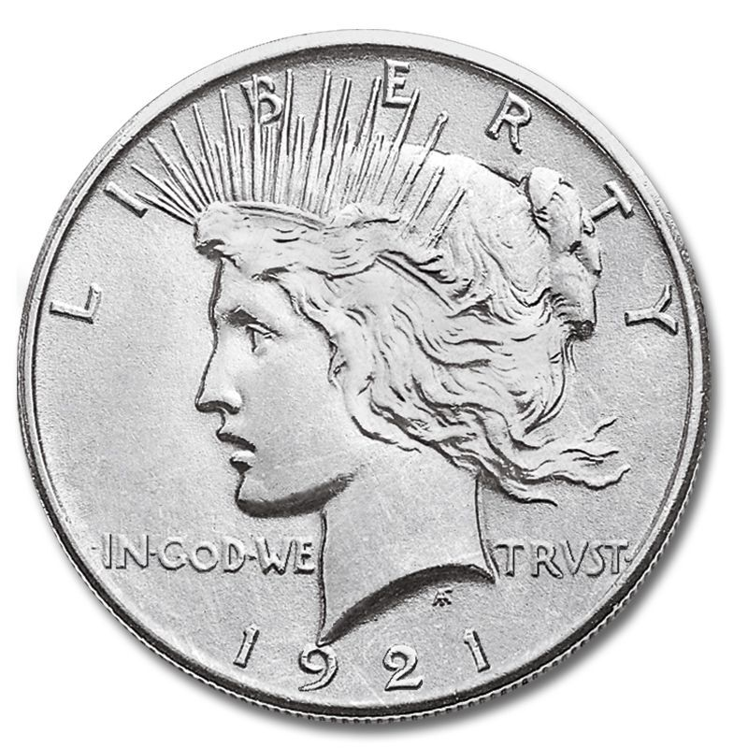
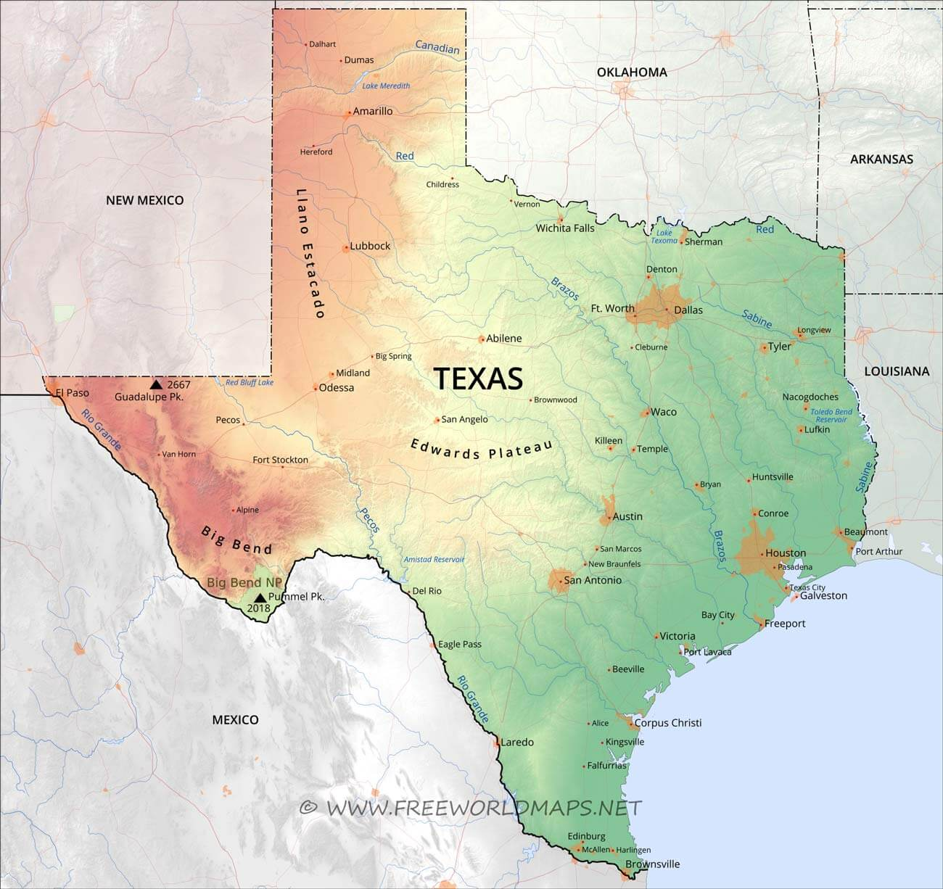
Fill Texas with Silver Dollars Two Feet Deep
Blind-Fold and Pick the Right One Randomly

Slide 60
We’ve only discussed eight of the prophecies in scripture
There are 100-150+ Prophecies exist of Jesus, what are the odds of sixteen?

Slide 61
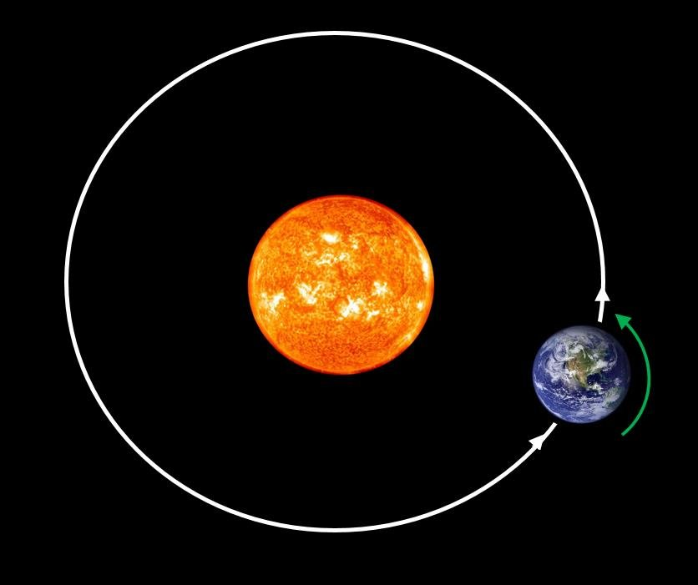
Now you need the scale of earth and its orbit around the sun for illustration

Slide 62
Chance is unable to explain the statistical odds that Jesus Christ fulfilled. God must exist

