Slide 1
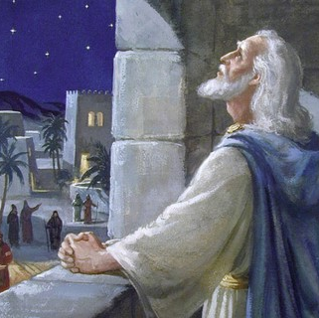
The Prophecy of Daniel Continues
Daniel 8:11-12: “the regular burnt offering was taken away from him, and the place of his sanctuary was overthrown...”

Slide 2
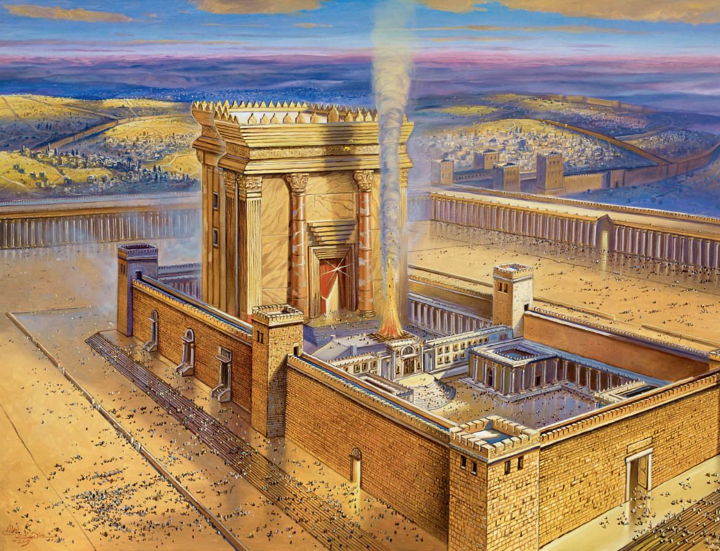
Offering
Would Cease
Daniel made this prophecy and it happened four hundred years later…

Slide 3
Antiochus Epiphanes

Slide 4
Verse 13-14 say: “Then I heard a holy one speaking, and another holy one said to the one who spoke, ‘For how long is the vision concerning the regular burnt offering…

Slide 5
the transgression that makes desolate, and the giving over of the sanctuary and host to be trampled underfoot?’ And he said to me, ‘For 2,300 evenings and mornings. Then the sanctuary shall be restored to its rightful state…’”

Slide 6
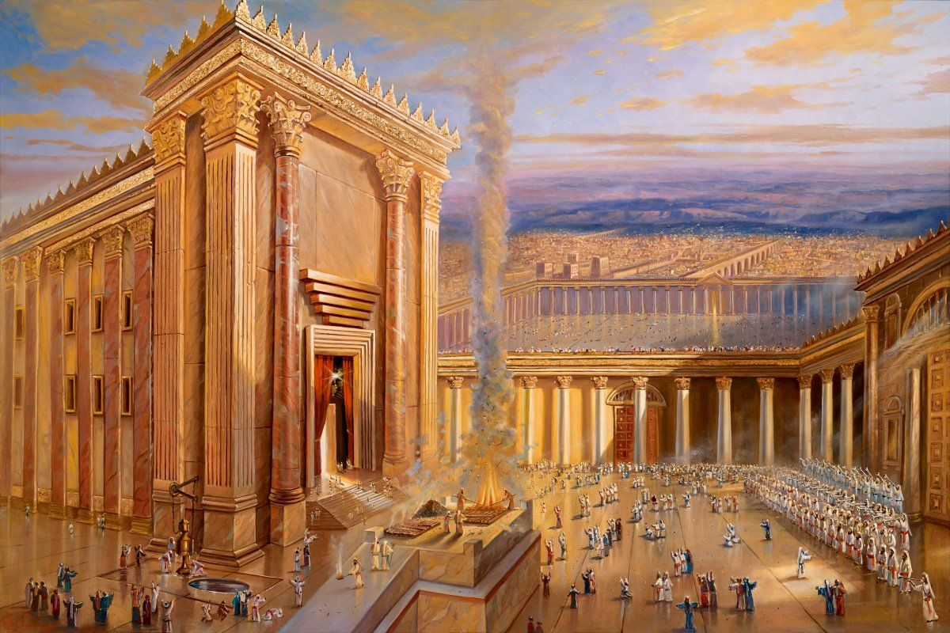
No Offering Daniel says for 2,300 days…
Skeptics say the dates do not match the history

Slide 7
December 15, 167 B.C. December 25, 164 B.C.
Not 2,300 days…

Slide 9
What Do We Know So Far?
2,300 Evenings and Mornings…
Not adding up historically to 2,300 years…
Is it an error?

Slide 11
Why Would it Say Evening and Morning and not just 2,300 days?

Slide 12
Search the Bible…
Exodus 29:38 tells us the Jews were to make one offering in the morning and one in the evening for the regular burnt offering…

Slide 13
So instead of 2,300 days, it’s 2,300 of these sacrifices in the Hebrew, which is 1,150 days…

Slide 14
December 15, 167 B.C. December 25, 164 B.C.
1,090 vs. 1,150…

Slide 16
Leaps Months Not Years
Herodotus explains how the intercalary months worked in the Greek calendars, having one added every other year.

Slide 17
Two Intercalary Months for Three Year Timespan

Slide 18
December 15, 167 B.C. December 25, 164 B.C.
1,090 + 60 vs. 1,150
1,090 + 60 = 1,150 Exactly

Slide 19
Daniels Prophecy is Exactly Right 400 years earlier
Antiochus Epiphanes would stop 2,300 offers exactly before the Jews rebelled and retook the temple.

