Slide 1
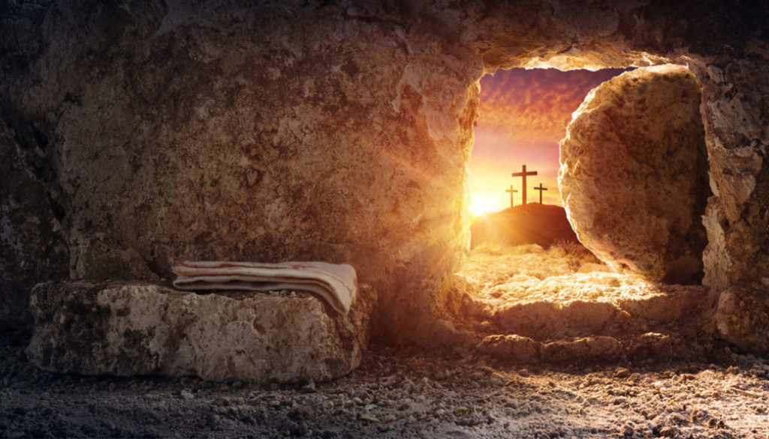
Did the Resurrection of Jesus Happen?

Slide 2
1 Corinthians 15:14-19: “if Christ has not been raised, then our preaching is in vain and your faith is in vain… if Christ has not been raised, your faith is futile and you are still in your sins. ¹⁸ Then those also who have fallen asleep in Christ have perished. ¹⁹ If in Christ we have hope in this life only, we are of all people most to be pitied.

Slide 3
The Historical Argument for the Resurrection is our focus
The Bible makes the claim clear

Slide 4
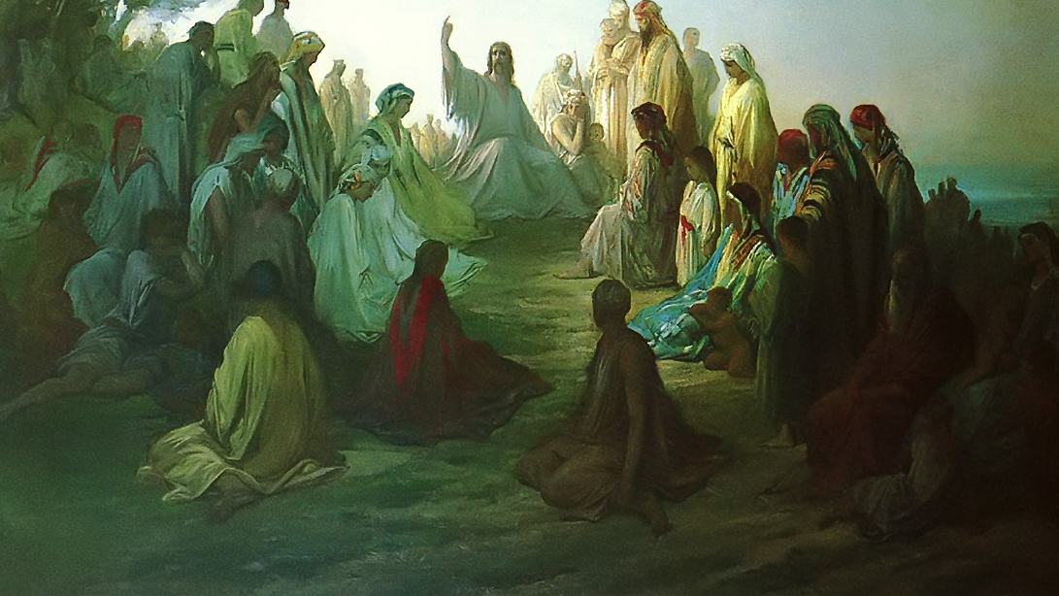
Jesus Himself said He would die and rise again in John 2:19

Slide 5
The claims of scripture are uniform, Christ died a rose again on the third day, just as He claimed He would

Slide 7
Why do atheists reject the evidence for Jesus and His resurrection?

Slide 9
They assume God doesn’t exist from the start, so they reach that conclusion.
Yet that is the question at hand

Slide 10
Historical Evidence
Not all evidence is equal historically speaking

Slide 11
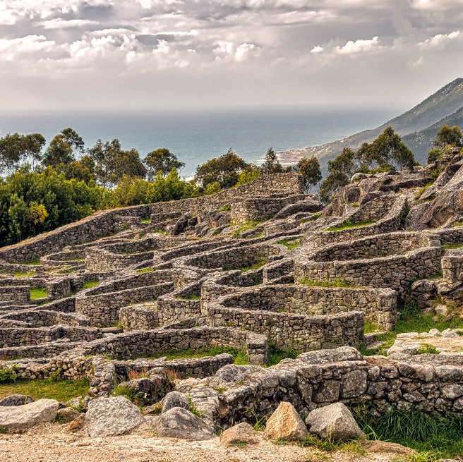
What Makes the Best Historical Evidence?
Eye-Witness Accounts Make the Strongest Form of Evidence by Far in History

Slide 15
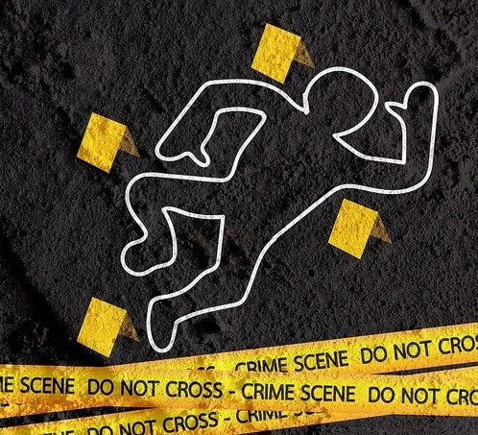
Before we cover the resurrection, here are some details to know
Keep the following things in mind with eye-witness testimony

Slide 16
1. Identical Stories are Suspect in investigations
They make it appear forged

Slide 17
2. The same story with different details is a good sign
Authentic and not forged

Slide 18
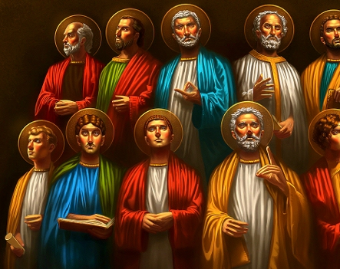
3. Multiple witnesses, from different angles, is a good sign.
Friends, Neutral, or enemies

Slide 19
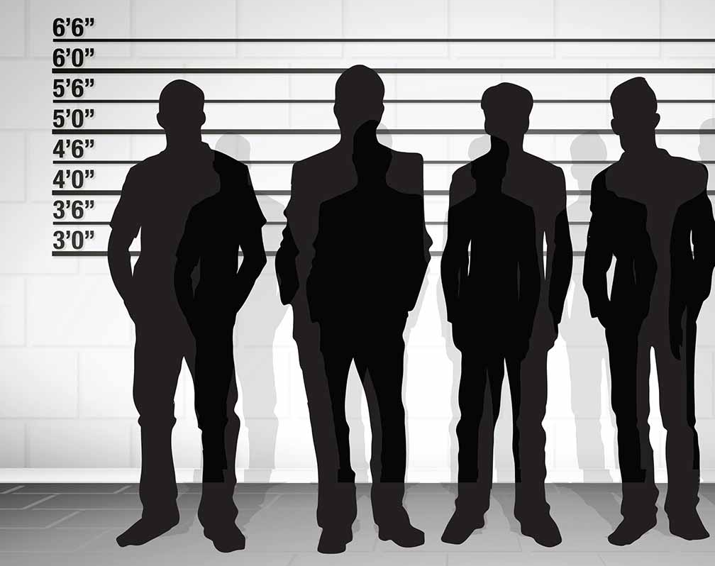
Strength
Friendly (I)
Neutral (II)
Enemy (III)

Slide 20
4. One witness is good, multiple eyewitness's is far better!
Few More Details…

Slide 21
5. Firsthand Eyewitness is Stronger than Secondhand
Much of history is still secondhand

Slide 23
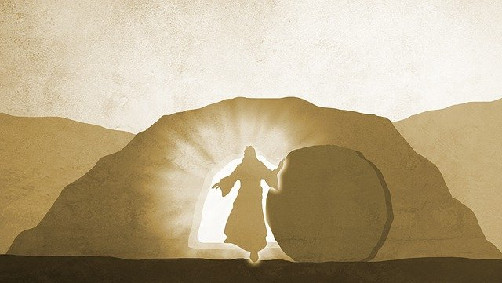
What then is the Evidence for the Resurrection?

Slide 24
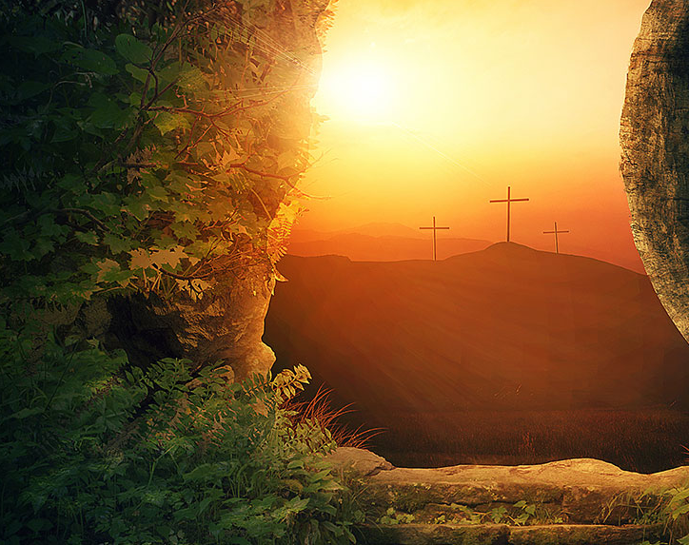
Minimal Facts Approach is the first angle that uses extra Biblical sources
Five facts are emphasized

Slide 25
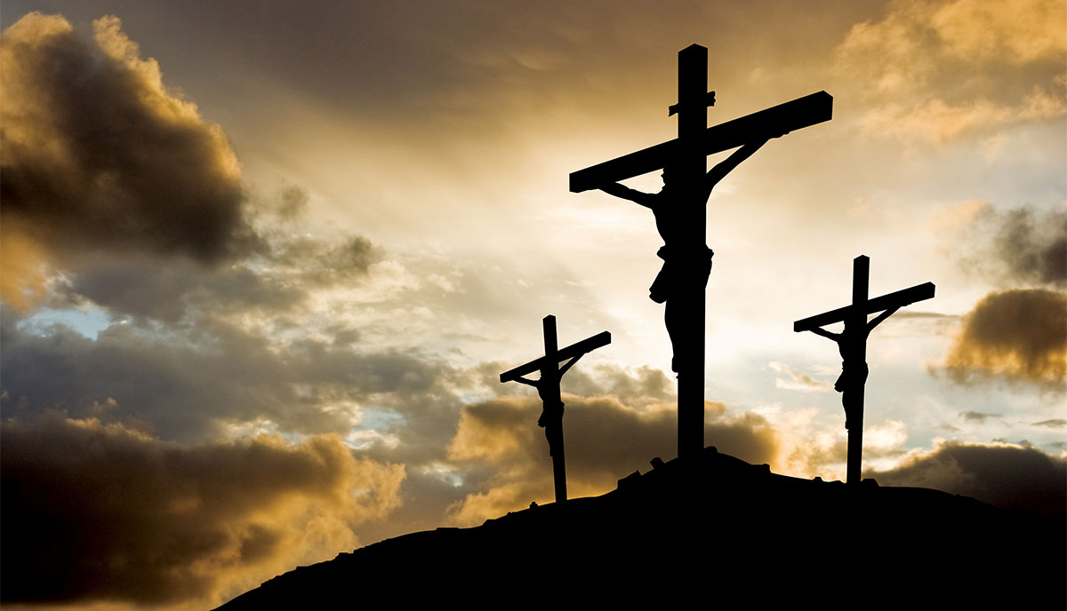
1. Jesus died by crucifixion at the hands of the Romans
No ancient history for 500 years refutes it

Slide 26
Who are the historians that confirm this historical fact?
Biblical and Non-Biblical

Slide 27
Biblical Authors
Matthew
Mark (Peter)
Luke (Paul)
John

Slide 28
Could they be making up the crucifixion story?
Why invent a story with a culturally shameful death for the hero?

Slide 29
1 Corinthians 15:3-5: “For I delivered to you first of all that which I also received: that Christ died for our sins according to the Scriptures, and that He was buried, and that He rose again the third day according to the Scriptures”

Slide 30
Moving on to the Extra-Biblical Sources and their confirmation
Who are the extra Biblical Sources and What do They Say?

Slide 31
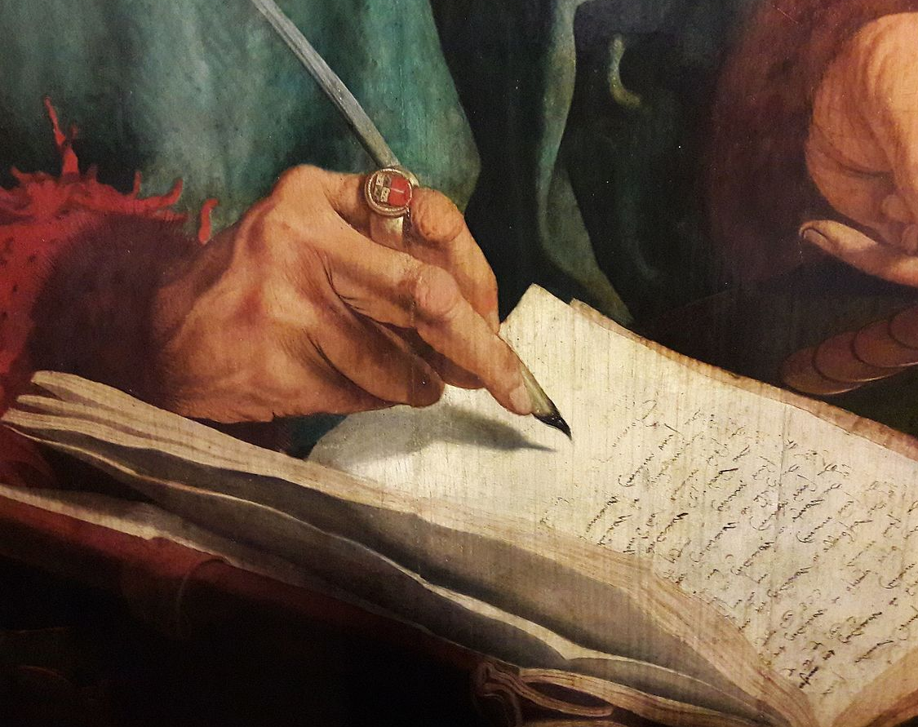
Authors Names
Josephus
Tacitus
Lucian
Mara Bar-Serapion
The Talmud

Slide 32
Flavius Josephus (AD 37?-101?) Jewish Historian: “For he . . . wrought surprising feats. . . . He was the Christ. When Pilate . . .condemned him to be crucified, those who had . . . come to love him did not give up their affection for him.”

Slide 33
Lucian (circa 120-after 180) Greek writer & historian
"The Christians, you know, worship a man to this day the distinguished personage who introduced their novel rites, and was crucified on that account

Slide 34
1. Jesus died by crucifixion at the hands of the Romans
Confirmed

Slide 35
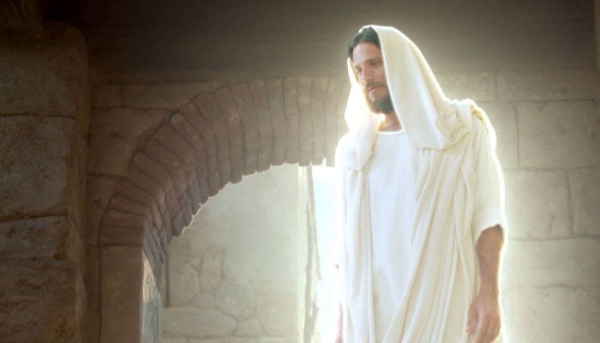
2. The Disciples Sincerely Believed He Rose from the Dead & Appeared to Them
Whether or not He did, the disciples thought He did.

Slide 36
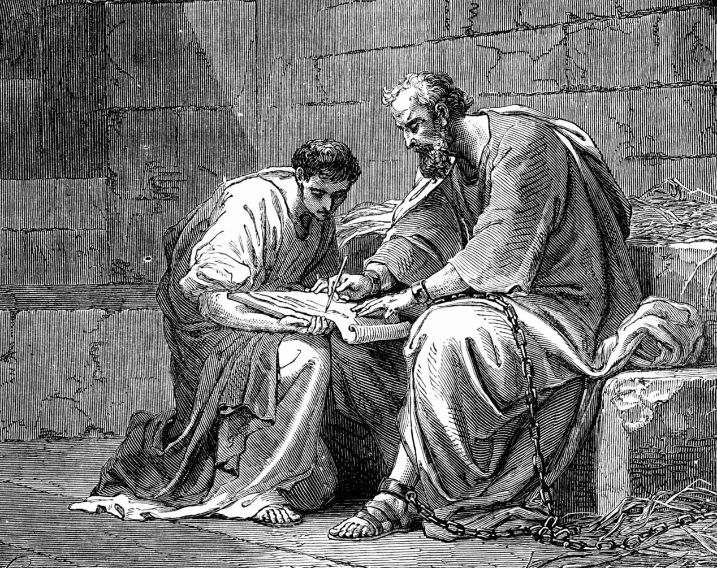
How do we know they believed this?
The Disciples Were Put in Prison and Killed for their Faith that Jesus Rose from the Dead

Slide 37
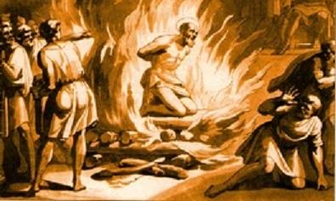
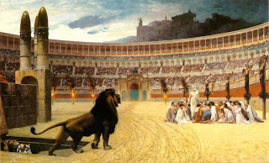
Remember the painful ways they died?
Burnt alive, thrown to the beast, crucified, skinned, stabbed, stoned, boiled in oil, speared, and more.

Slide 38
Matthew - killed by stabbing as ordered by King Hircanus
James, son of Alphaeous – Stoned and clubbed to death
James, brother of Jesus - thrown down from a height, stoned and then beaten to death at the hands of Ananias
John - tortured by boiling oil, exiled to Patmos in AD 95
Mark - burned during Roman emperor Trajan's reign
Peter - crucified upside-down by the gardens of Nero on the Vatican hill circa AD 64

Slide 39
Andrew - crucified on an "X" shaped cross by Aegeas, governor of the Edessenes, around AD 80
Philip - stoned and crucified in Hierapolis, Phrygia
Simon - crucified in Egypt under Trajan's reign
Thomas - death by spear thrust in Calamina, India
James, son of Zebedee - killed by sword in AD 44 by order of King Herod Agrippa I of Judea
Bartholomew - beaten, flayed alive, crucified upside down, then beheaded

Slide 40
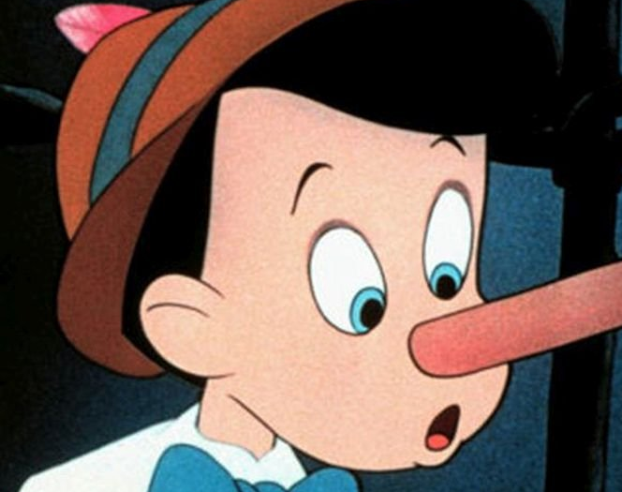
People die for a lie all the time
However, people don’t die for lies they made up and know aren’t true. The disciples think it’s true.

Slide 41
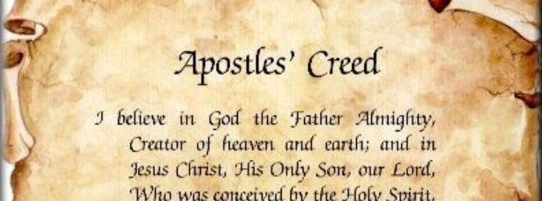
Early Creed Statements
These creeds were written very early and recorded in the Bible

Slide 42
1 Corinthians 15:3-7: “For I delivered to you as of first importance what I also received: that Christ died for our sins in accordance with the Scriptures, ⁴ that he was buried, that he was raised on the third day in accordance with the Scriptures, ⁵ and that he appeared to Cephas, then to the twelve. ⁶ Then he appeared to more than five hundred brothers at one time, most of whom are still alive, though some have fallen asleep. ⁷ Then he appeared to James, then to all the apostles.”

Slide 43
Conclusion
Clearly, the disciples believed Jesus appeared to them, whether He did

Slide 44
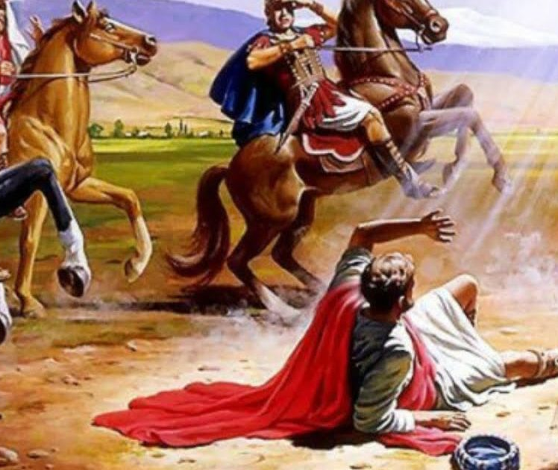
3. The conversion of Paul
Paul started off as a persecutor of the earliest Christians

Slide 45
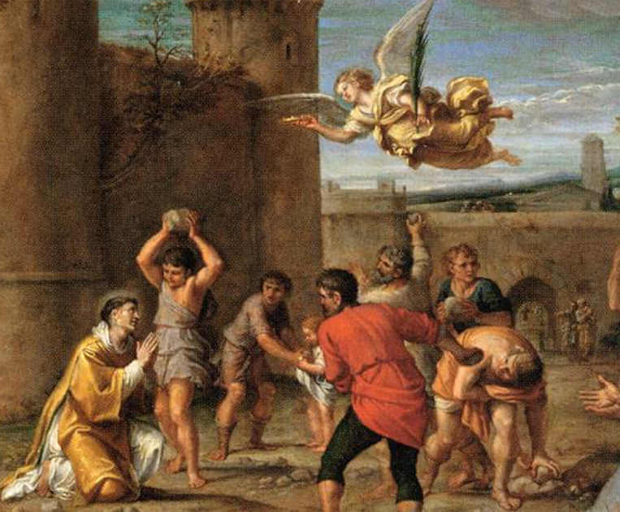
We first hear about Paul at the execution of Stephen for his faith in Jesus

Slide 46
“He who formerly persecuted us now preaches the faith which he once tried to destroy.”
Galatians 1:23

Slide 47
1 Corinthians 15:9: ”For I am the least of the apostles, who am not worthy to be called an apostle, because I persecuted
the church of God.”

Slide 48
Paul begins as the enemy of the church, and then completely changes to lead the church

Slide 49
Acts 9:1-6: “Then Saul, still breathing threats and murder against the disciples of the Lord, went to the high priest and asked letters from him to the synagogues of Damascus, so that if he found any who were of the Way, whether men or women, he might…

Slide 50
bring them bound to Jerusalem. As he journeyed he came near Damascus, and suddenly a light shone around him from heaven. Then he fell to the ground, and heard a voice saying to him, “Saul, Saul, why are you persecuting Me?”

Slide 51
And he said, “Who are You, Lord?” Then the Lord said, “I am Jesus, whom you are persecuting. It is hard for you to kick against the goads.” So he, trembling and astonished, said, “Lord, what do You want me to do?”

Slide 52
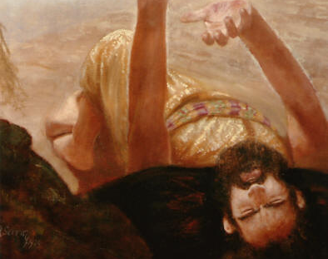
Why would Paul go on to die for this faith if he didn’t believe Jesus appeared?
Paul ends up dying for his faith in Jesus

Slide 53
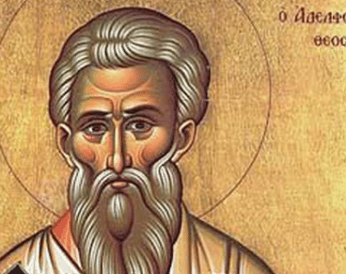
4. The Conversion of the Skeptic James
James was the brother of Jesus

Slide 54
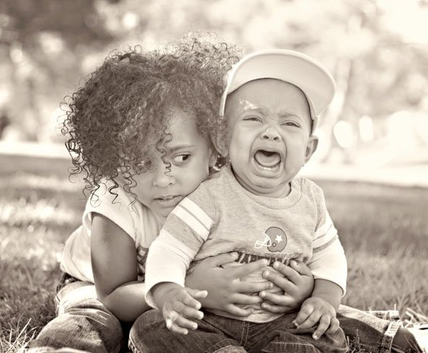
How would you feel if people said your brother was God? Probably wouldn’t be on that bandwagon, right?

Slide 55
The Bible says that James was not a
believer during the time of Christ
ministry on earth
The writers of the gospels knew it

Slide 56
John 7:5: “For even His brothers did not believe in Him.”

Slide 57
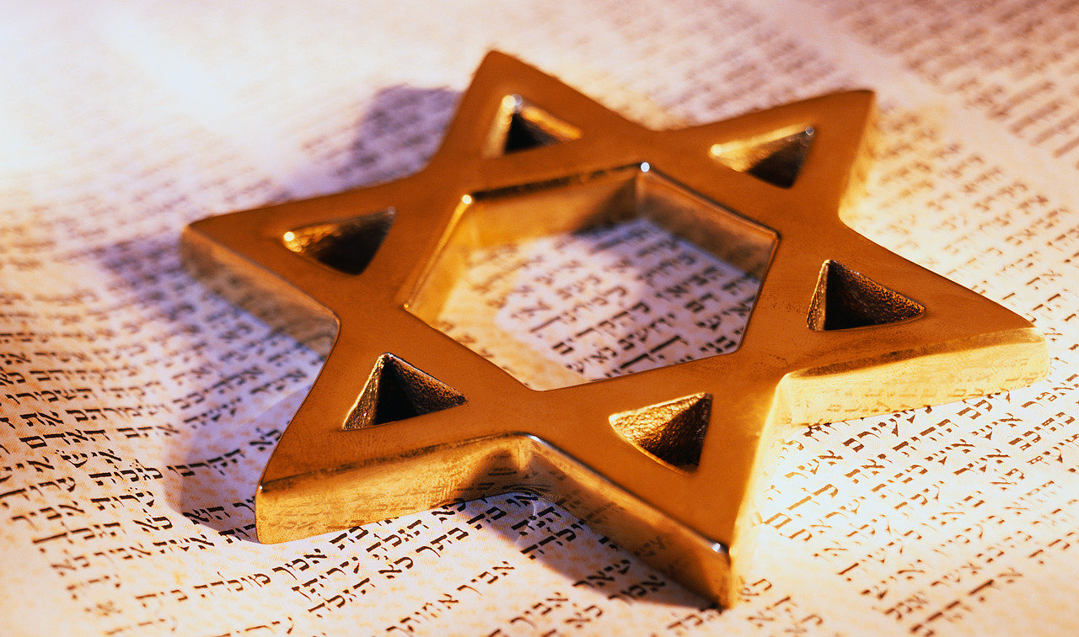
Before his conversion, we have evidence from another historian (Hegesippus) that James was a devout Jew who followed the Jewish laws

Slide 58
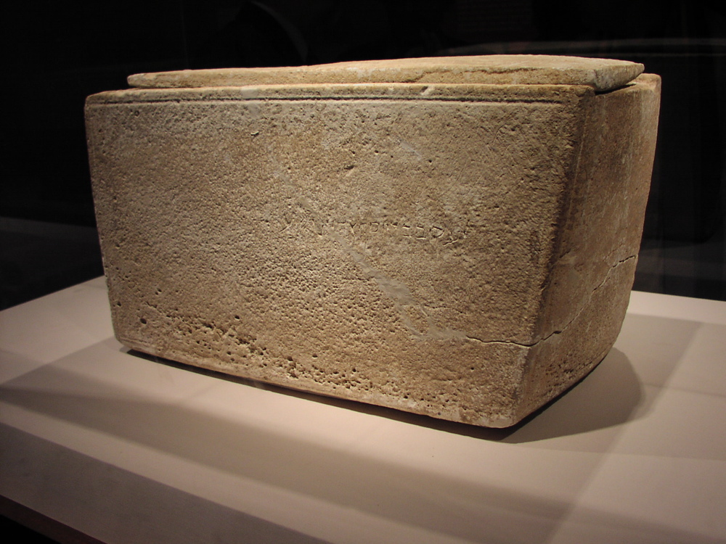
We have archeological evidence to confirm that James is the brother of Jesus (his ossuary was found)

Slide 59
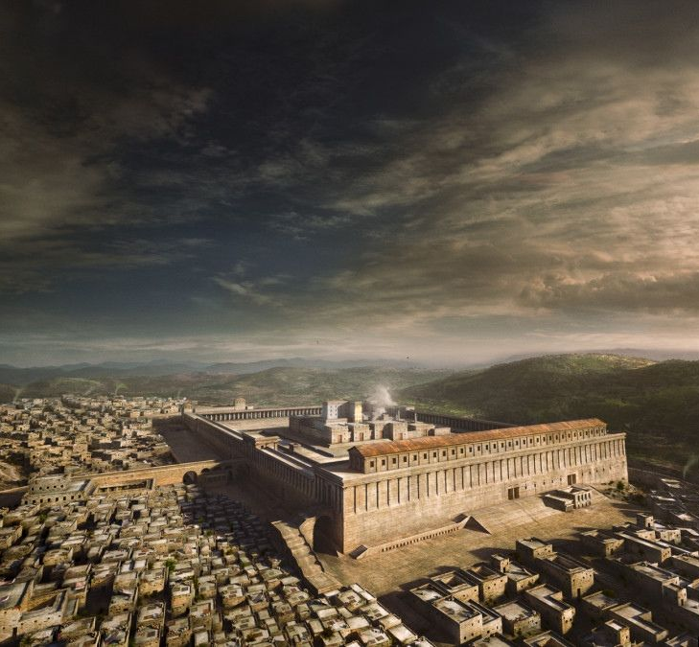
But after Jesus dies, James converts and becomes the head at the Church in Jerusalem

Slide 61
Why would he suddenly believe Jesus is God and rose from the dead?

Slide 62
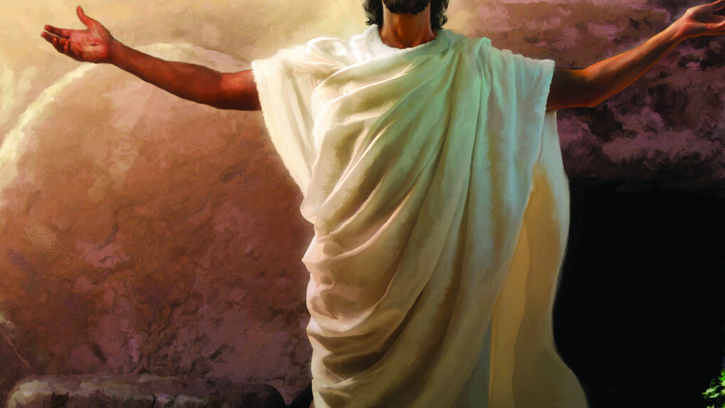
Only One Explanation

Slide 63
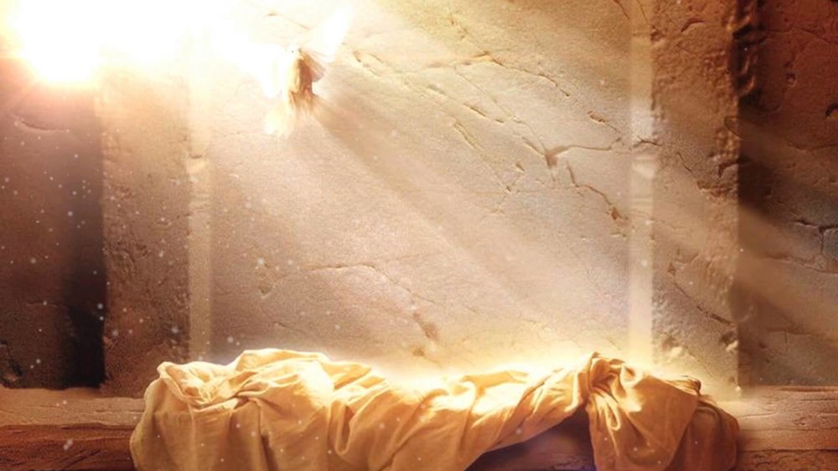
5. Empty Tomb
There is great historical evidence the
tomb was empty

Slide 64
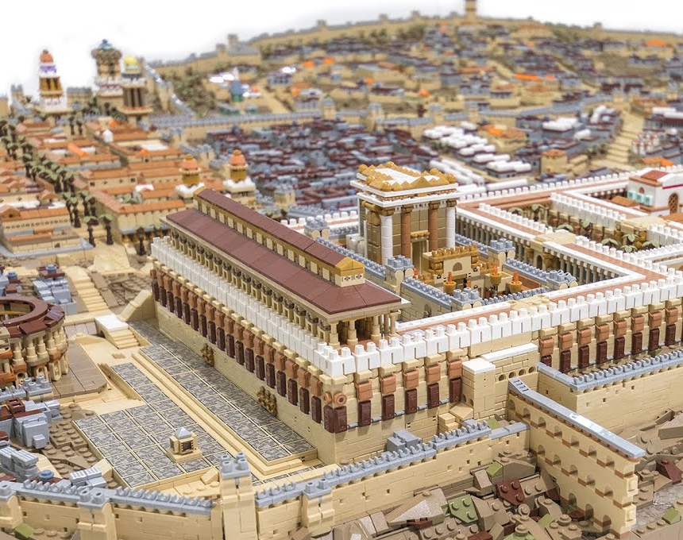
Empty Tomb Evidence A. The Jerusalem Factor
Not hard to show the body unless the tombs empty

Slide 65
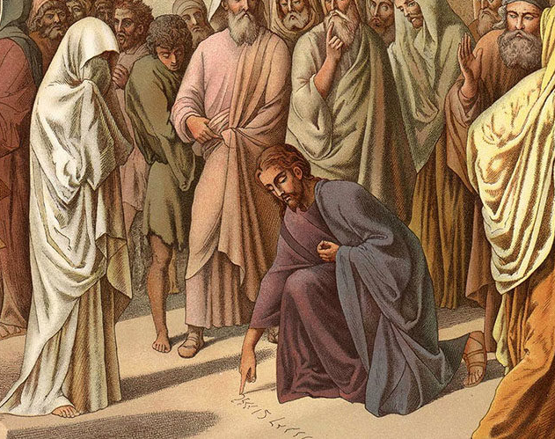
No one bothers writing against the Christians saying “We still have the body”
The body is clearly gone

Slide 66
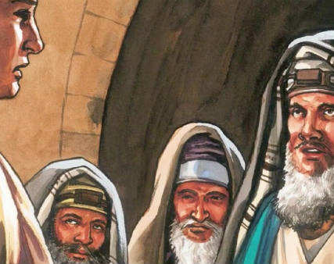
Empty Tomb Evidence B. Enemy Attestation
The Bible records the enemy's theory

Slide 67
Matthew 28:12-13: “When they had assembled with the elders and consulted together, they gave a large sum of money to the soldiers, ¹³ saying, “Tell them, ‘His disciples came at night and stole Him away while we slept.’”

Slide 68
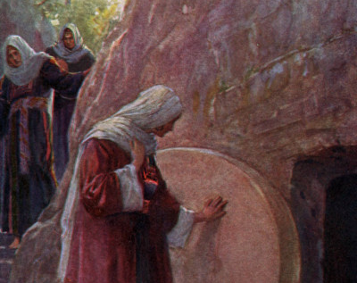
Empty Tomb Evidence C. Testimony of Women
Why is this point a key evidence?

Slide 69
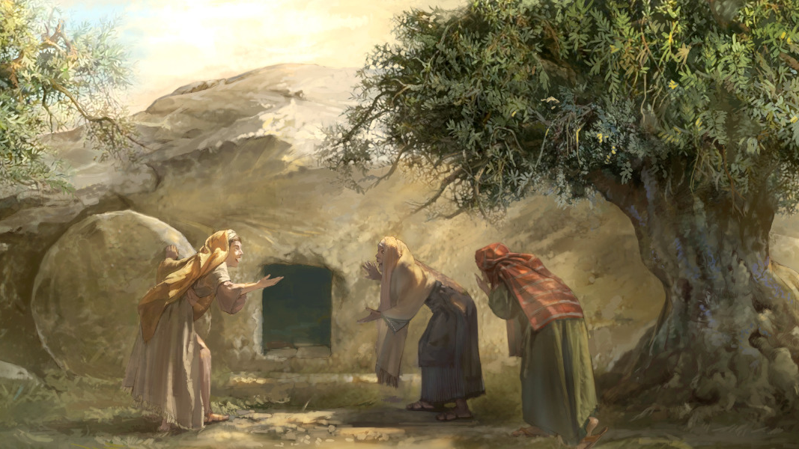
In that culture the testimony of women was seen as a worthless piece of evidence

Slide 70
“Sooner let the words of the Law be burnt than delivered to women.”
(Talmud, Sotah 19a)

Slide 71
“But let not the testimony of women be admitted, on account of the levity and boldness of their sex, nor let servants be admitted to give testimony on account of the ignobility of their souls; since it is probable that they may not speak
truth, either our of hope of gain,
or fear of punishment.”
(Josephus, Antiquities 4.8.15)

Slide 72
“Any evidence which a women gives is not valid (to offer), also they are not valid to offer. This is equivalent to saying that one who is Rabbinically accounted a robber is qualified to give the same evidence as a women.” (Talmud, Rosh Hashannah)

Slide 73
If the disciples were making up the account, they would not use women as their witnesses to convince the culture they lived in.

Slide 74
They simply told the truth about what happened. The tomb was empty and found by women on the third day to be empty.

Slide 75
The resurrection of Jesus Christ is either one of the most wicked, vicious, heartless hoaxes ever foisted on the minds of human beings--or it is the most remarkable fact of history.

Slide 76
6. Jesus Burial Story is Trustworthy
The inclusion of the famous Joseph of Arimathea shows they are not inventing the story

Slide 77
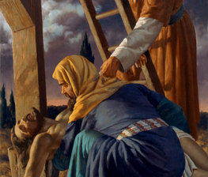
Joseph was a Sanhedrein (Jewish Court) making him a popular Jew
Making stories up about them is very difficult

Slide 78
People could investigate easily
Joseph was far too popular and would be far too known and accessible

Slide 79
*Broken Roman Seal*
The tomb of Jesus had the Roman seal over it, which stood for the power and authority of the Roman Empire
Matthew 27:66: “So they went and made the tomb secure, sealing the stone and setting the guard.”
It was unusual though for someone crucified to be buried like Jesus

Slide 80
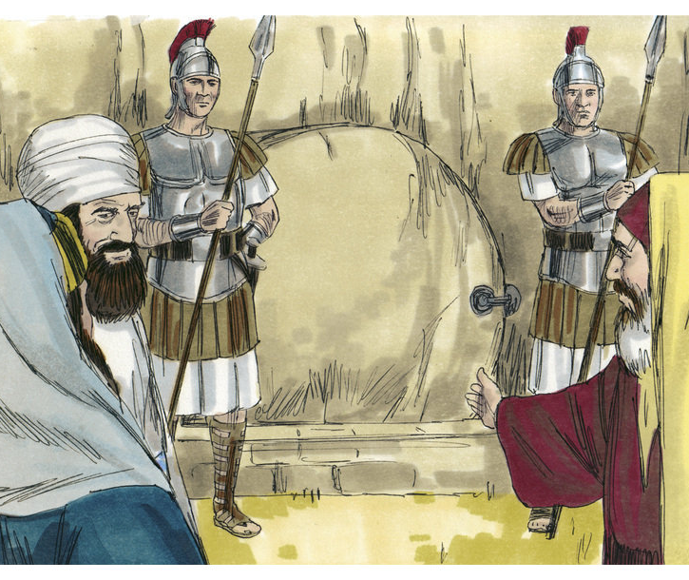
7. Broken Roman Seal
The Romans put the seal on the tomb, which is Roman “police tape”

Slide 81
People feared the breaking of the seal
The Roman Empire would hunt you down, and kill you if you broke the seal

Slide 82
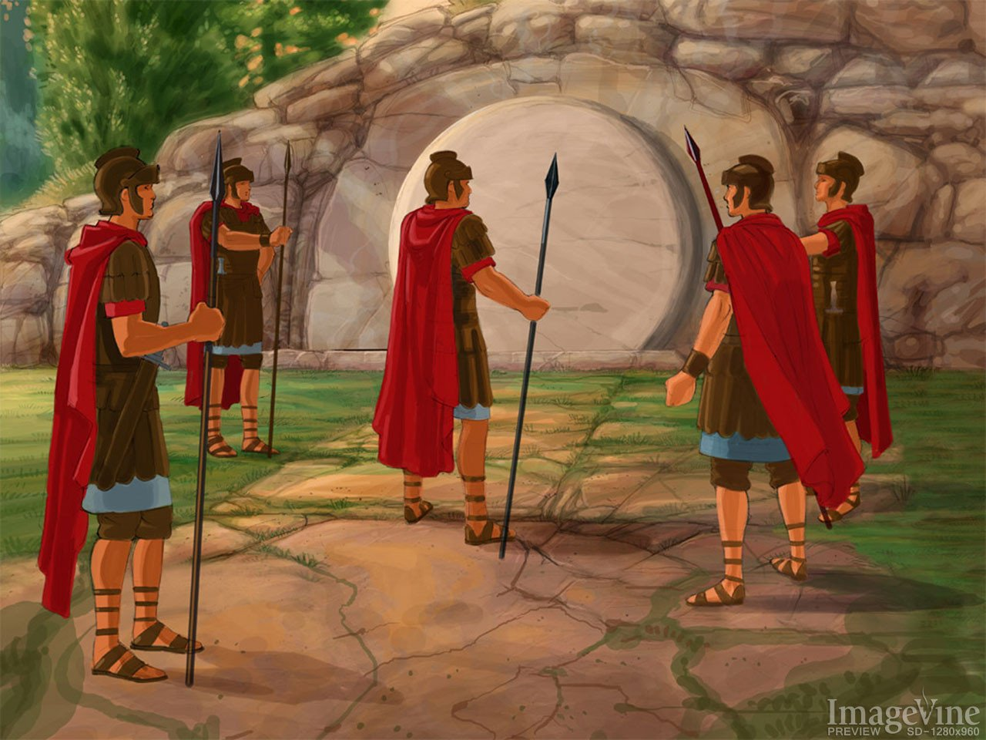
8. The Roman Guards at the Tomb go Awol and Abandon Their Post
Roman Soldiers Were Fierce

Slide 83
Matthew 27:62-66: “On the next day, which followed the Day of Preparation, the chief priests and Pharisees gathered together to Pilate, saying, “Sir, we remember, while He was still alive, how that deceiver said, ‘After three days I will rise…

Slide 84
Therefore command that the tomb be made secure until the third day, lest His disciples come by night and steal Him away, and say to the people, ‘He has risen from the dead.’ So the last deception will be worse than the first…

Slide 85
Pilate said to them, “You have a guard; go your way, make it as secure as you know how.” So they went and made the tomb secure, sealing the stone and setting the guard.”

Slide 86
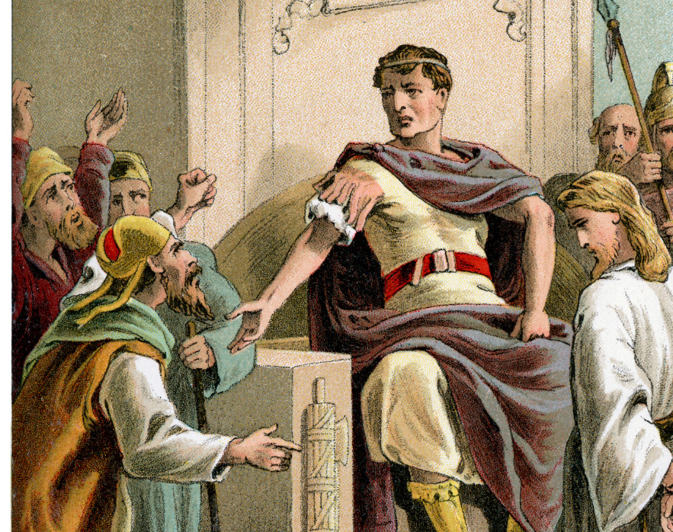
They knew Jesus had a large following
They would put enough soldiers to make sure the disciples couldn’t take the body

Slide 87
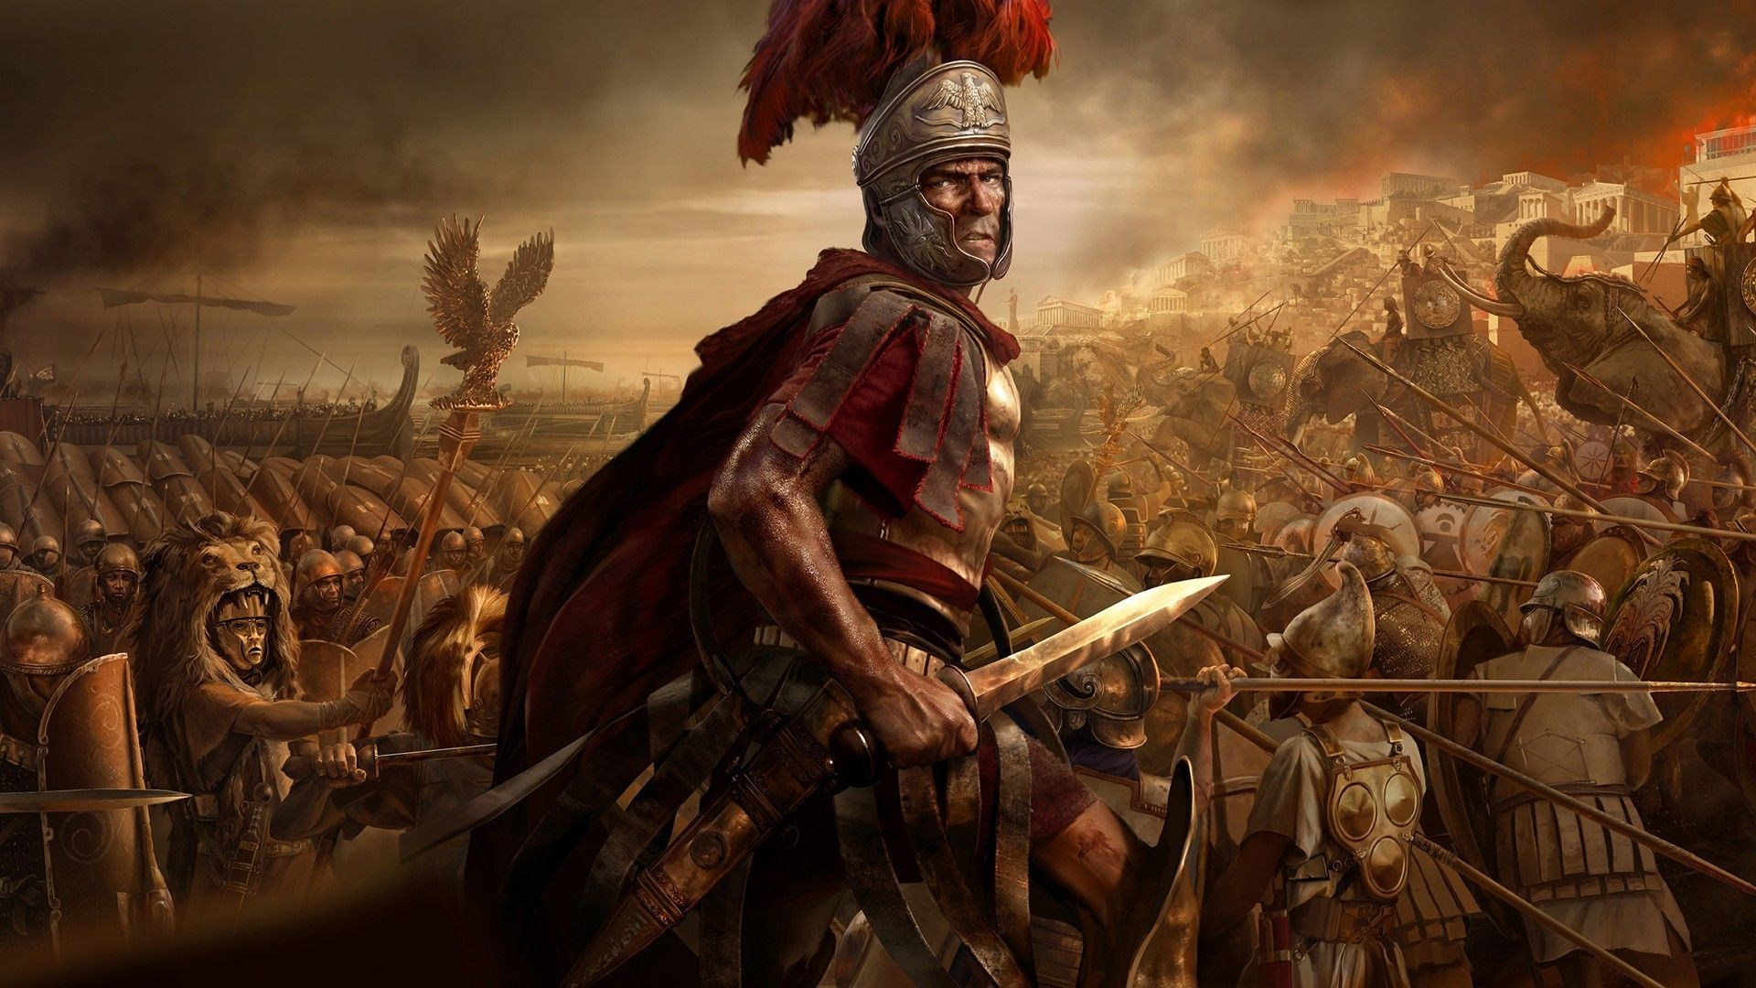
Roman Soldiers Were Flawless in Their Task
If they fell asleep on duty, they could be lit on fire in their sleep and executed

Slide 88
They ran away, under penalty of death
Why would they risk death if disciples or other people attack them?

Slide 89
9. The Large Stone was Removed
These stones weighed an average of 3-4k pounds

Slide 90
Matthew 27:60: “And laid it in his new tomb which he had hewn out of the rock; and he rolled a large stone against the door of the tomb, and departed.”

Slide 91
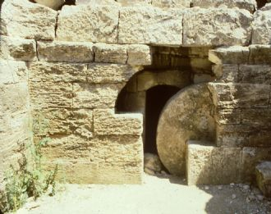
A Wall Held the Stone Up Generally and was rolled down an incline
Would take a lever system to move the stone

Slide 92
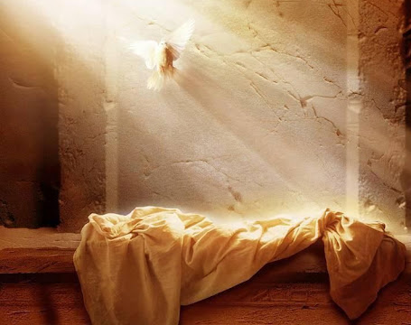
10. The Grave clothes are left behind at the tomb of Jesus
The Shroud of Turin might be it

Slide 93
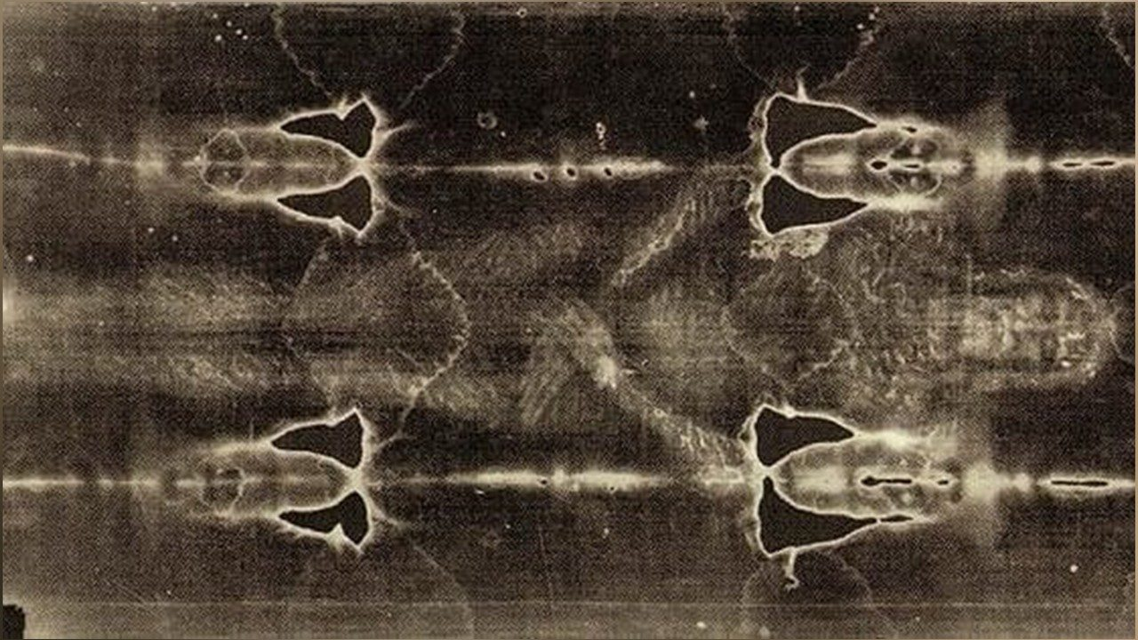
The Tomb Wasn’t Entirely Empty

Slide 94
John 20:7: “And the handkerchief that had been around His head, not lying with the linen cloths, but folded together in a place by itself.”

Slide 95
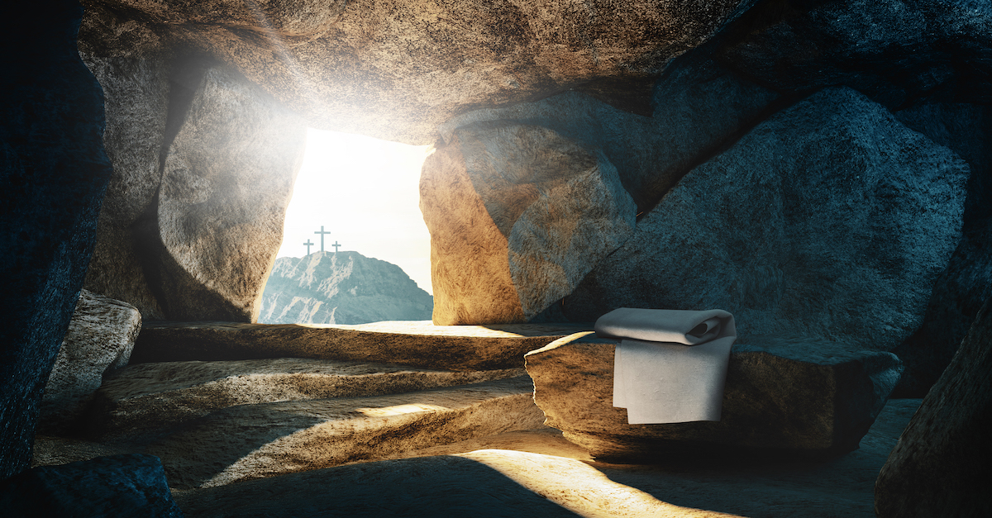

Slide 96
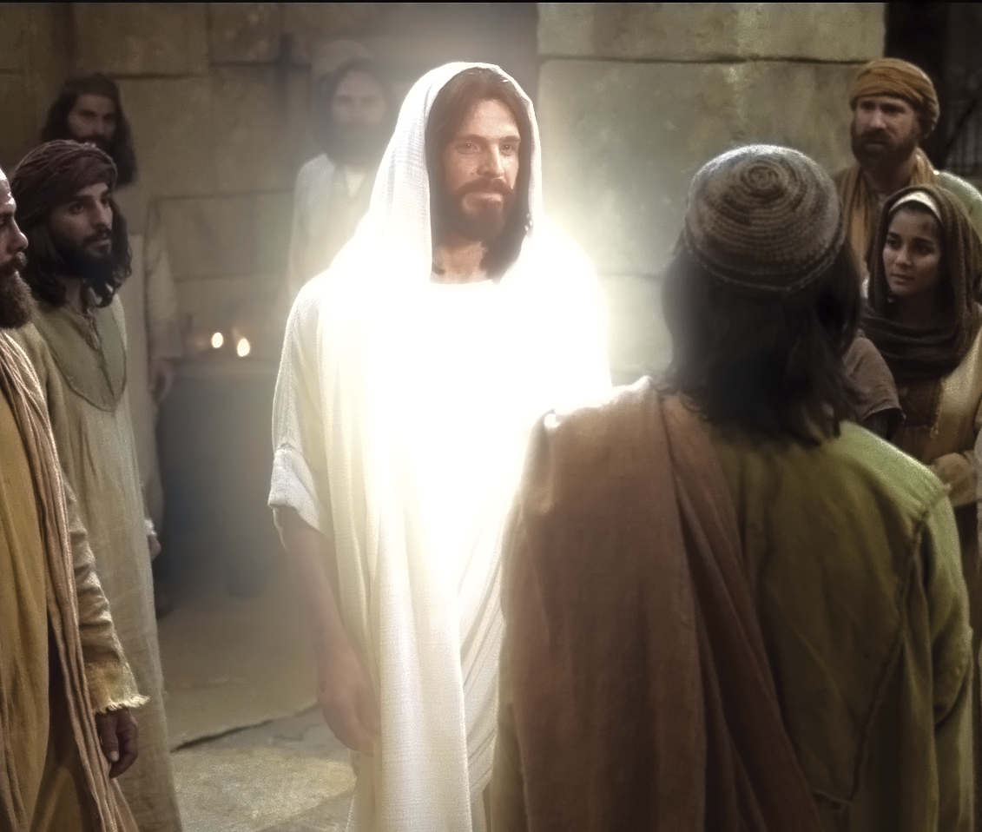
11. Jesus appears to over 500 witnesses at one time
How does that make sense?

Slide 97
1 Corinthians 15:3-8: “For I delivered to you first of all that which I also received: that Christ died for our sins according to the Scriptures…

Slide 98
and that He was buried, and that He rose again the third day according to the Scriptures, and that He was seen by Cephas, then by the twelve. After that He was seen by over five hundred brethren at once, of whom…

Slide 99
the greater part remain to the present, but some have fallen asleep. After that He was seen by James, then by all the apostles. Then last of all He was seen by me also, as by one born out of due time.”

Slide 101
“Conspiracy Theories” to Explain the Resurrection

Slide 102
Sadly, the Internet has Made People Believe These Bad “Theories” are True

Slide 103
Conspiracy 1: The Disciples Stole the Body of Jesus
Hence the Empty Tomb

Slide 104
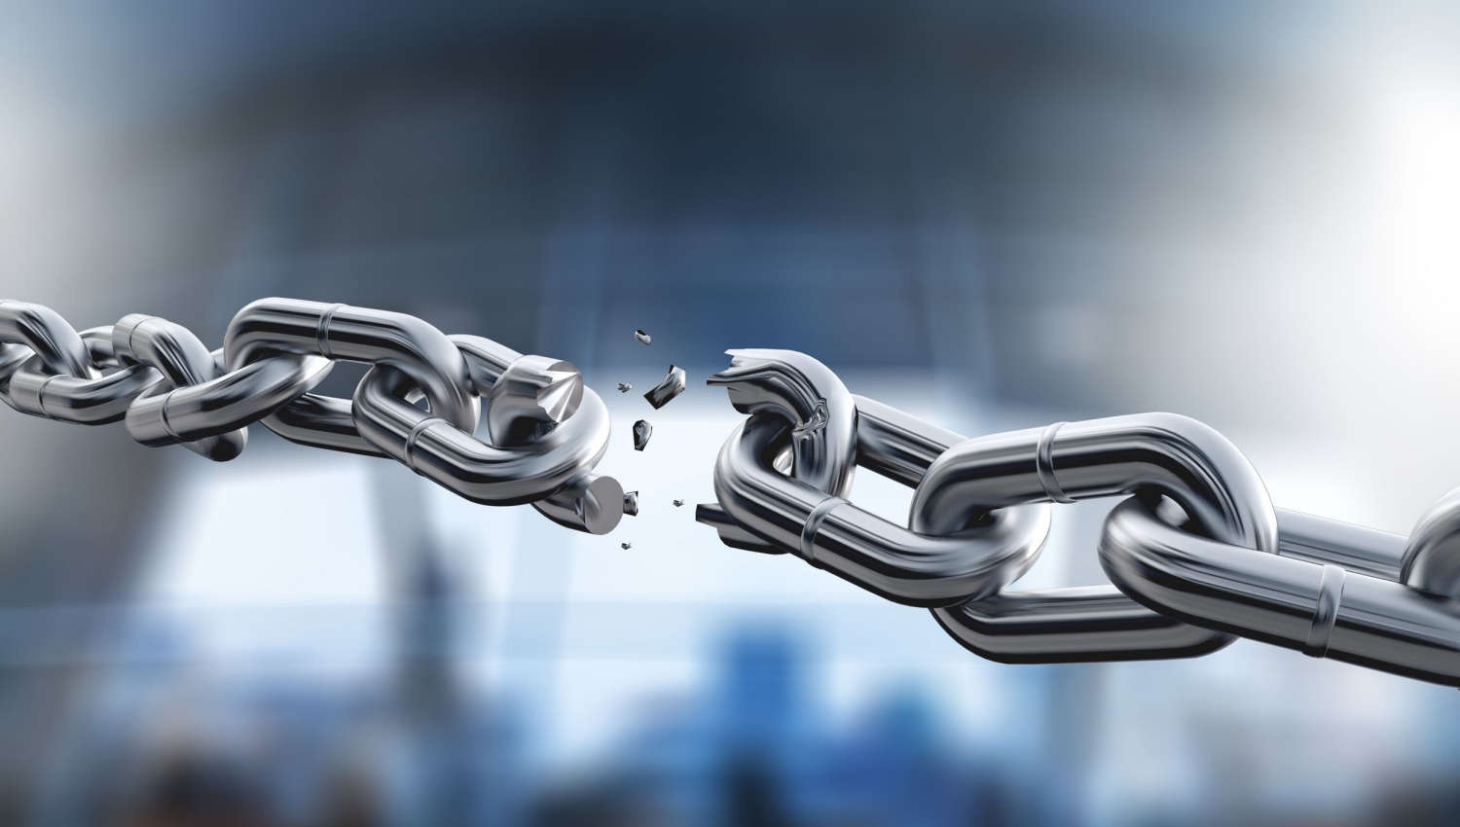
One of the Weakest Positions on the Topic

Slide 105
History can shed some critical light on the theory
Historical facts show the theory is false

Slide 106
Problems with the Theory?

Slide 107
1. The disciples would need to concoct an elaborate plan.
The guards are Roman Afterall

Slide 108
After all, we don’t have couple off duty security guards hired to protect the tomb of Jesus, we have the Roman military

Slide 109
The disciples would need to concoct an elaborate plan.
The Romans were prepared for the disciples to try and steal the body. There’s no way they could do it.

Slide 110
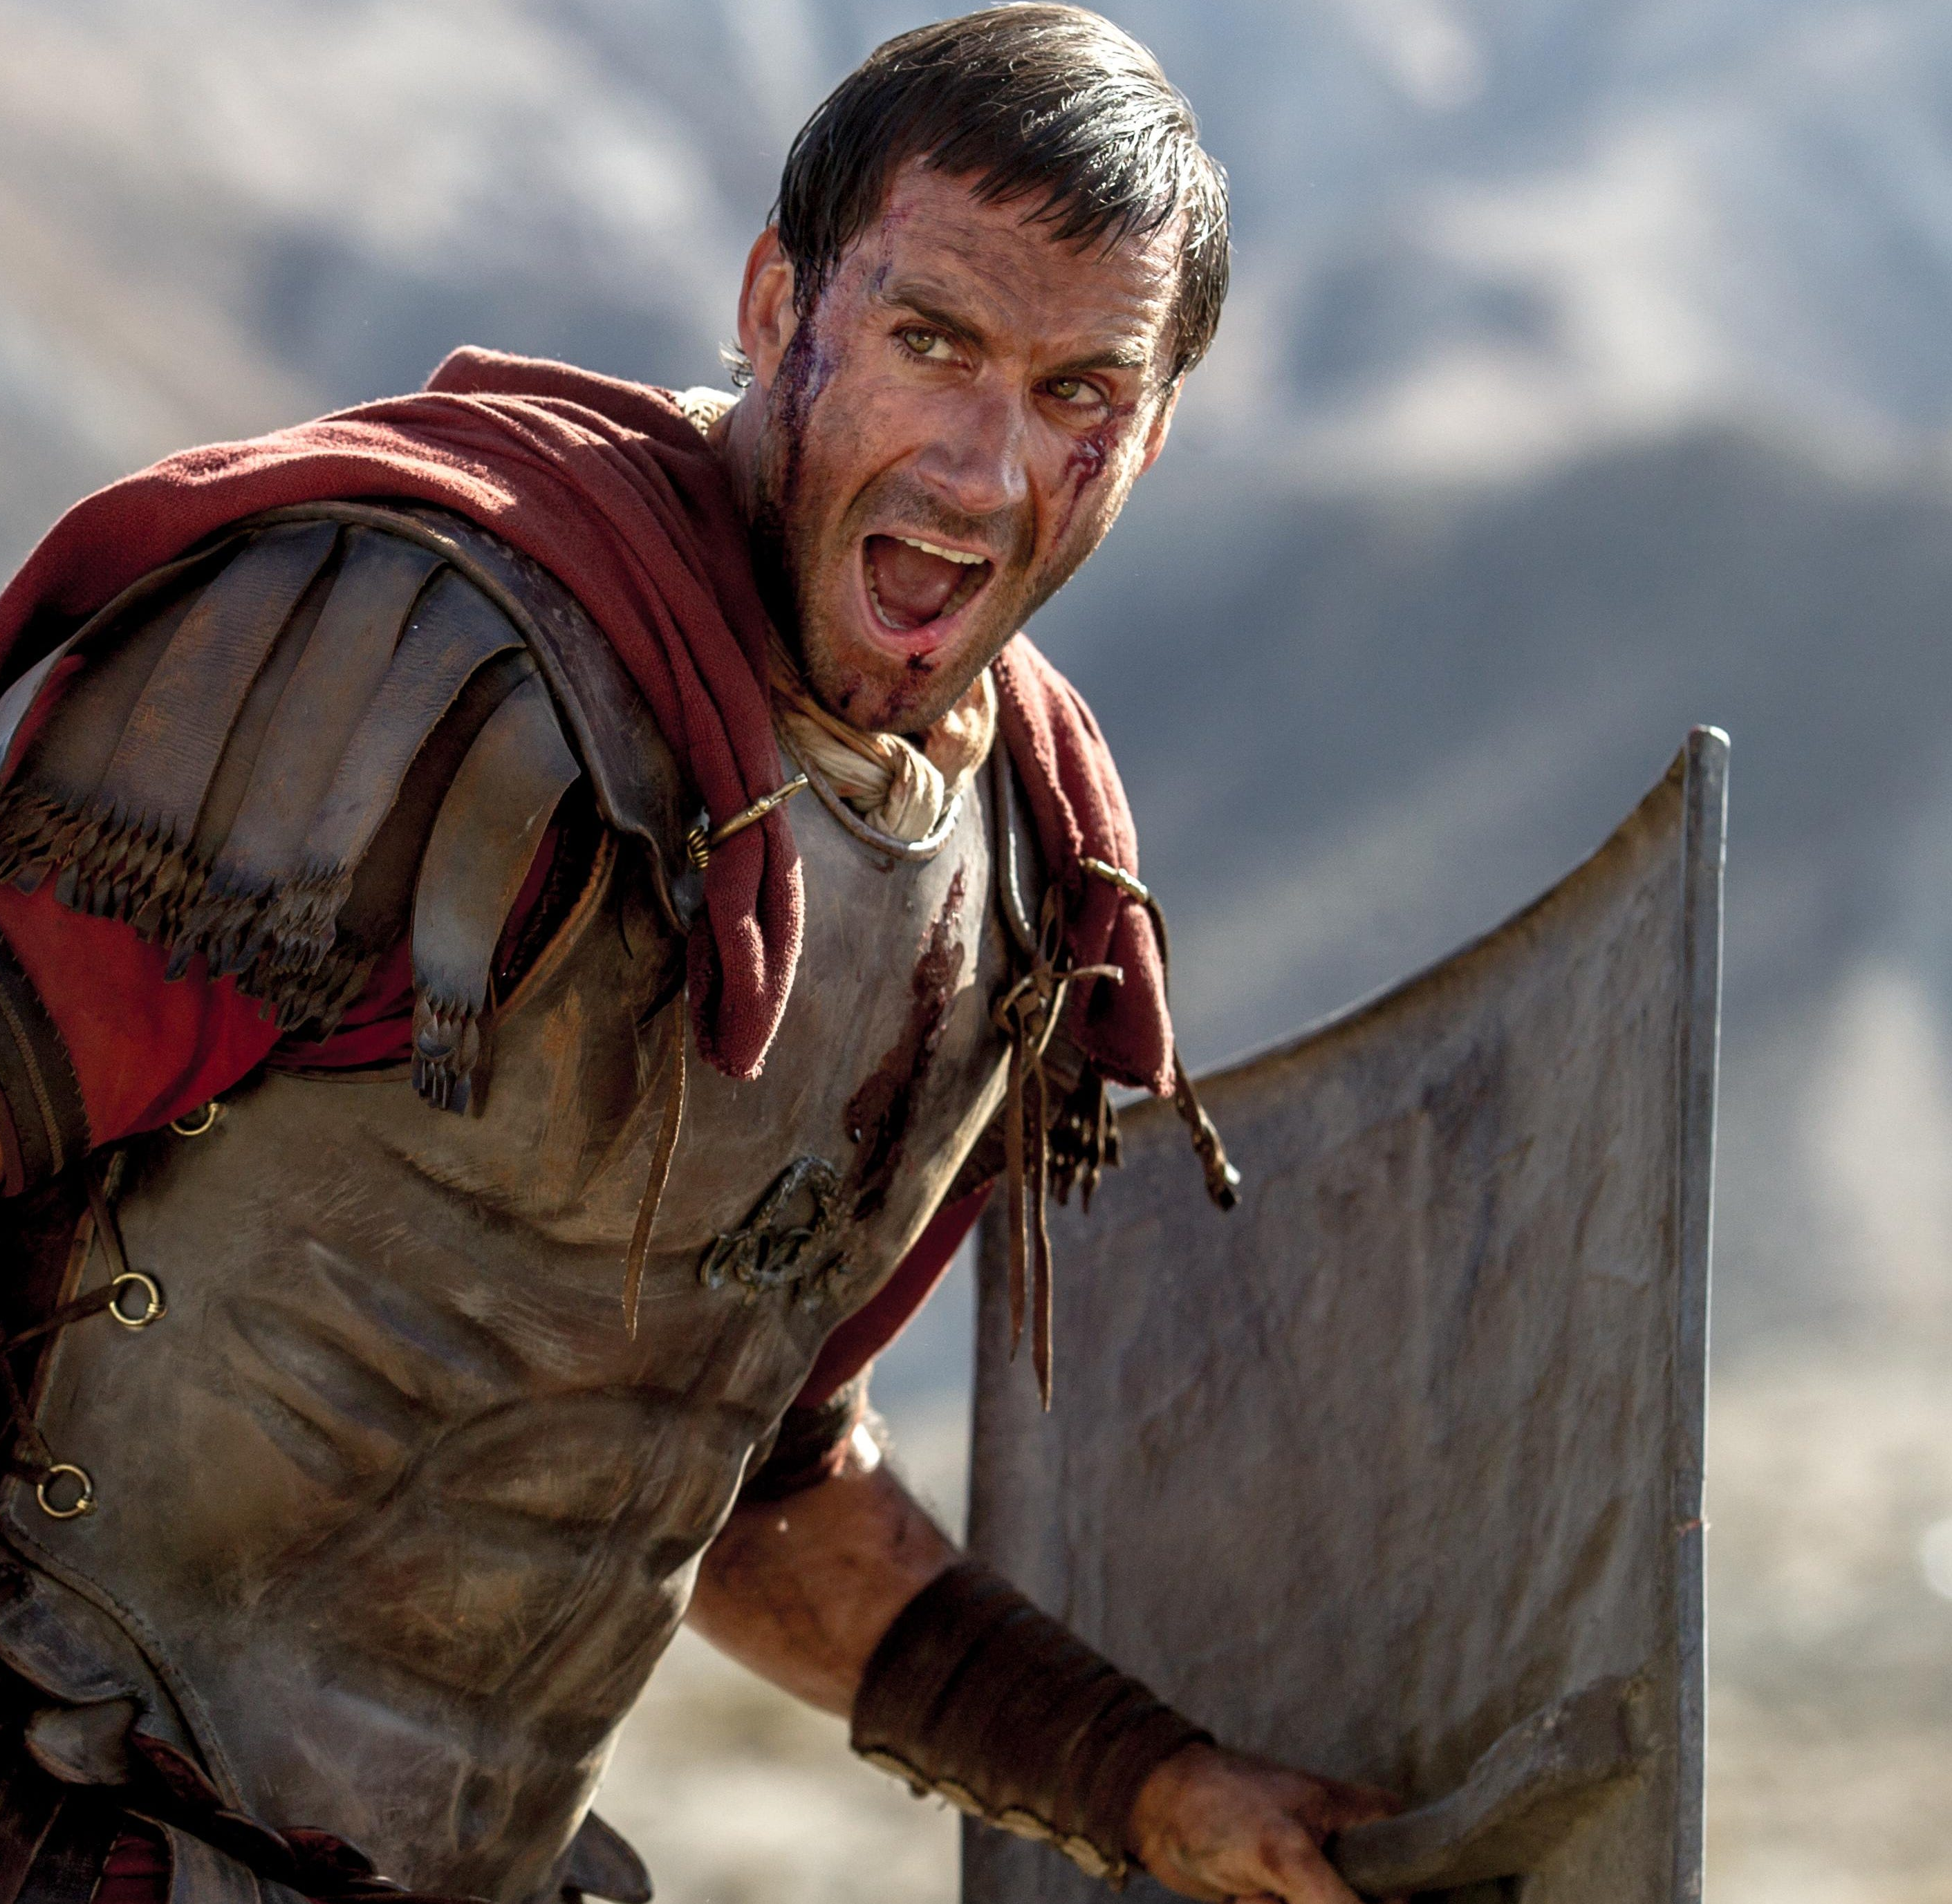
Soldiers are under penalty of death of running
The Roman seal was broken, why weren’t the disciples hunted?
Why are the cloths left?

Slide 111
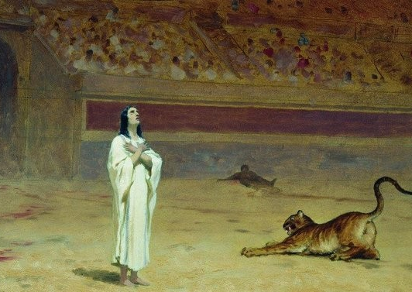
Why do they all die for their faith if they make it up?
They didn’t die for the empty tomb

Slide 112
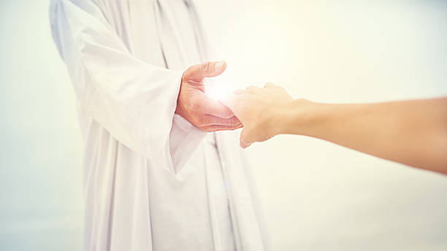
Remember: They die for the belief
that Jesus appeared to them after they found the tomb empty

Slide 113
Why do James and Paul both convert?
They claim seeing Christ

Slide 114
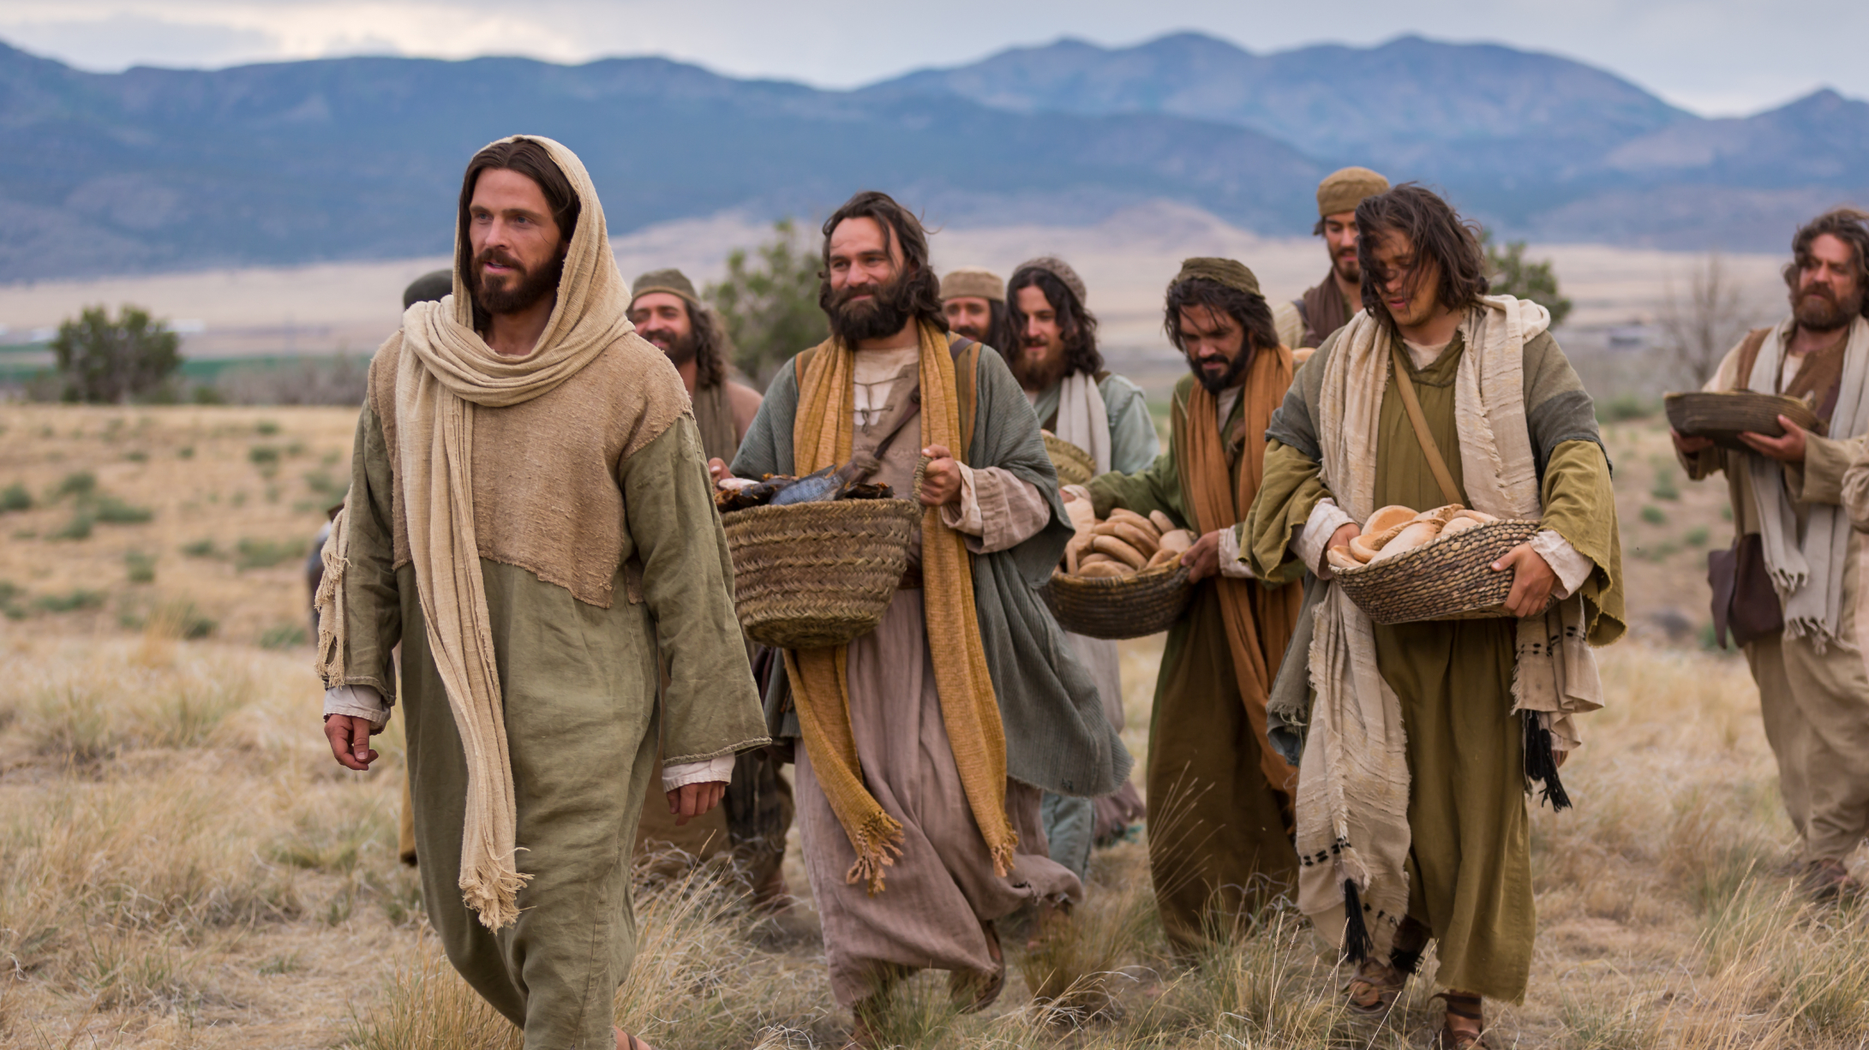
What if another group of people stole the body?
Who's going to risk their lives?
Pranks aren’t worth dying for

Slide 115
The evidence of history says the disciples did not steal the body of Jesus
They have other theories

Slide 116
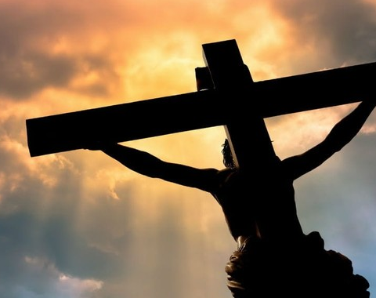
2. The Swoon or Fake Death Conspiracy Theory
Did Jesus Actually Die?

Slide 117
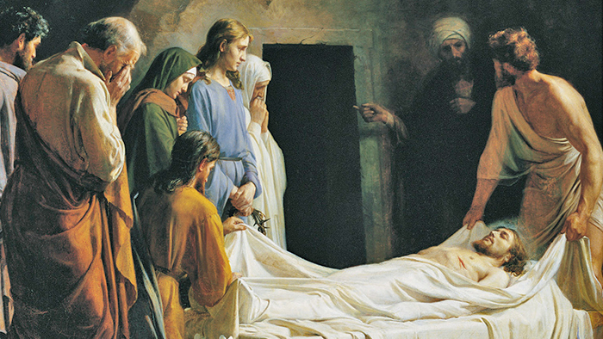
Did Jesus just pass out on the cross?

Slide 118
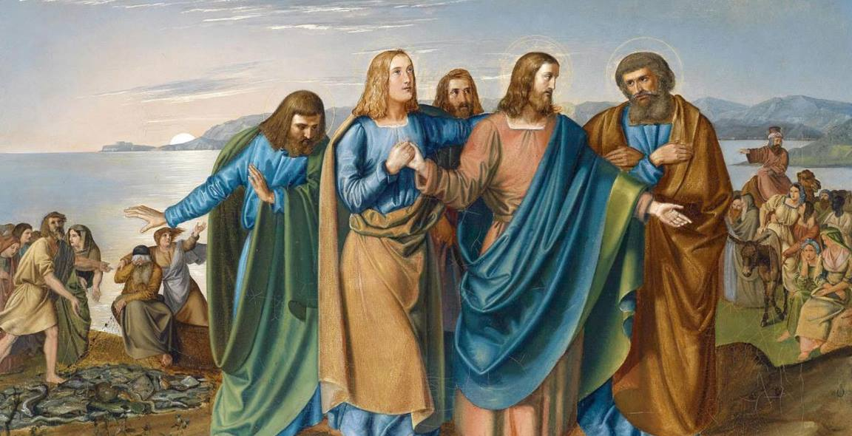
Jesus then Appears to the Disciples and Deceives Them

Slide 119
Problems with the Theory?

Slide 120
Problems:
When Jesus was stabbed in the side, blood and water came out, showing He was dead

Slide 121
John 19:34: “But one of the soldiers pierced His side with a spear, and immediately blood and water came out.”

Slide 122
Even Modern Medical Science Agrees Blood and Water Means Dead

Slide 123
Jesus was also beaten, crucified, had severe blood loss, flogged, and a crown of thorns
How on earth would he recover so quickly?

Slide 124
How would Jesus wake up and move a 4k pound stone and leave?
He beats off the Roman Guards too?

Slide 125
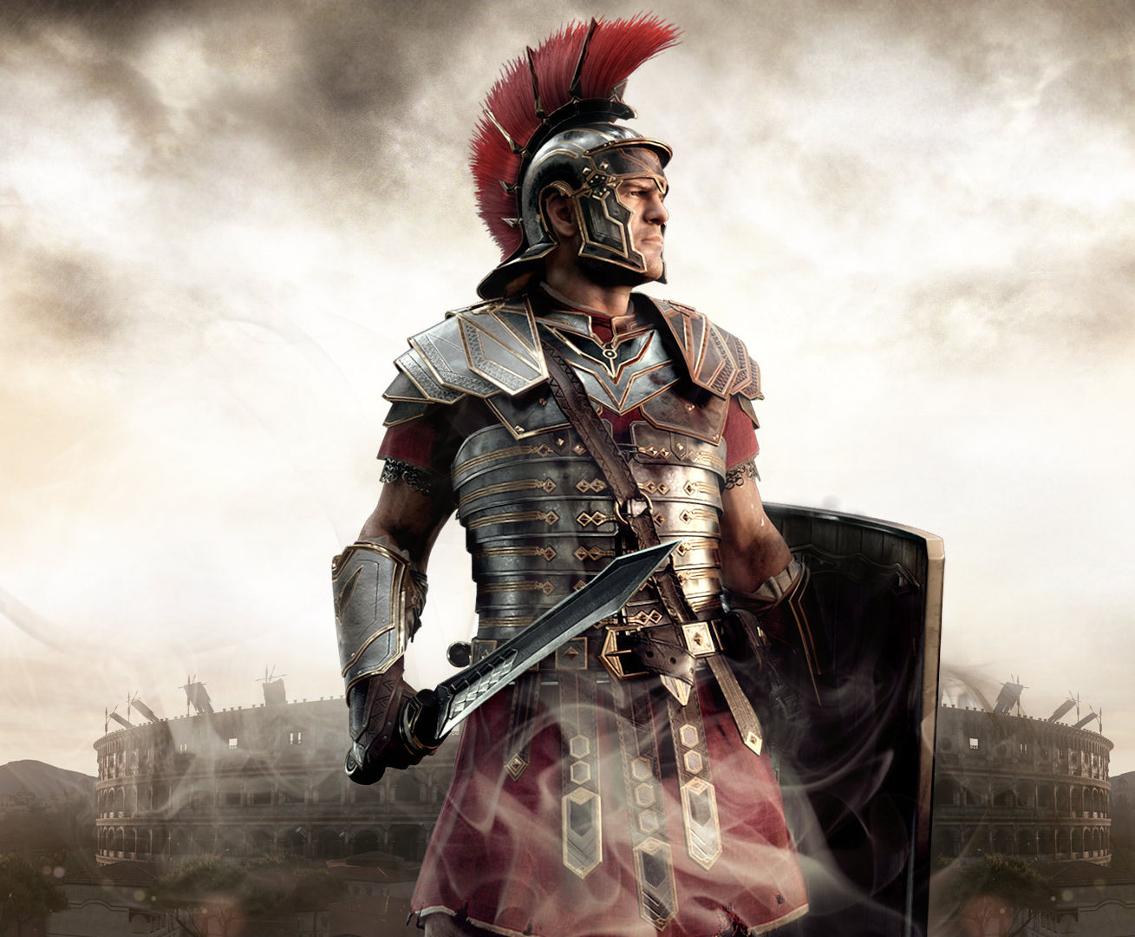
Multiple Guards Have to Sign Off on the Body Confirming the Victim is Dead

Slide 126
How likely is the theory?
Identifying a dead body is not difficult, changes happen

Slide 127
Why Would Jesus Fold and Leave His Clothes?

Slide 128
How did the body of Jesus remain completely still for hours before burial?
They wouldn’t notice a breath?

Slide 130
3. Displaced body of Jesus Conspiracy Theory
Maybe the body of Jesus was moved…

Slide 131
Was the body only temporarily in the first tomb?

Slide 132
Did they move the body to a new tomb?

Slide 133
The Roman Guards were at the tomb to prevent this from happening

Slide 134
The Roman Seal was placed on the tomb for three days, no one could open it
Why didn’t they find the new tomb?

Slide 135
Joseph of Arimathea knew the disciples
Why didn’t he tell them the body was moved to a new tomb?

Slide 136
History is Silent
No one though this was the case in history.
No evidence in history exists for this theory or conspiracy.

Slide 137
Why do James and Paul both convert?
They claim seeing Christ

Slide 138
Remember, the disciples don’t believe because of the empty tomb
They believe because Jesus appeared after

Slide 139
4. Maybe the Dog-Ate-It conspiracy theory
Maybe they never buried Him

Slide 140
They threw the body in the common-graveyard

Slide 141
Problems with the Theory?

Slide 142
Trustworthy burial story with Joseph.
They claim to see Him after.
Roman Seal on an Empty Tomb?
Doesn’t make sense of history

Slide 143
Why did the Pharisees make up the story the disciples stole the body if there wasn’t one?
Why are his clothes in the tomb!

Slide 144
6. They went to the wrong tomb on Easter morning, and it was empty
An honest mistake, they got lost

Slide 145
The women went to the wrong tomb? Then the men did the same thing by accident?
Two identical, independent mistakes?

Slide 146
Why were His clothes in the wrong tomb!?

Slide 147
Why did the Pharisees say the body was gone?
Why do they claim they saw Him alive?
Yet another theory that doesn’t make sense

Slide 148
7. The Identical Twin Conspiracy Theory of the Resurrection
Did Jesus have an identical twin?

Slide 149
The Twin Brother Tricks Everyone into Believing

Slide 150
WHY IS THE TOMB EMPTY STILL?!?

Slide 151
Now you need an elaborate theory on how to steal the body like discussed earlier
All for a prank being pulled off?

Slide 152
The twin would need to crucify himself too for the prank.
Stabbed by spear.
Trick his other brother James.
Fake the ascension.
Walk through walls/teleport.

Slide 153
No Jesus Didn’t Have a Twin Brother, this may be the worst theory
One last issue to quickly address

Slide 154
Could all the sighting of Jesus after be hallucinations?

Slide 155
Maybe if it was just one person it would work, but all of them? No.
A dozen people at the same time?

Slide 156
Many people, same hallucination, same time? It would literally take a miracle
500 people at one time seeing Him?

Slide 157
Face the Historical Fact: Jesus Rose from the Dead

