Slide 1
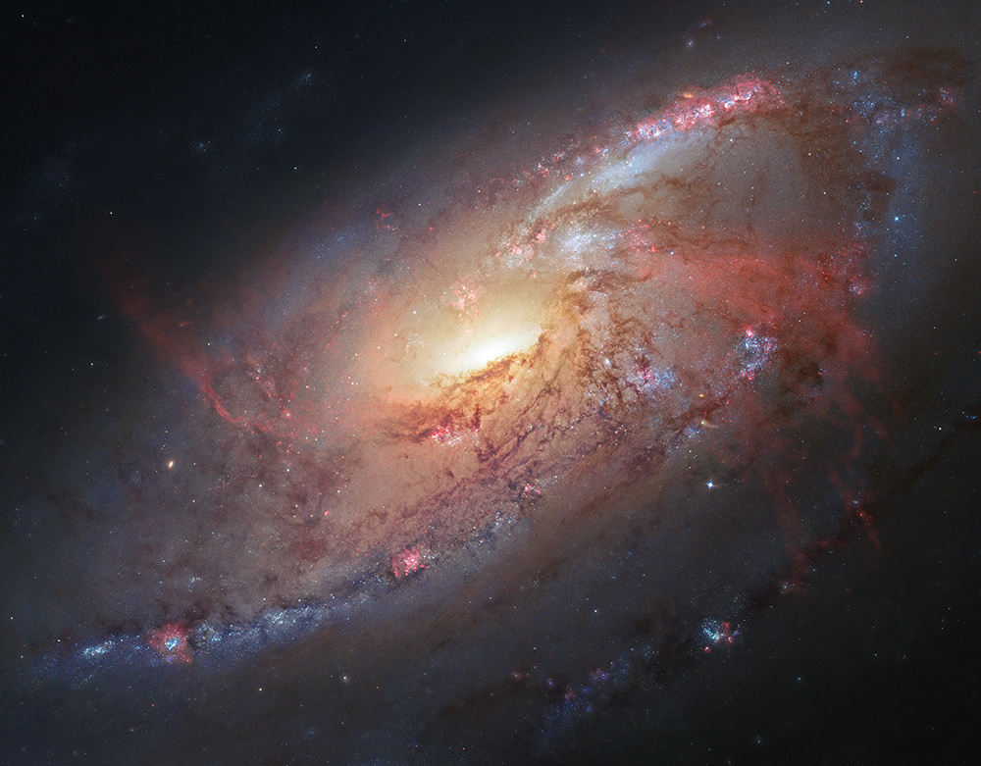
Evidence for the Existence of God
The God of The Bible

Slide 2
The Evidence Will Support God Broadly, and the Biblical God Specifically
Who is the Biblical God?

Slide 3
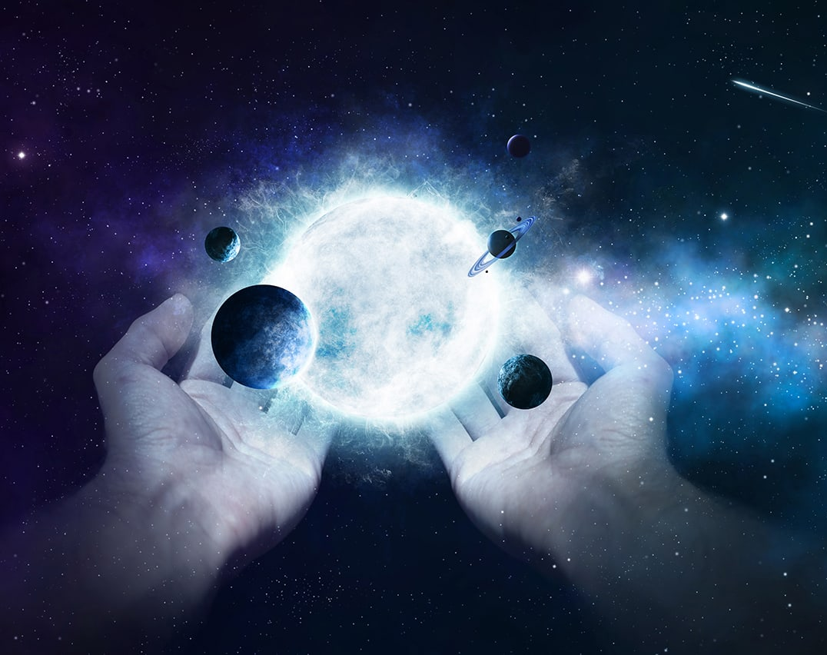
1. God is the Creator of Everything
Everything in heaven & earth

Slide 4
Genesis 1:1:
“In the Beginning God Created the Heaven and the Earth.”

Slide 5
God is Separate from the Universe
God is not the universe

Slide 6
Pantheism is Rejected by the Bible
Buddhism is Rejected

Slide 7
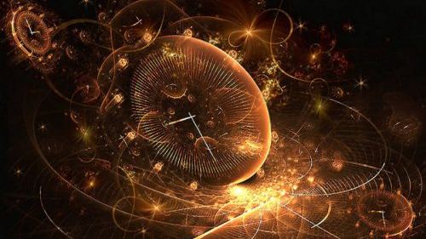
2. God is Eternal in Nature

Slide 8
God Didn’t Have a Beginning or an End
Is that even Possible?

Slide 9
Psalm 90:2
“Before the mountains were brought forth, or ever you had formed the earth and the world, from everlasting to everlasting you are God.

Slide 10
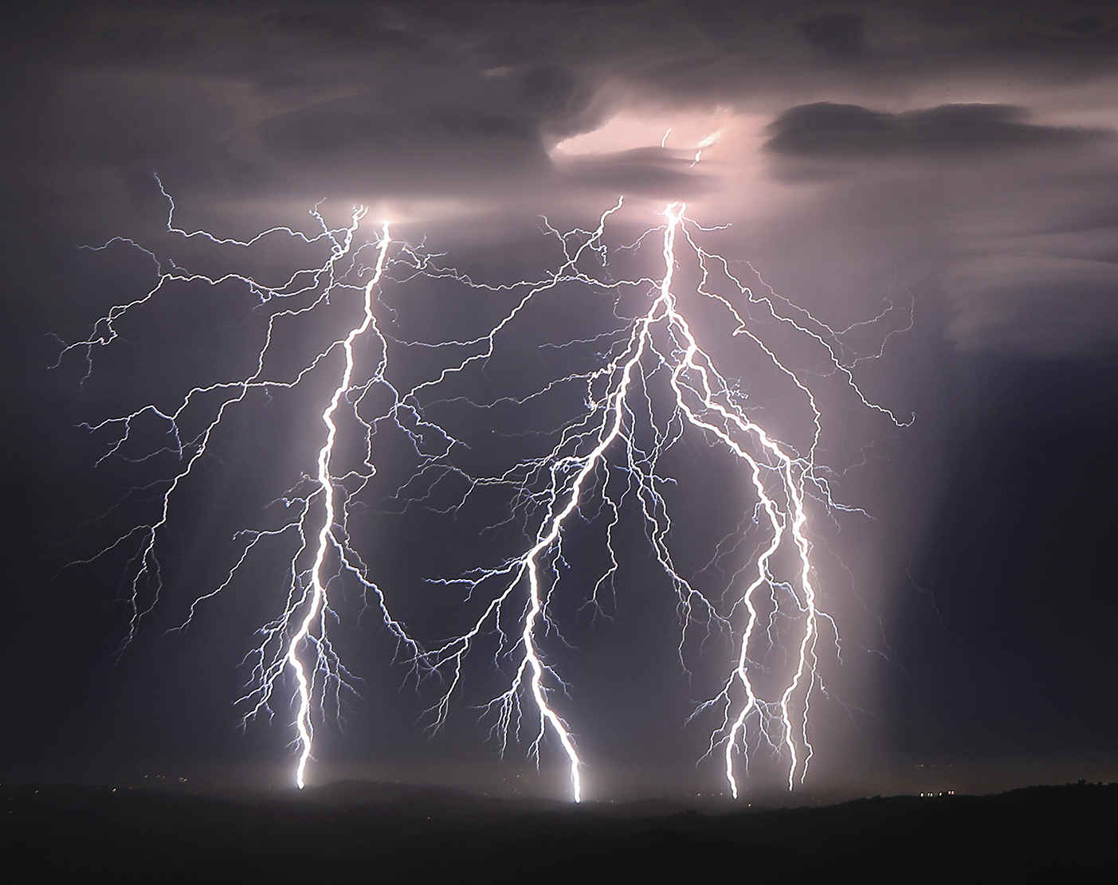
3. God is Infinite in Power
There Can Only Be One God

Slide 11
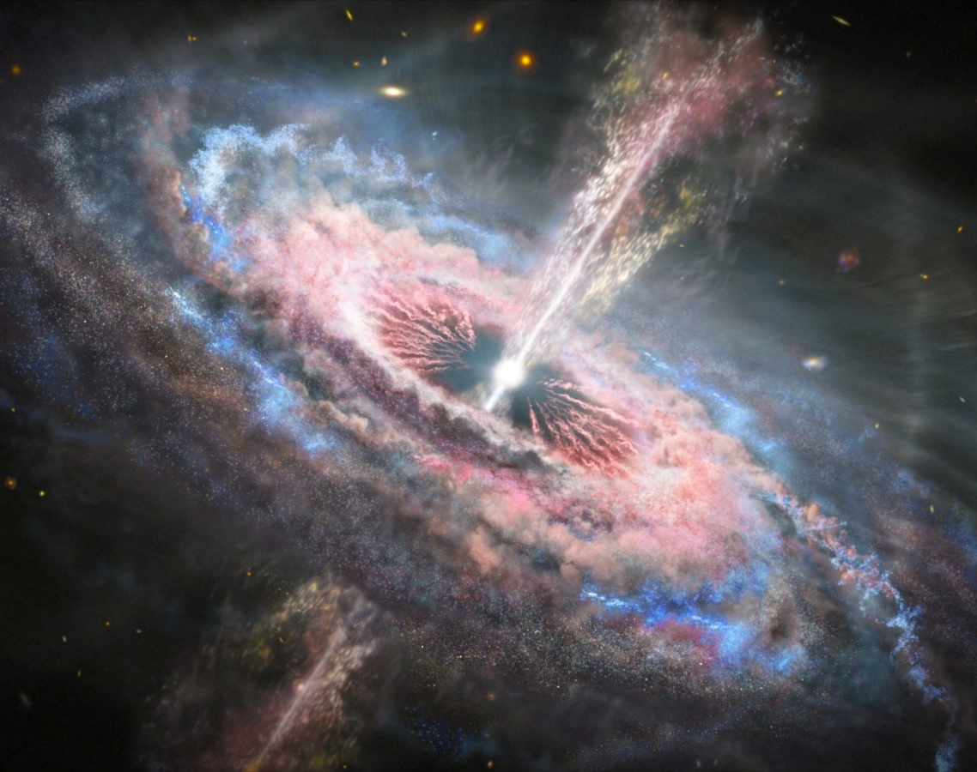
God has the power to do anything He chooses
His power follows His Will

Slide 12
Psalm 147:5
“Great is our Lord, and abundant in power; his understanding is beyond measure.

Slide 13
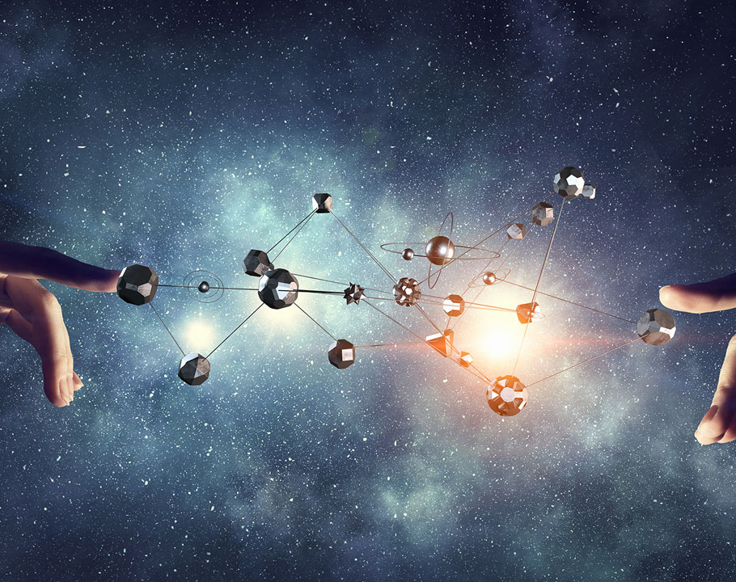
4. God has a Mind and Will
Scripture Makes it Clear

Slide 14
God is not a deist God who stands back just to observe
God has a will in creation

Slide 15
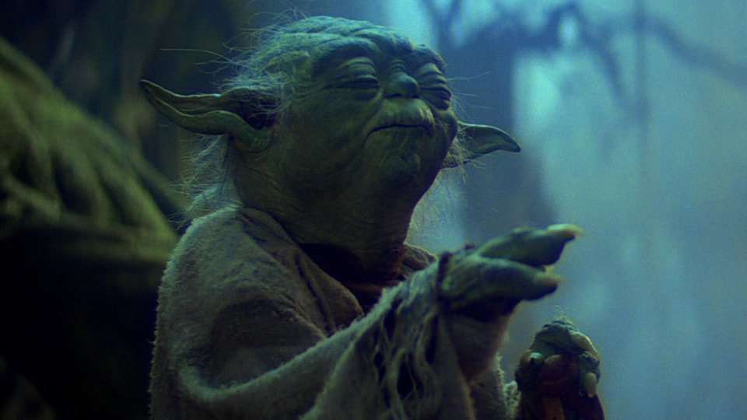
God is Not Like the Force

Slide 16
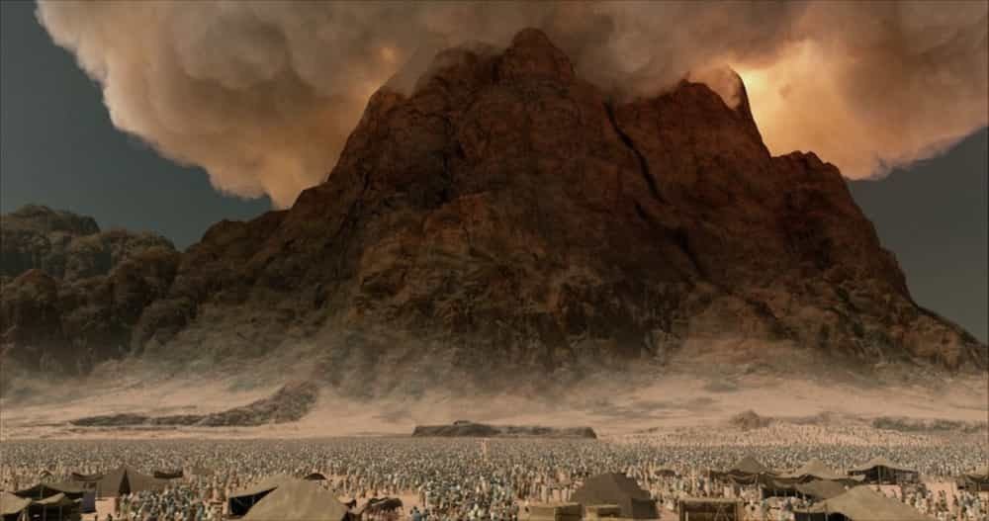
God is a God who Speaks and Communicates to Mankind

Slide 17
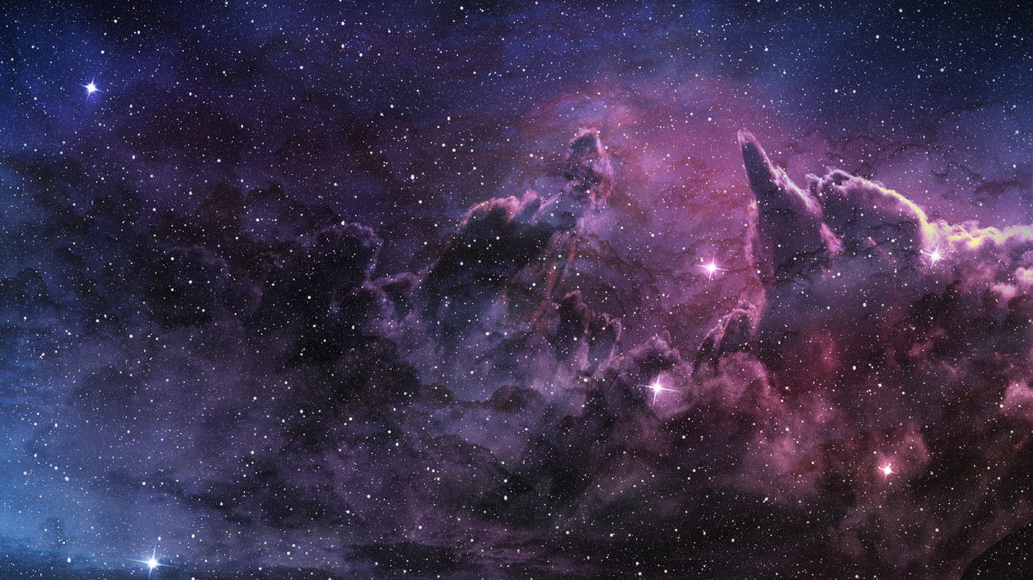
Now the Evidence for God

Slide 19
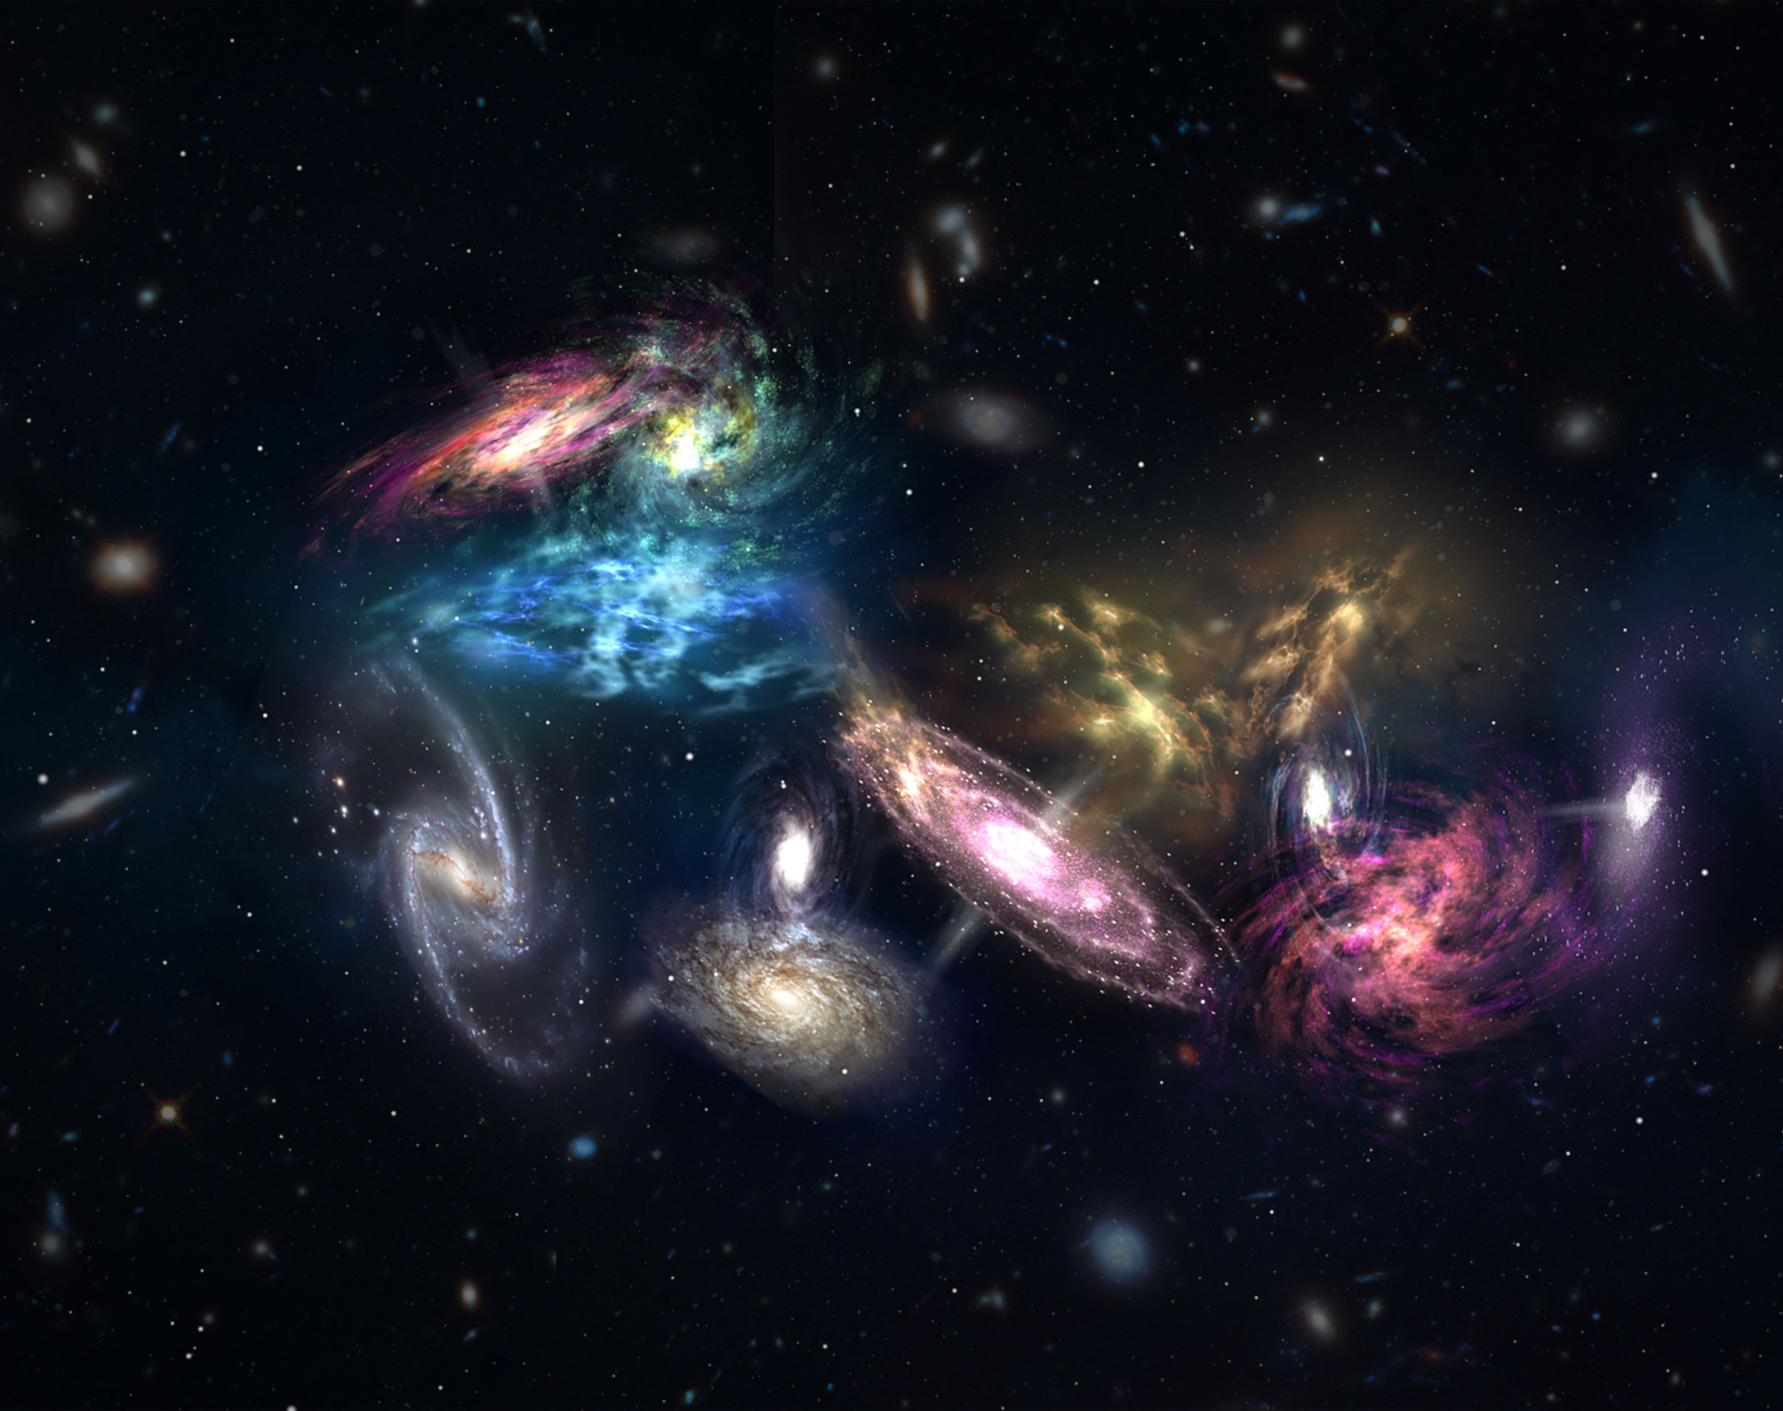
Cosmological Argument
for God’s Existence

Slide 20
Premise 1: Everything that begins to exist has a cause.

Slide 21
Premise 2: The Universe Began to Exist in the Past.

Slide 22
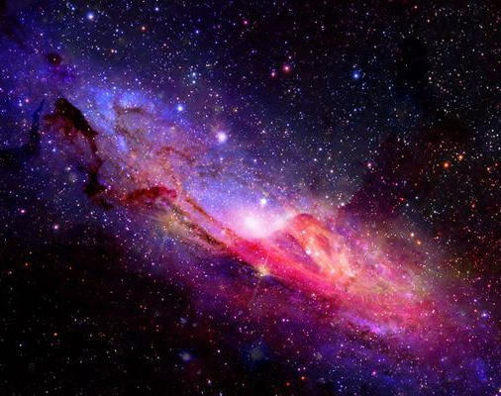
The Logical Conclusion: The Universe has a Cause
Only Possible Conclusion

Slide 23
P1: Anything that begins to exist has a cause.
P2: The Universe Began to Exist.
Therefore: The Universe has a Cause

Slide 24
The Logical Law of Causality confirms Premise 1
Any Change Requires Cause

Slide 25
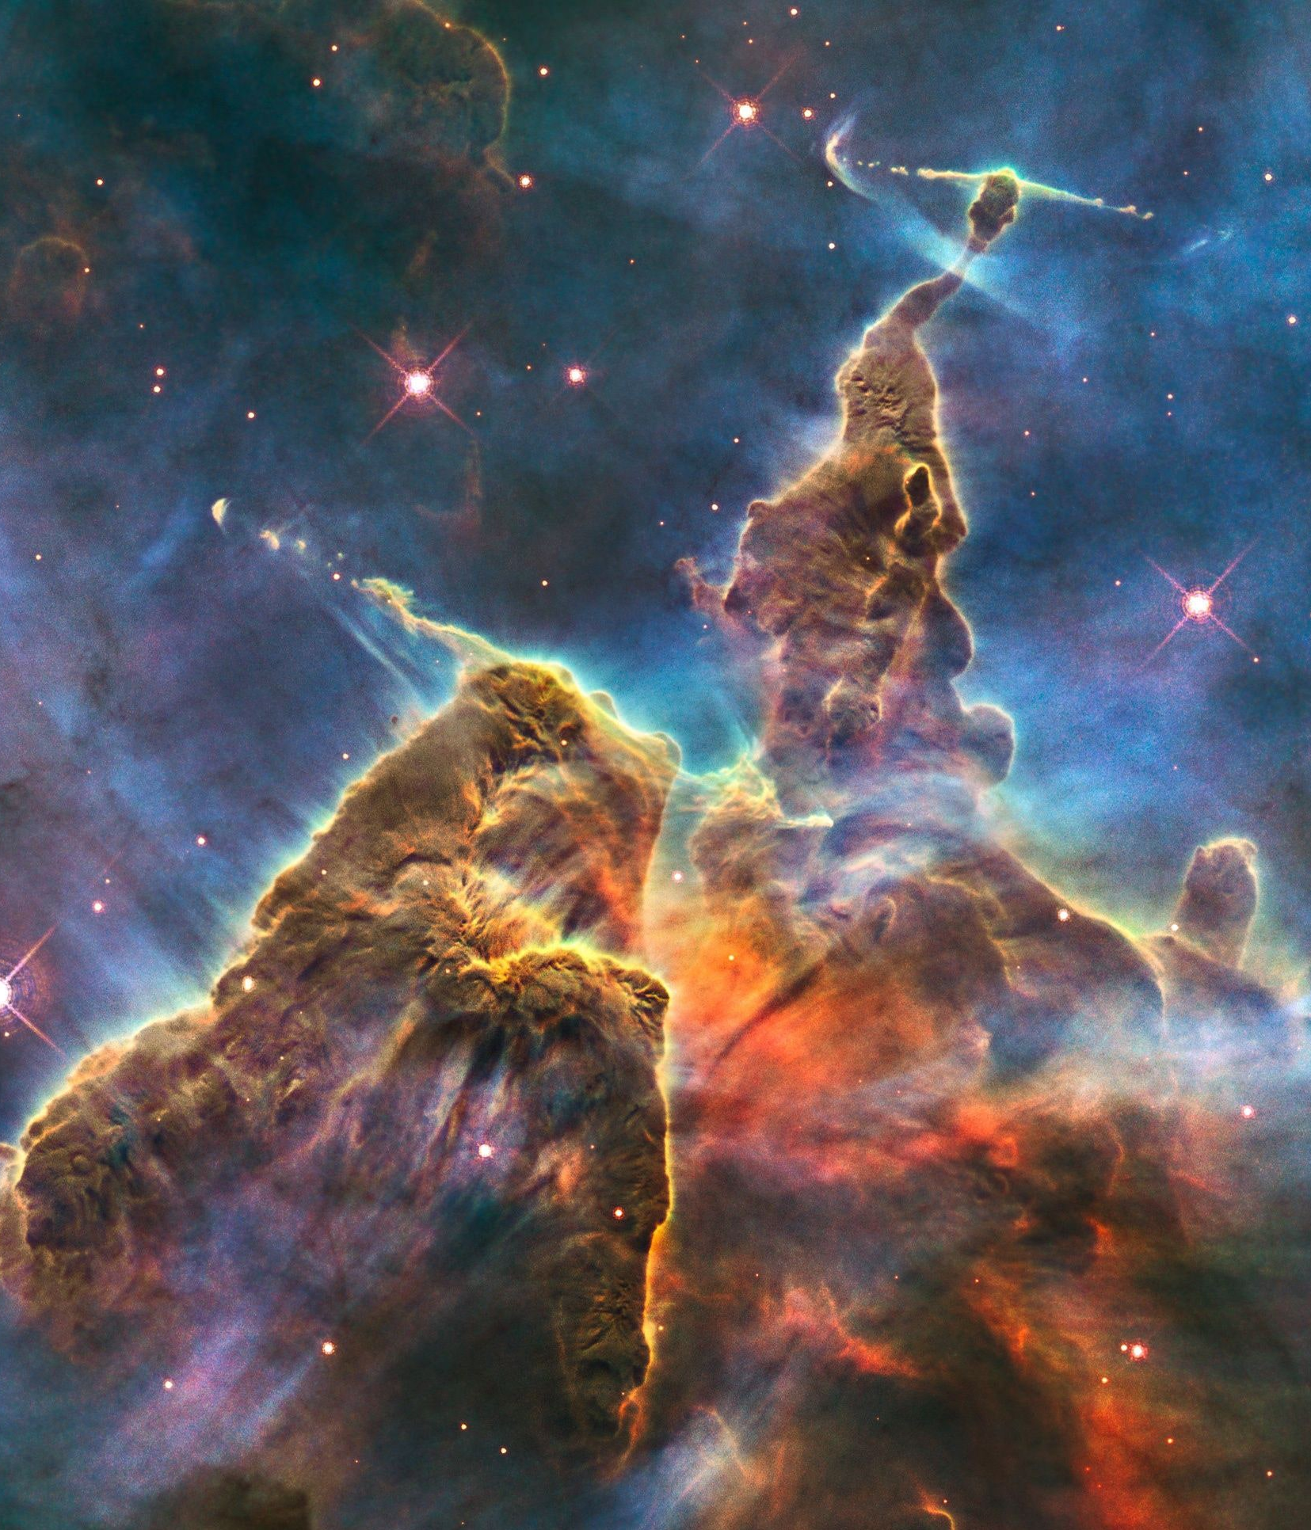
Nothingness
Something
CAUSE

Slide 26
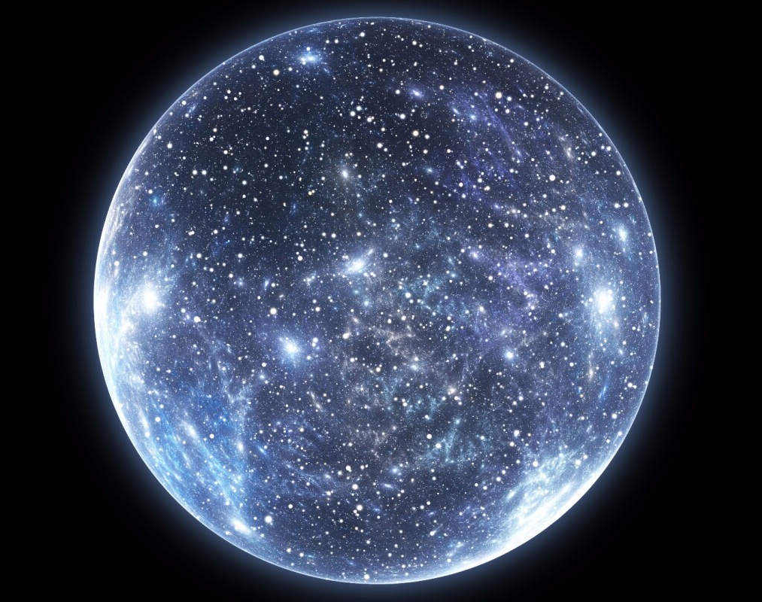
If the world didn’t have a cause, it came from nothingness
But Nothing is Nothing…

Slide 27
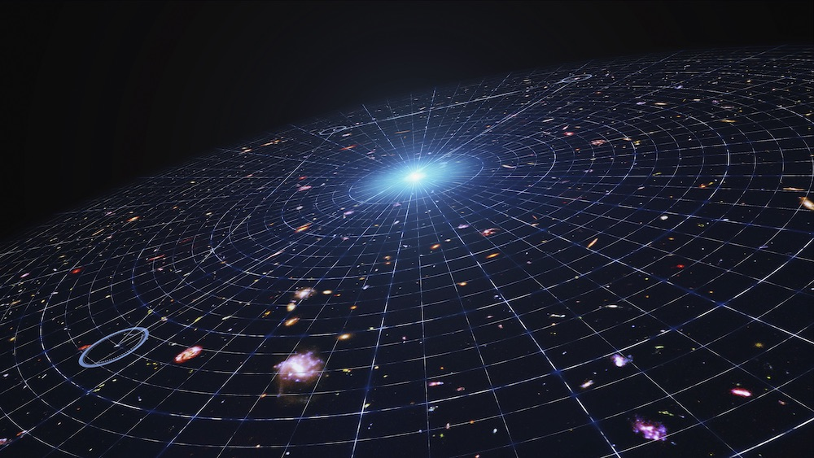
The Cause Must Be Powerful Enough to Cause and Create the Universe

Slide 28
Unless the Universe Always Existed

Slide 29
Multiple Evidences Show the Universe is Finite in Age

Slide 30
1. An Infinite Regression Doesn’t Work in Reality

Slide 31
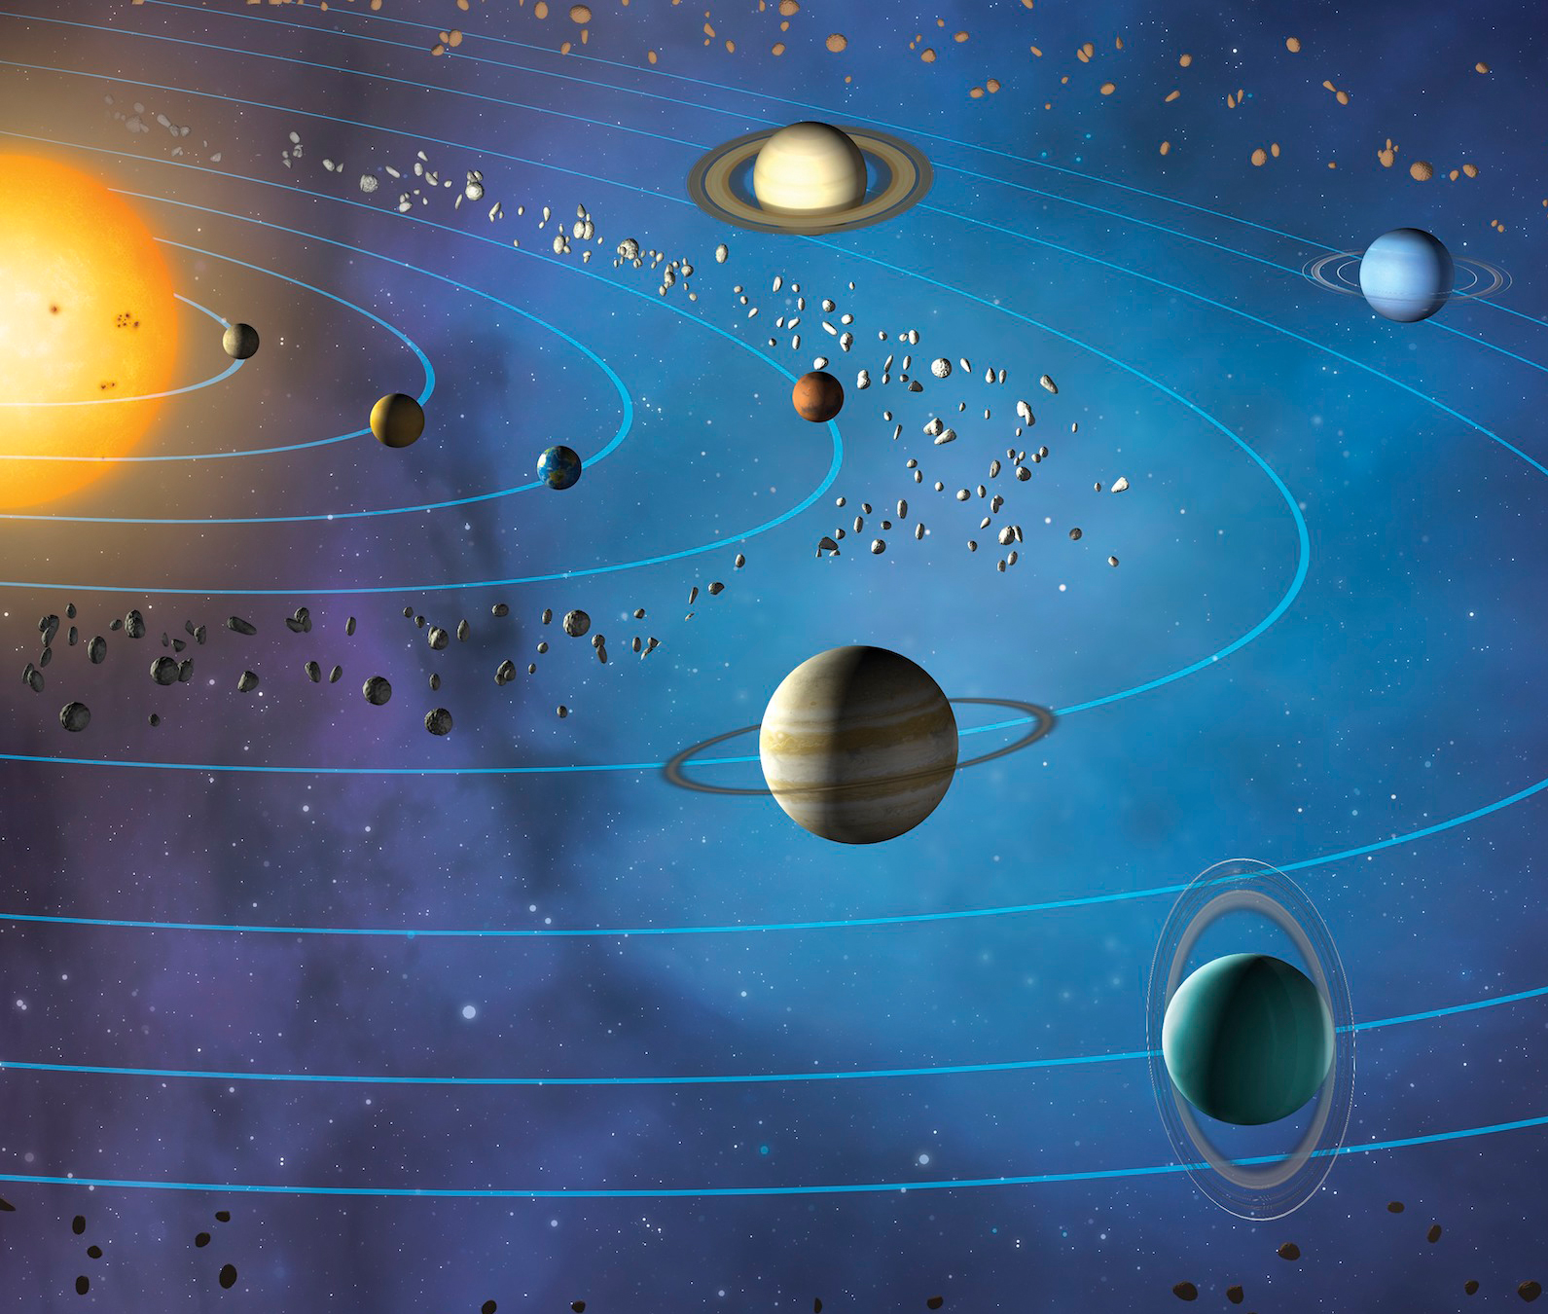
Imagine Planets Orbiting the Sun Forever… But each planet has a different length “year”
Which one has gone around the most?

Slide 32
Mathematically, they have each rotated around the sun the same number
There must be a beginning

Slide 33
2. Energy is running out
Analogy

Slide 34
The amount of energy in the universe is decreasing
Couldn’t Go On Forever

Slide 35
P1: Anything that begins to exist has a cause.
P2: The Universe Began to Exist.
Those two premises are both true

Slide 36
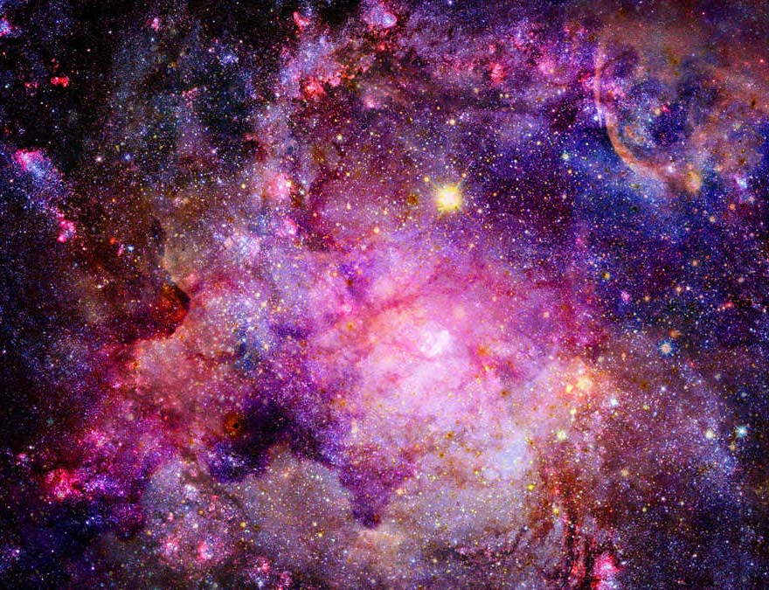
The Universe Has a Cause
Cause Must Be:
Infinite Power
Outside Time
A Mind/Will

Slide 38
Teleological Argument for God’s Existence
The Argument from Design

Slide 39
Telos from the Greek meaning Purpose
William Paley Watch Analogy

Slide 40
Ask Yourself…
If you walk through a forest and find a pocket watch on the ground, is it reasonable to conclude a watch-maker made it?

Slide 41
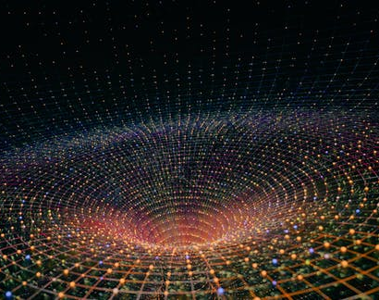
Why conclude a watch maker?
The reason the watch requires a designer is because of the complex, interacting parts that fulfill a purpose and function

Slide 42
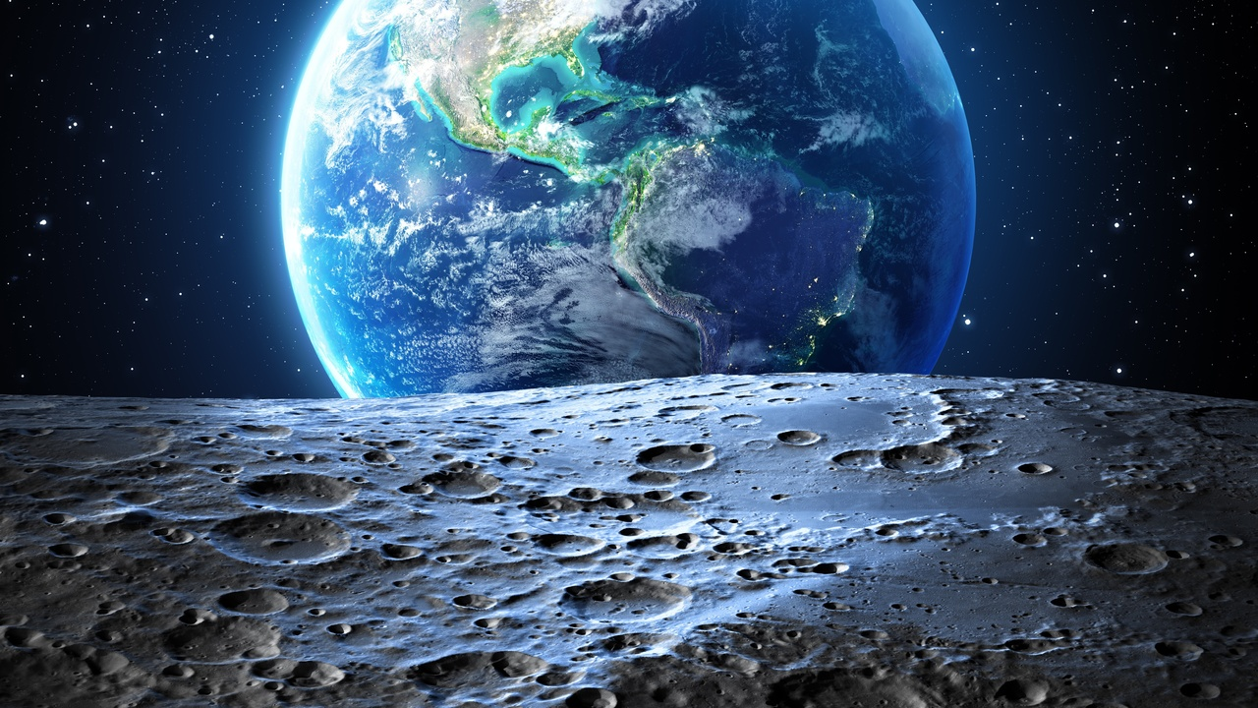
Premise 1: Fine-Tuning & Complexity implies a designer or creator.

Slide 43
Premise 2: The Universe is fine-tuned and designed to serve a specific purpose.

Slide 44
Conclusion: The Universe has a Designer

Slide 45
Fine-Tuning is when many parts interact and work together to accomplish a purpose

Slide 46
Evidence for Premise 1: Fine-Tuning & Complexity implies a designer or creator.

Slide 47
Logic & Statistics Confirm Premise 1
Fine-Tuning isn’t accidental…

Slide 48
Does a Word Simply Appear?

Slide 49
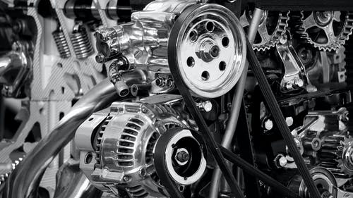
Do these parts just magically come together to function?

Slide 50
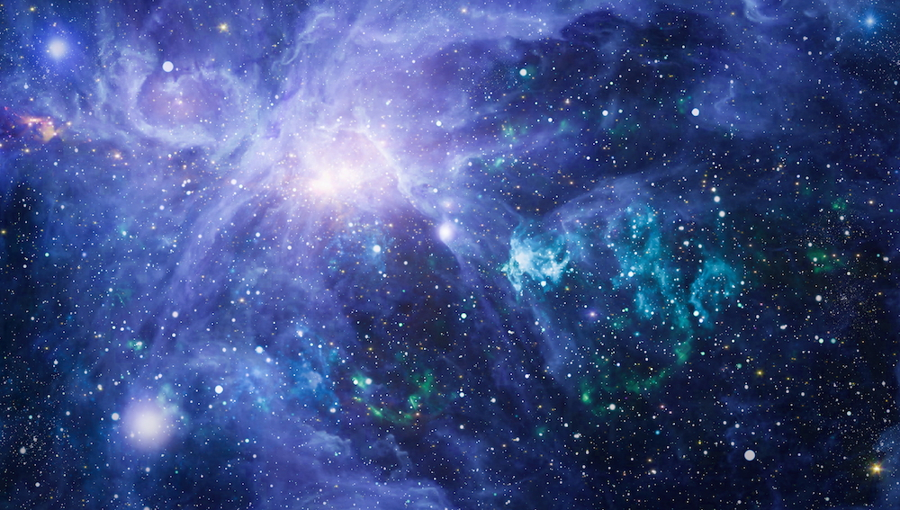
The Design of the Universe is Similar to the Machine

Slide 51
Premise 2: The Universe is fine-tuned and designed to serve a specific purpose.

Slide 52
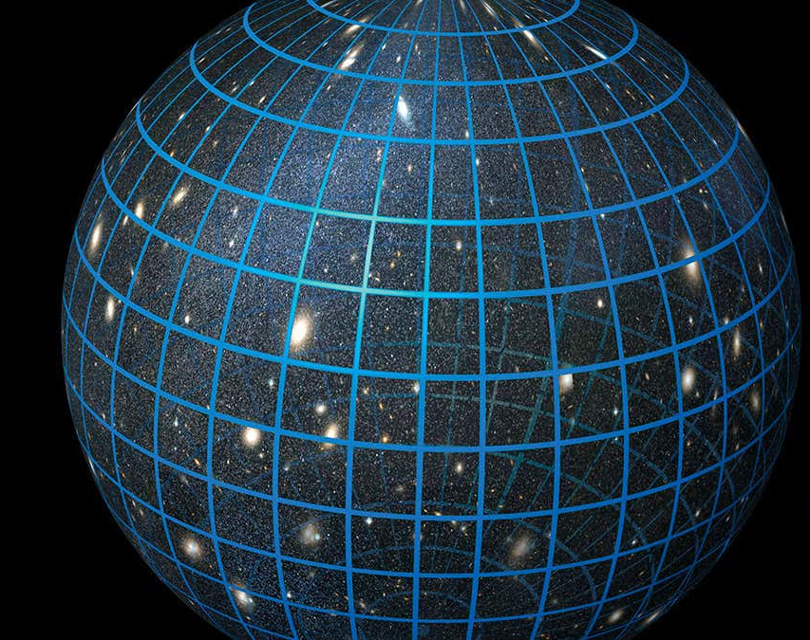
A. Beginning with the Large-Scale Fine-Tuning
The Universe is designed for life

Slide 53
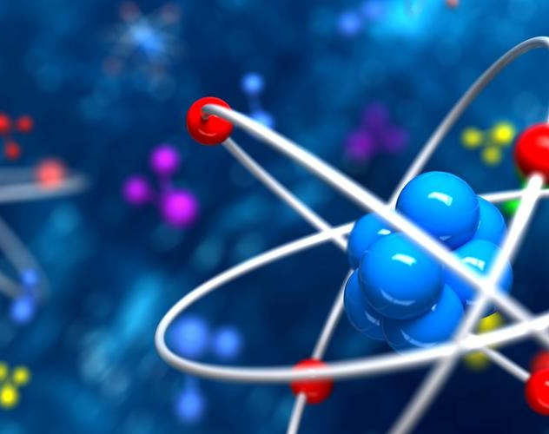
1. The Strong Nuclear Force is Perfect for Atoms to Exist
5% Different nothing exists

Slide 54
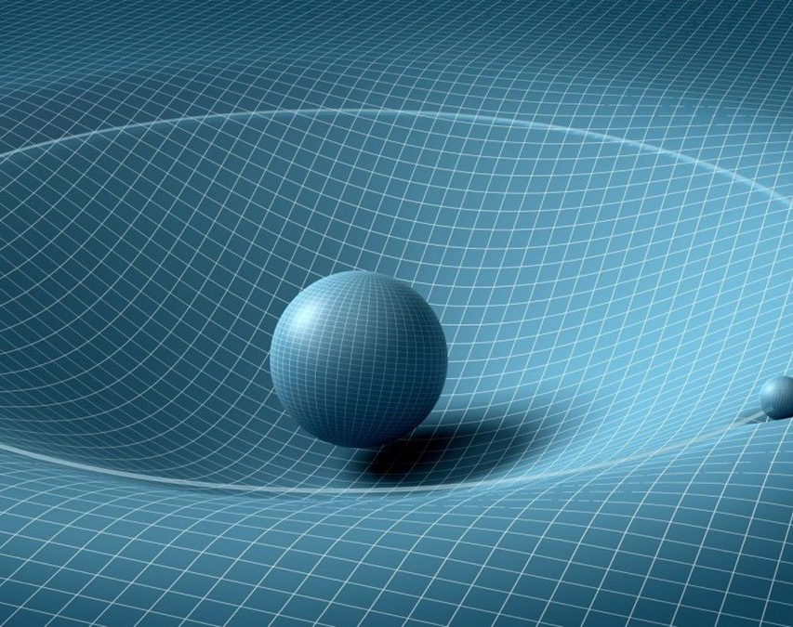
2. The Laws of Gravity Can’t be Any Different
Any difference means no life

Slide 55
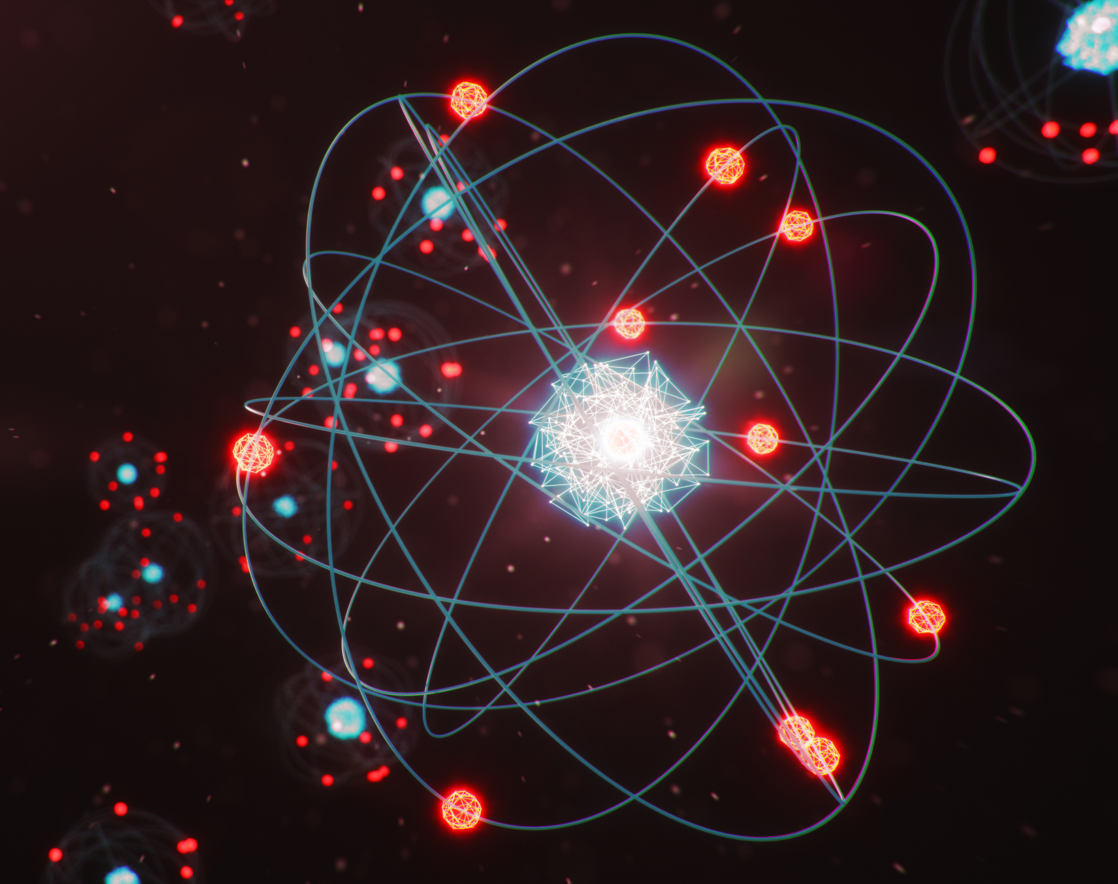
3. Proton and Neutron size difference is exactly right
Any change means no life

Slide 56
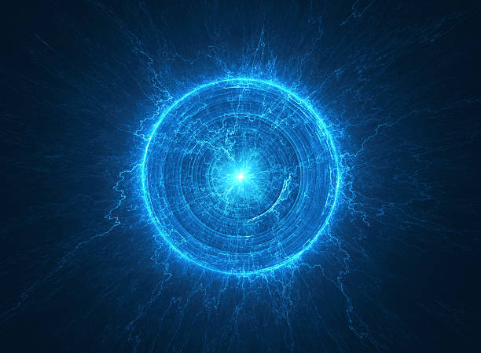
4. Electro Magnetic Force is the perfect strength
Too much means no world

Slide 57
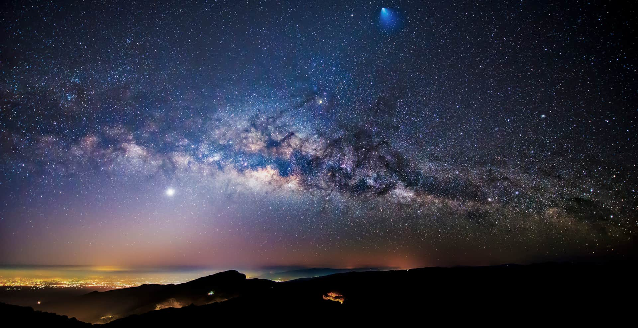
The Local Setting of Planet Earth

Slide 58
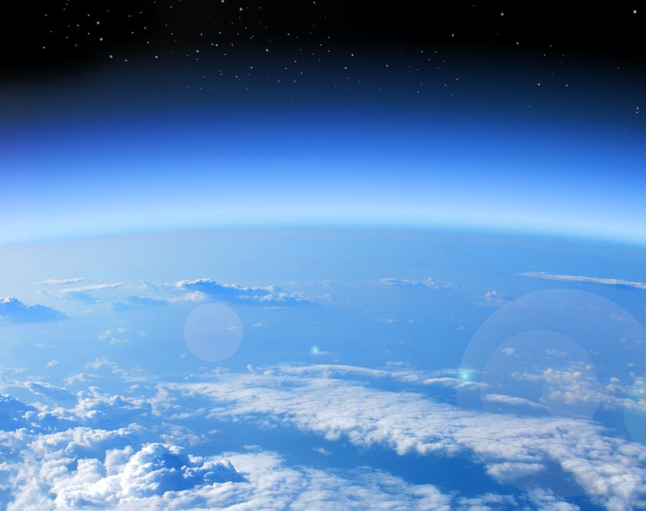
1. Oxygen Levels are Exactly Right inside earth’s atmosphere
Too much more or less is bad

Slide 59
2. Atmosphere Transparency level is perfect for life to exist
Let’s in enough but not all light

Slide 60
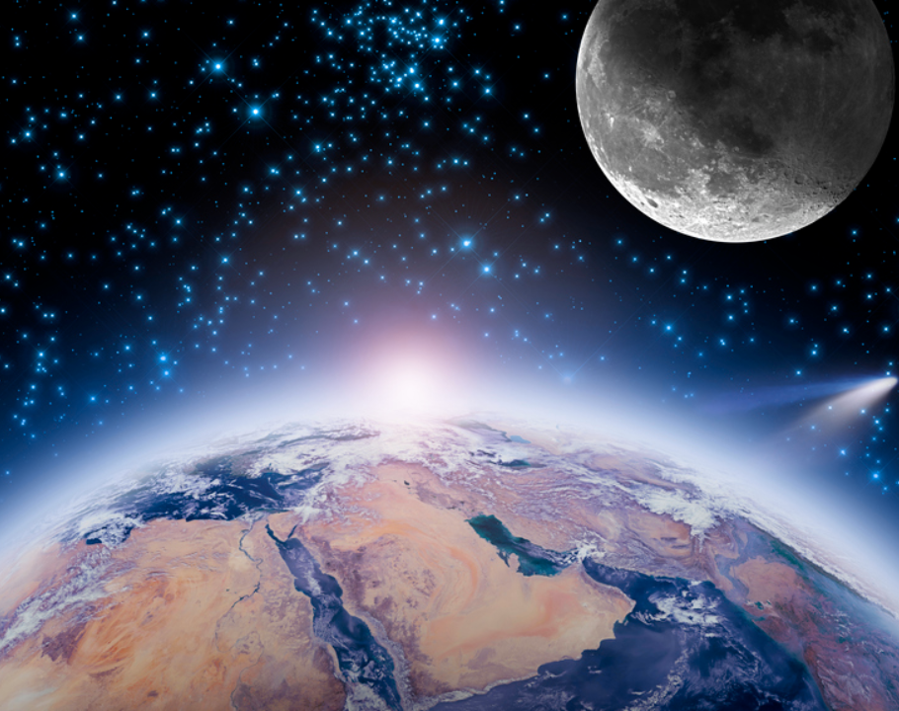
3. Moon and Earth Gravity Relationship Allows for Life to Exist
Ocean life
requires the moon

Slide 61
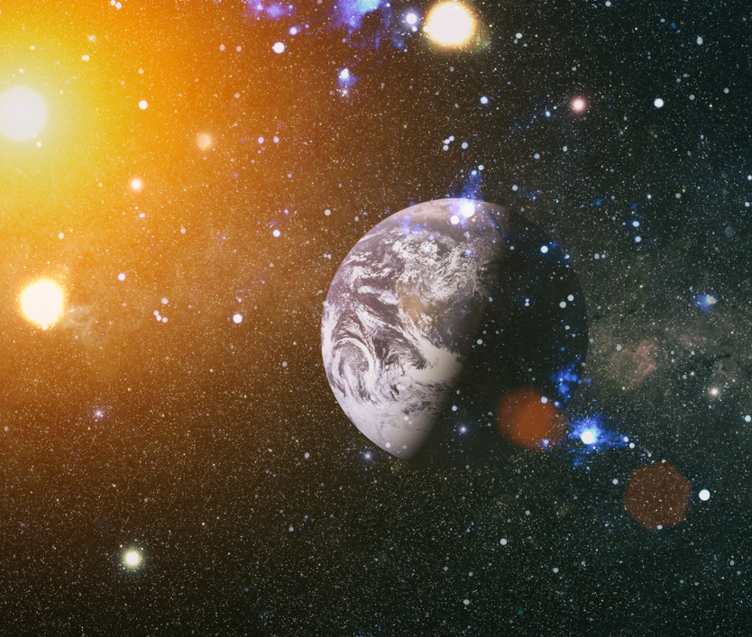
4. The 24-hour rotation of the earth is required for life to exist
Days don’t get too hot; nights don’t get too cold

Slide 62
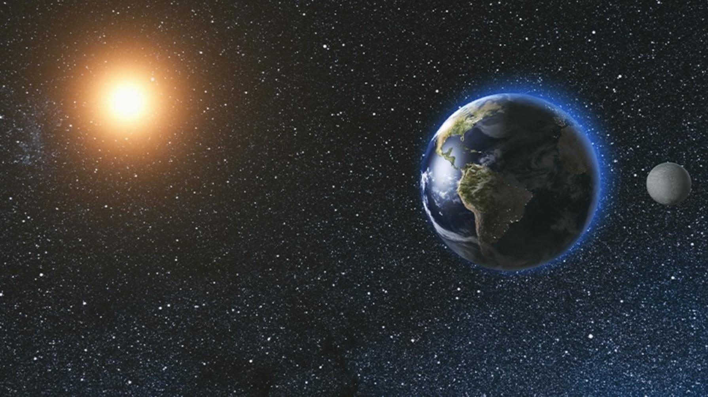
Goldilocks Zone for life
5. Distance from the Sun is Right for Life

Slide 63
Premise 2: The Universe is fine-tuned and designed to serve a specific purpose.

Slide 64
Human life is the reasons for the design

Slide 65
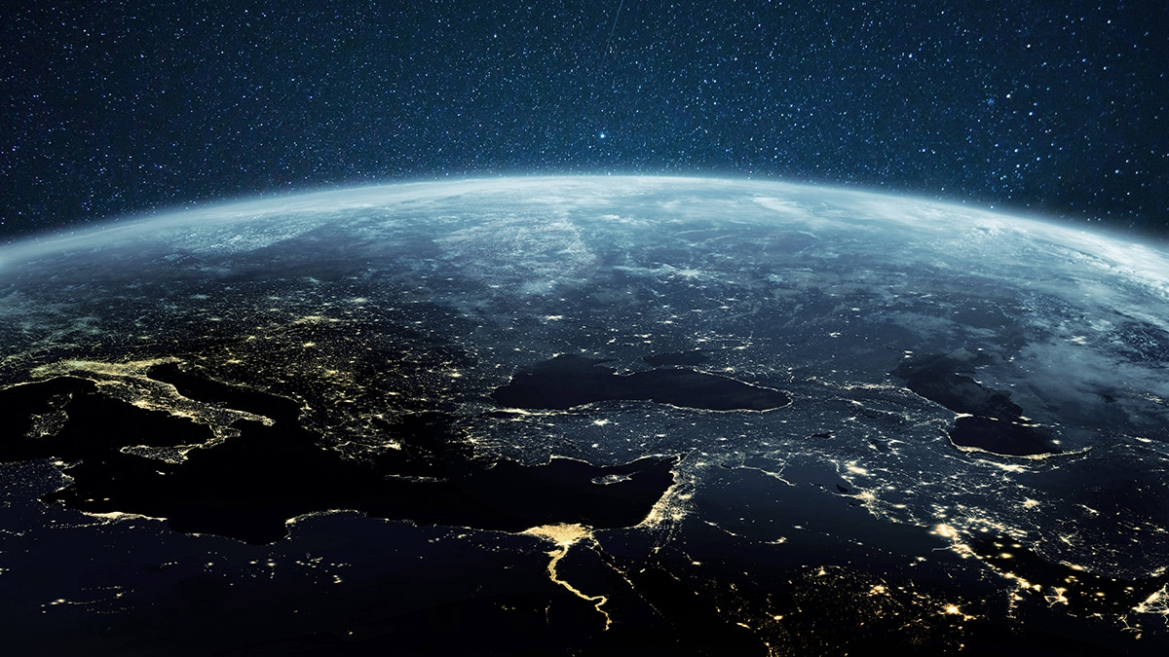
Many details of the fine-tuning weren’t discussed

Slide 66
Conclusion: The Universe has a Designer

Slide 67
No Way Around the Conclusion Except Blind Belief

Slide 68
Why Do People Reject the Clear Evidence for God Existing?
The Bible gives us the answer

Slide 69
People Reject God for Their Own Way
People Suppress the Truth They Know (Romans 1)
People do it because they love sin and don’t want to follow God’s ways.

Slide 70
The Universe Has a Creator
Creator Must Be:
Infinite Power
Outside Time
A Mind/Will
Man-Focused

Slide 71
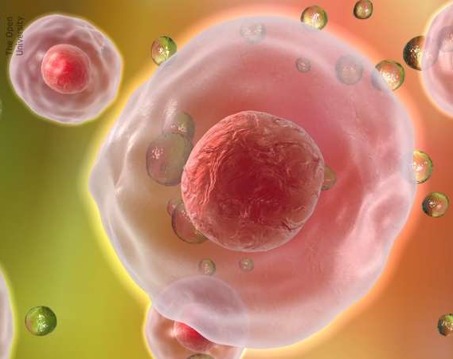
The argument from design will be continued in the discussion of the creation and complexity of life
We have only seen the big stuff

Slide 72
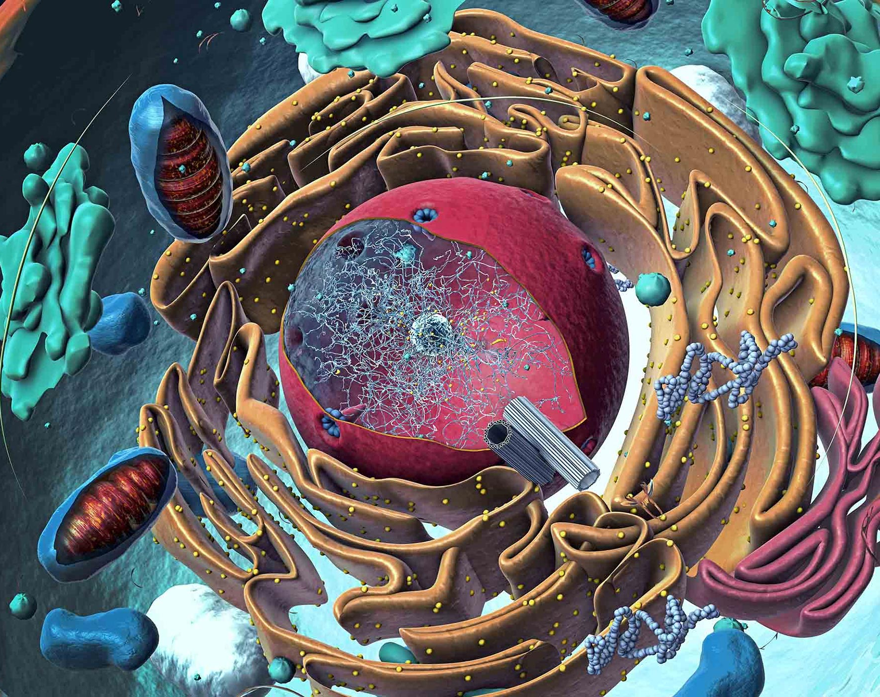
The small things in the microscope have the most fine-tuning and design in creation
Microcosm vs. the macrocosm

Slide 73
Conclusion of the Evidence
I don’t have enough faith to be an atheist and believe it’s all from nothing

Slide 75
If the world is designed for humans, why is there pain?
Does that mean God isn’t there?

Slide 76
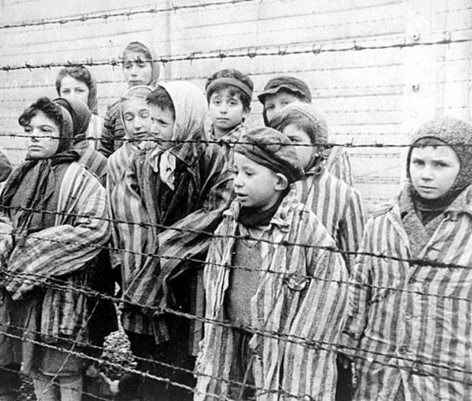
If God is powerful and loving, why create a world with evil?
God created things good

Slide 77
Evil doesn’t make sense without God being the standard of good
More when we reach the moral argument

Slide 79
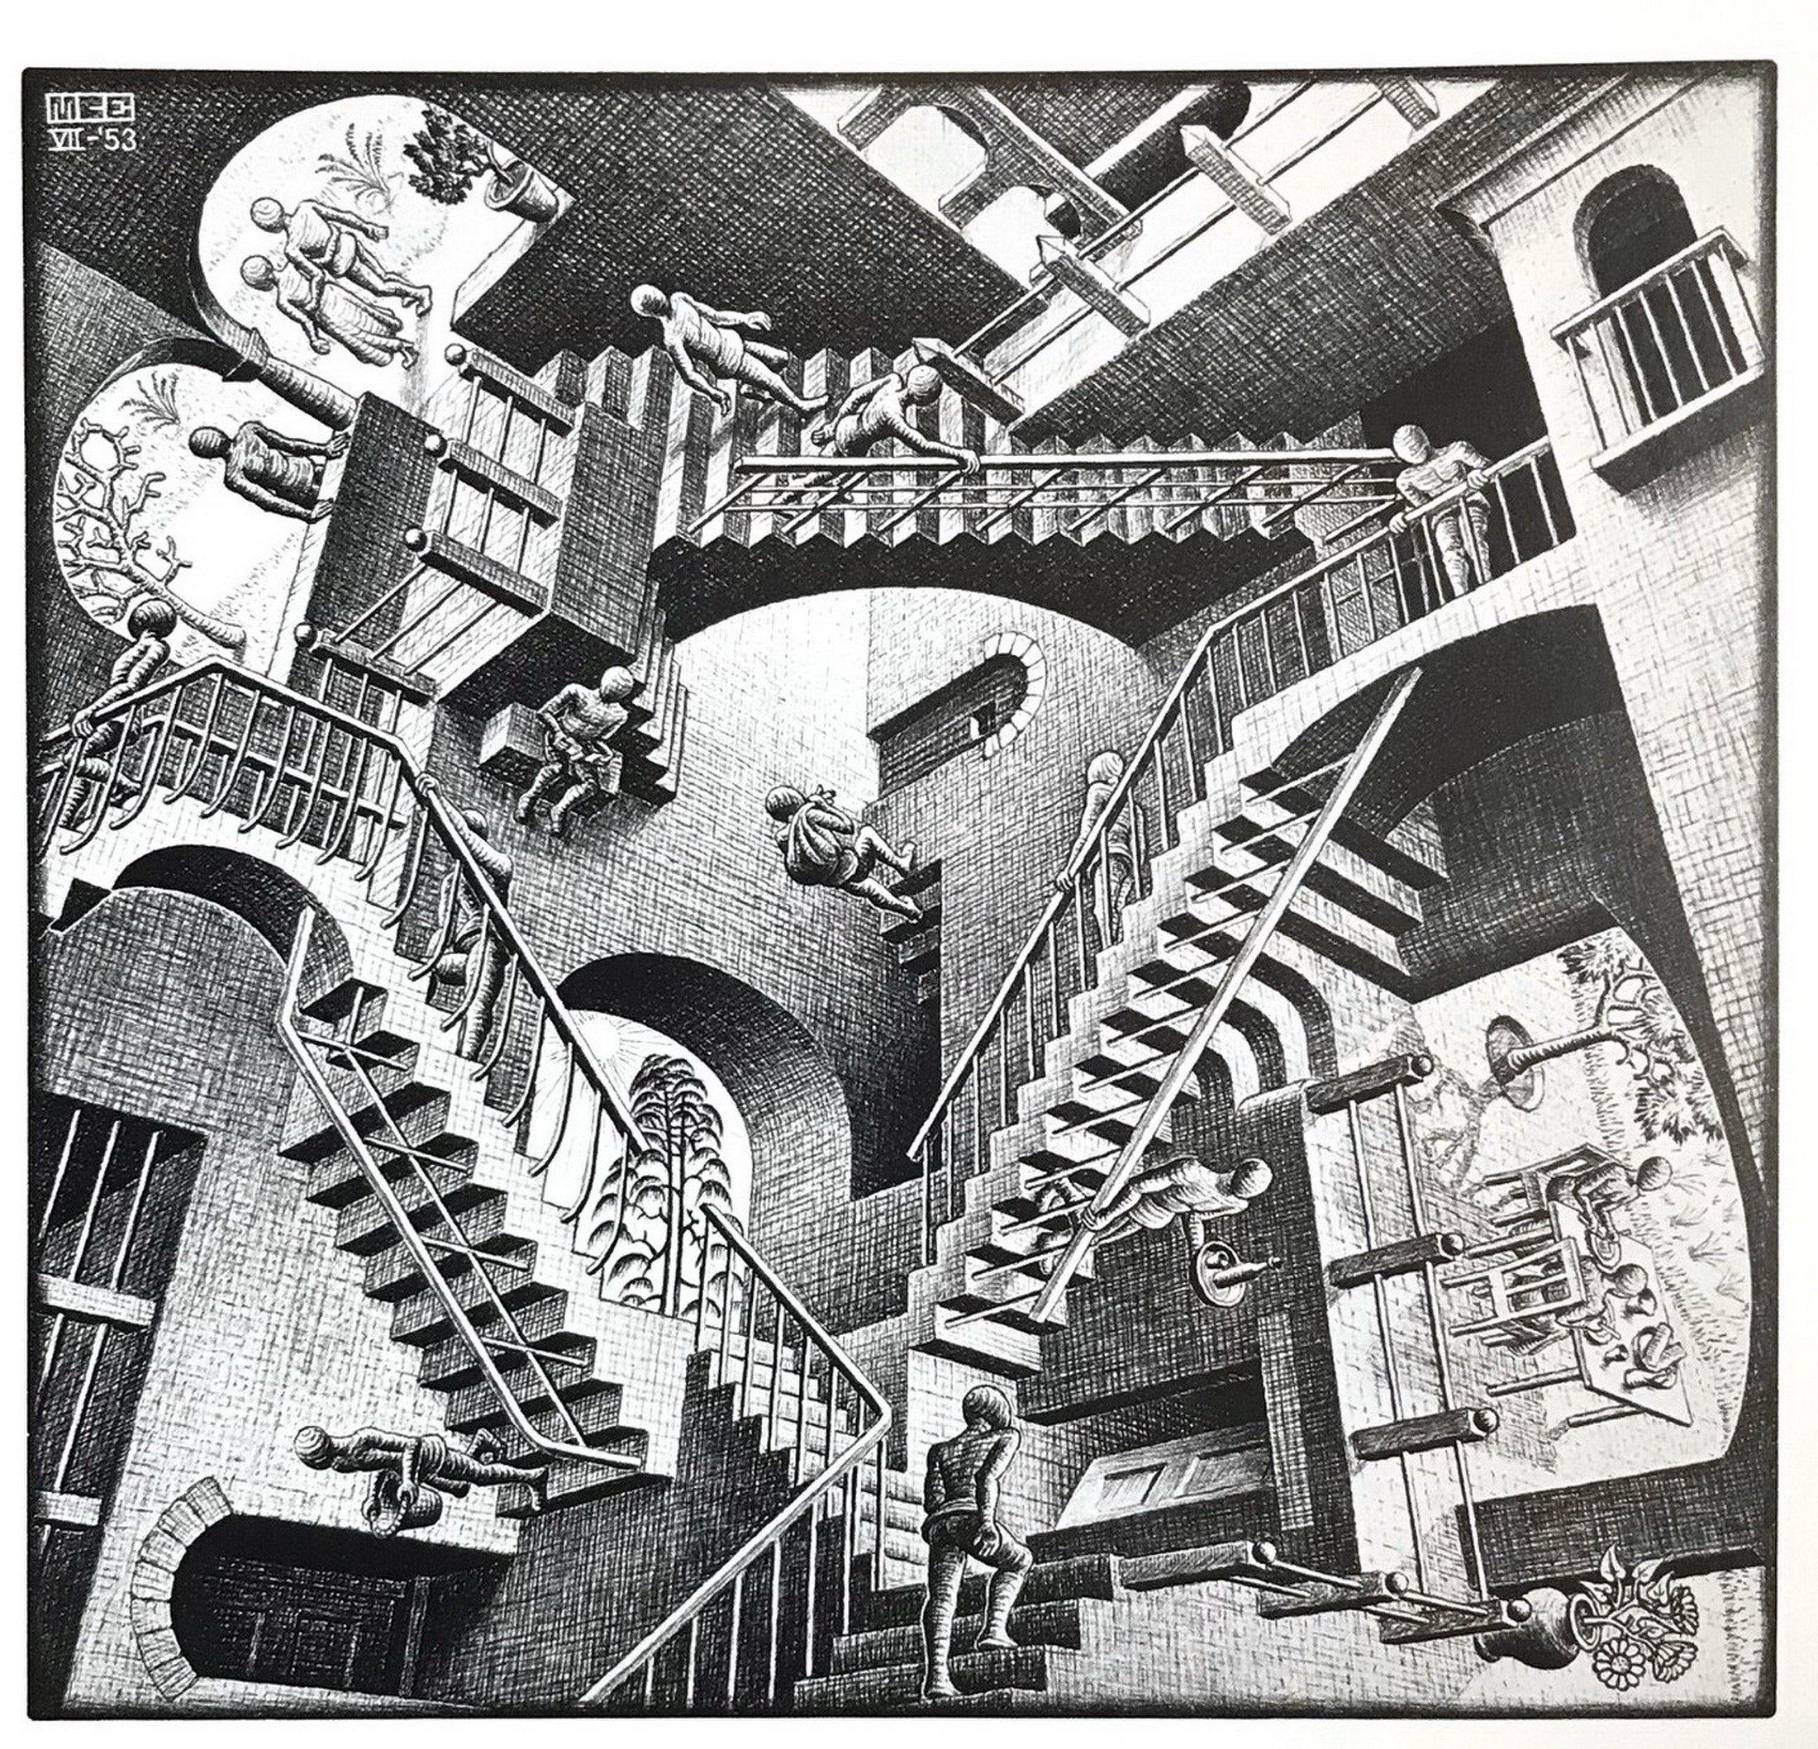
The Ontological Argument for God
The most mind bending and difficult argument to understand when it comes to evidence for God

Slide 80
Developed by Anselm
Mind Bending

Slide 81
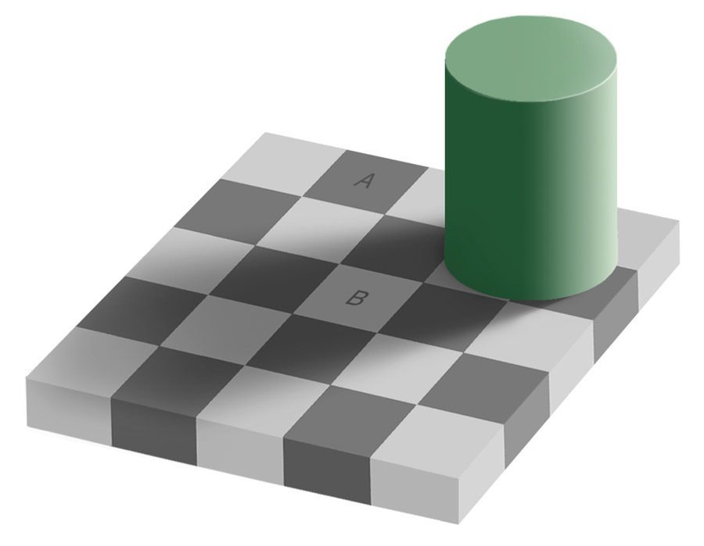
Square A and B are the same Color

Slide 82
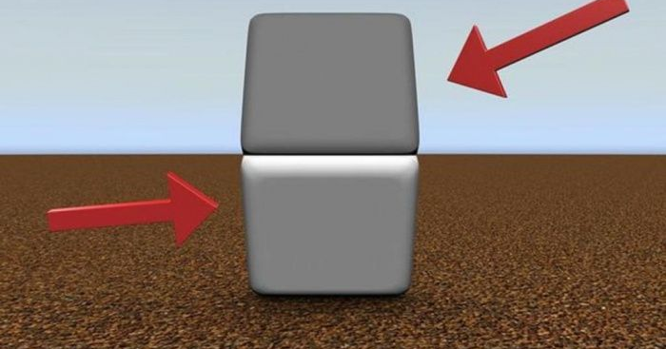

Slide 83
Many Feel Like It’s a Trick
Anselm pointed to Psalm 14:1 to explain his view of God’s existence being necessary

Slide 84
Psalms 14:1A “The fool says in his heart, “There is no God.”
Anselm said it’s logically Impossible

Slide 85
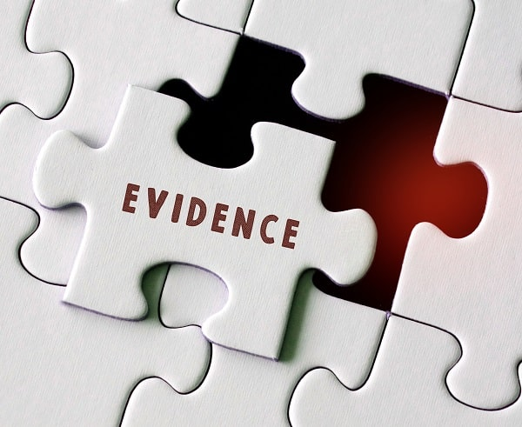
The Argument Has More Premises than other ones we looked at so far
Follow them closely…

Slide 86
P1. God is the object of thought of which no object of thought can be greater.

Slide 87
Now suppose God is only in the intellect (i.e., He exists in the mind but not in reality). But…

Slide 88
P2. Any object of though that can be believed to exist in reality will be thought to be greater than any object of though that exists only in the mind.

Slide 89
P3. It cannot be doubted that God can be thought to exist in reality, not only in the intellect.

Slide 90
Conclusion
Therefore, some object of thought can be thought to be greater than the object of thought of which no object of thought can be greater, which is a contradiction.

Slide 91
Conclusion
And so, we have to abandon our supposition that God is only in the intellect or mind. He must also exist in reality. Therefore, God exists.

Slide 92
A Modern Version of the Ontological Argument was Proposed by Alvin Plantinga

Slide 93
The New form of the argument deals with possible worlds
Possible worlds are not always real

Slide 94
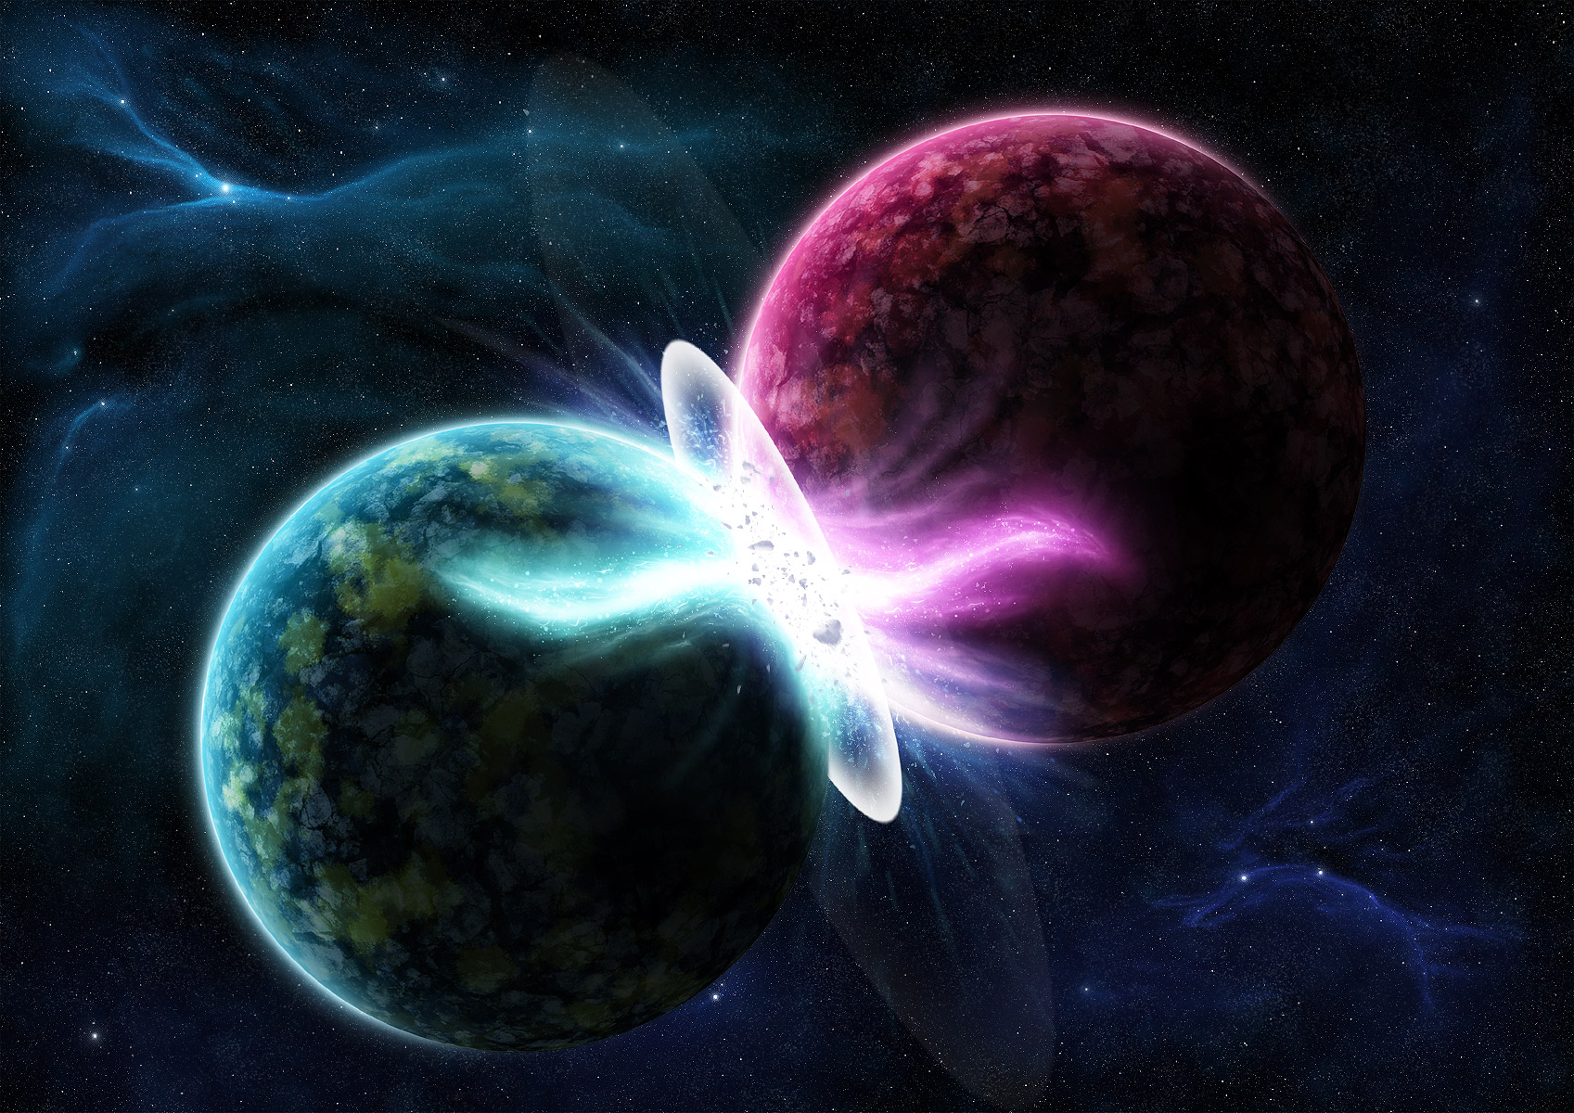
Possible Worlds
These are worlds that are logically possible. Example: There is a possible world with unicorns, even if it’s not the real one

Slide 95
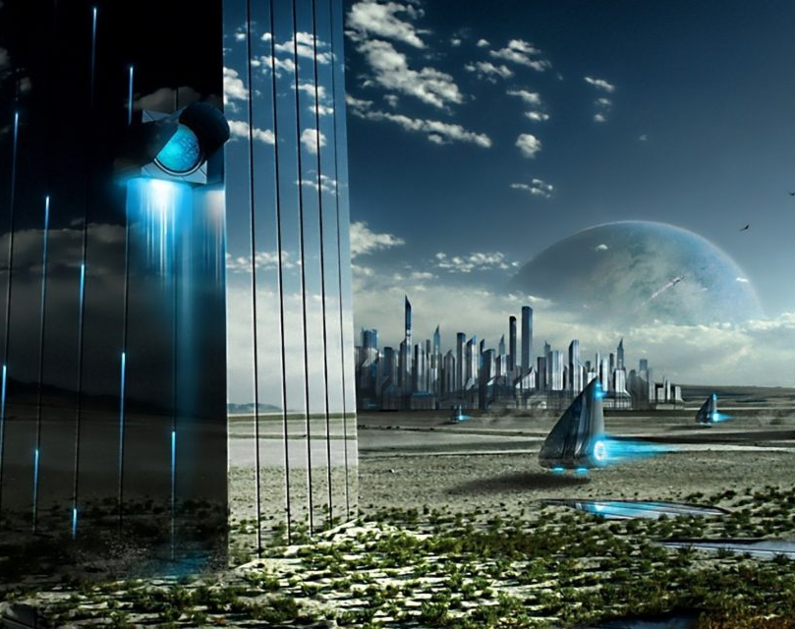
Not all worlds are possible
A world of square triangles is not possible. A world of black and white rainbows is impossible

Slide 96
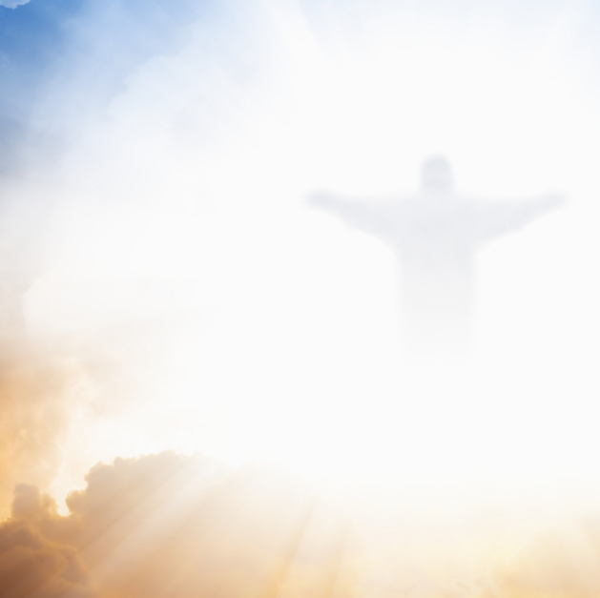
Maximally Great Being Defined
A maximally great being is infinite in power and knowledge, is omni (all) benevolent (good), and is eternal in nature

Slide 97
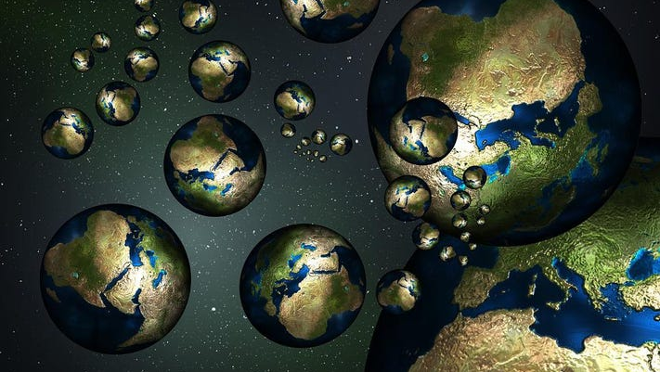
Premise 1
It is possible that a maximally great being exists.

Slide 98
Premise 2
If it’s possible that a maximally great being exists, then a maximally great being exists in some possible world.

Slide 99
Premise 3
If a maximally great being exists in some possible world, then it exists in all possible worlds.

Slide 100
Premise 4
If a maximally great being exists in all possible worlds, then it exists in the actual world.

Slide 101
Premise 5
Therefore, a maximally great being exists in the actual world

Slide 102
Conclusion
Therefore, God, the only possible maximally great being, exists.

Slide 103
Maximal Greatness Proves Only
one God exists
Just like the Bible says

Slide 105
The Moral (Axiological) argument for the existence of God
The argument from good/evil

Slide 106
Typically experience and feelings are not a guide for what is true or false

Slide 107
People’s feelings can lead them astray into lies
The Bible talks about morality

Slide 108
The Bible in Romans 1 & 2 says God wrote His law on the hearts of man
Deep down we known right and wrong

Slide 109
We have a moral GPS

Slide 110
Sin has damaged the guide God has given us and at times it leads us astray
Romans 1 says people suppress the truth in sin

Slide 111
Romans 1:18
“For the wrath of God is revealed from heaven against all ungodliness and unrighteousness of men, who by their unrighteousness suppress the truth.”

Slide 112
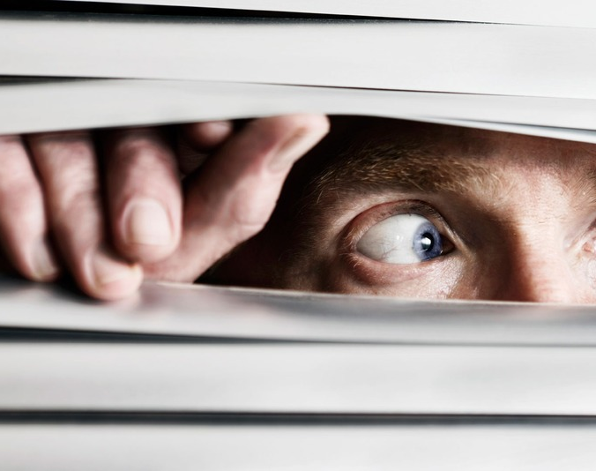
While sinners can suppress the truth at times, some things are hard to suppress
Certain things are so bad you can’t ignore it

Slide 113
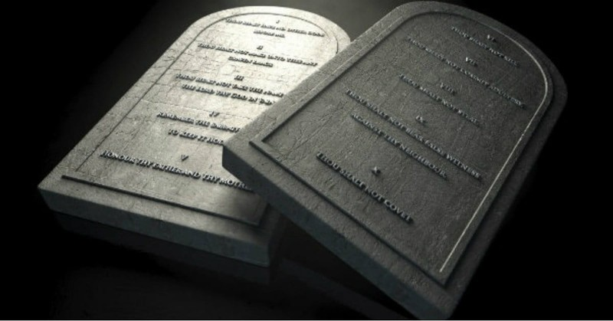
Thou Shall Not Murder

Slide 114
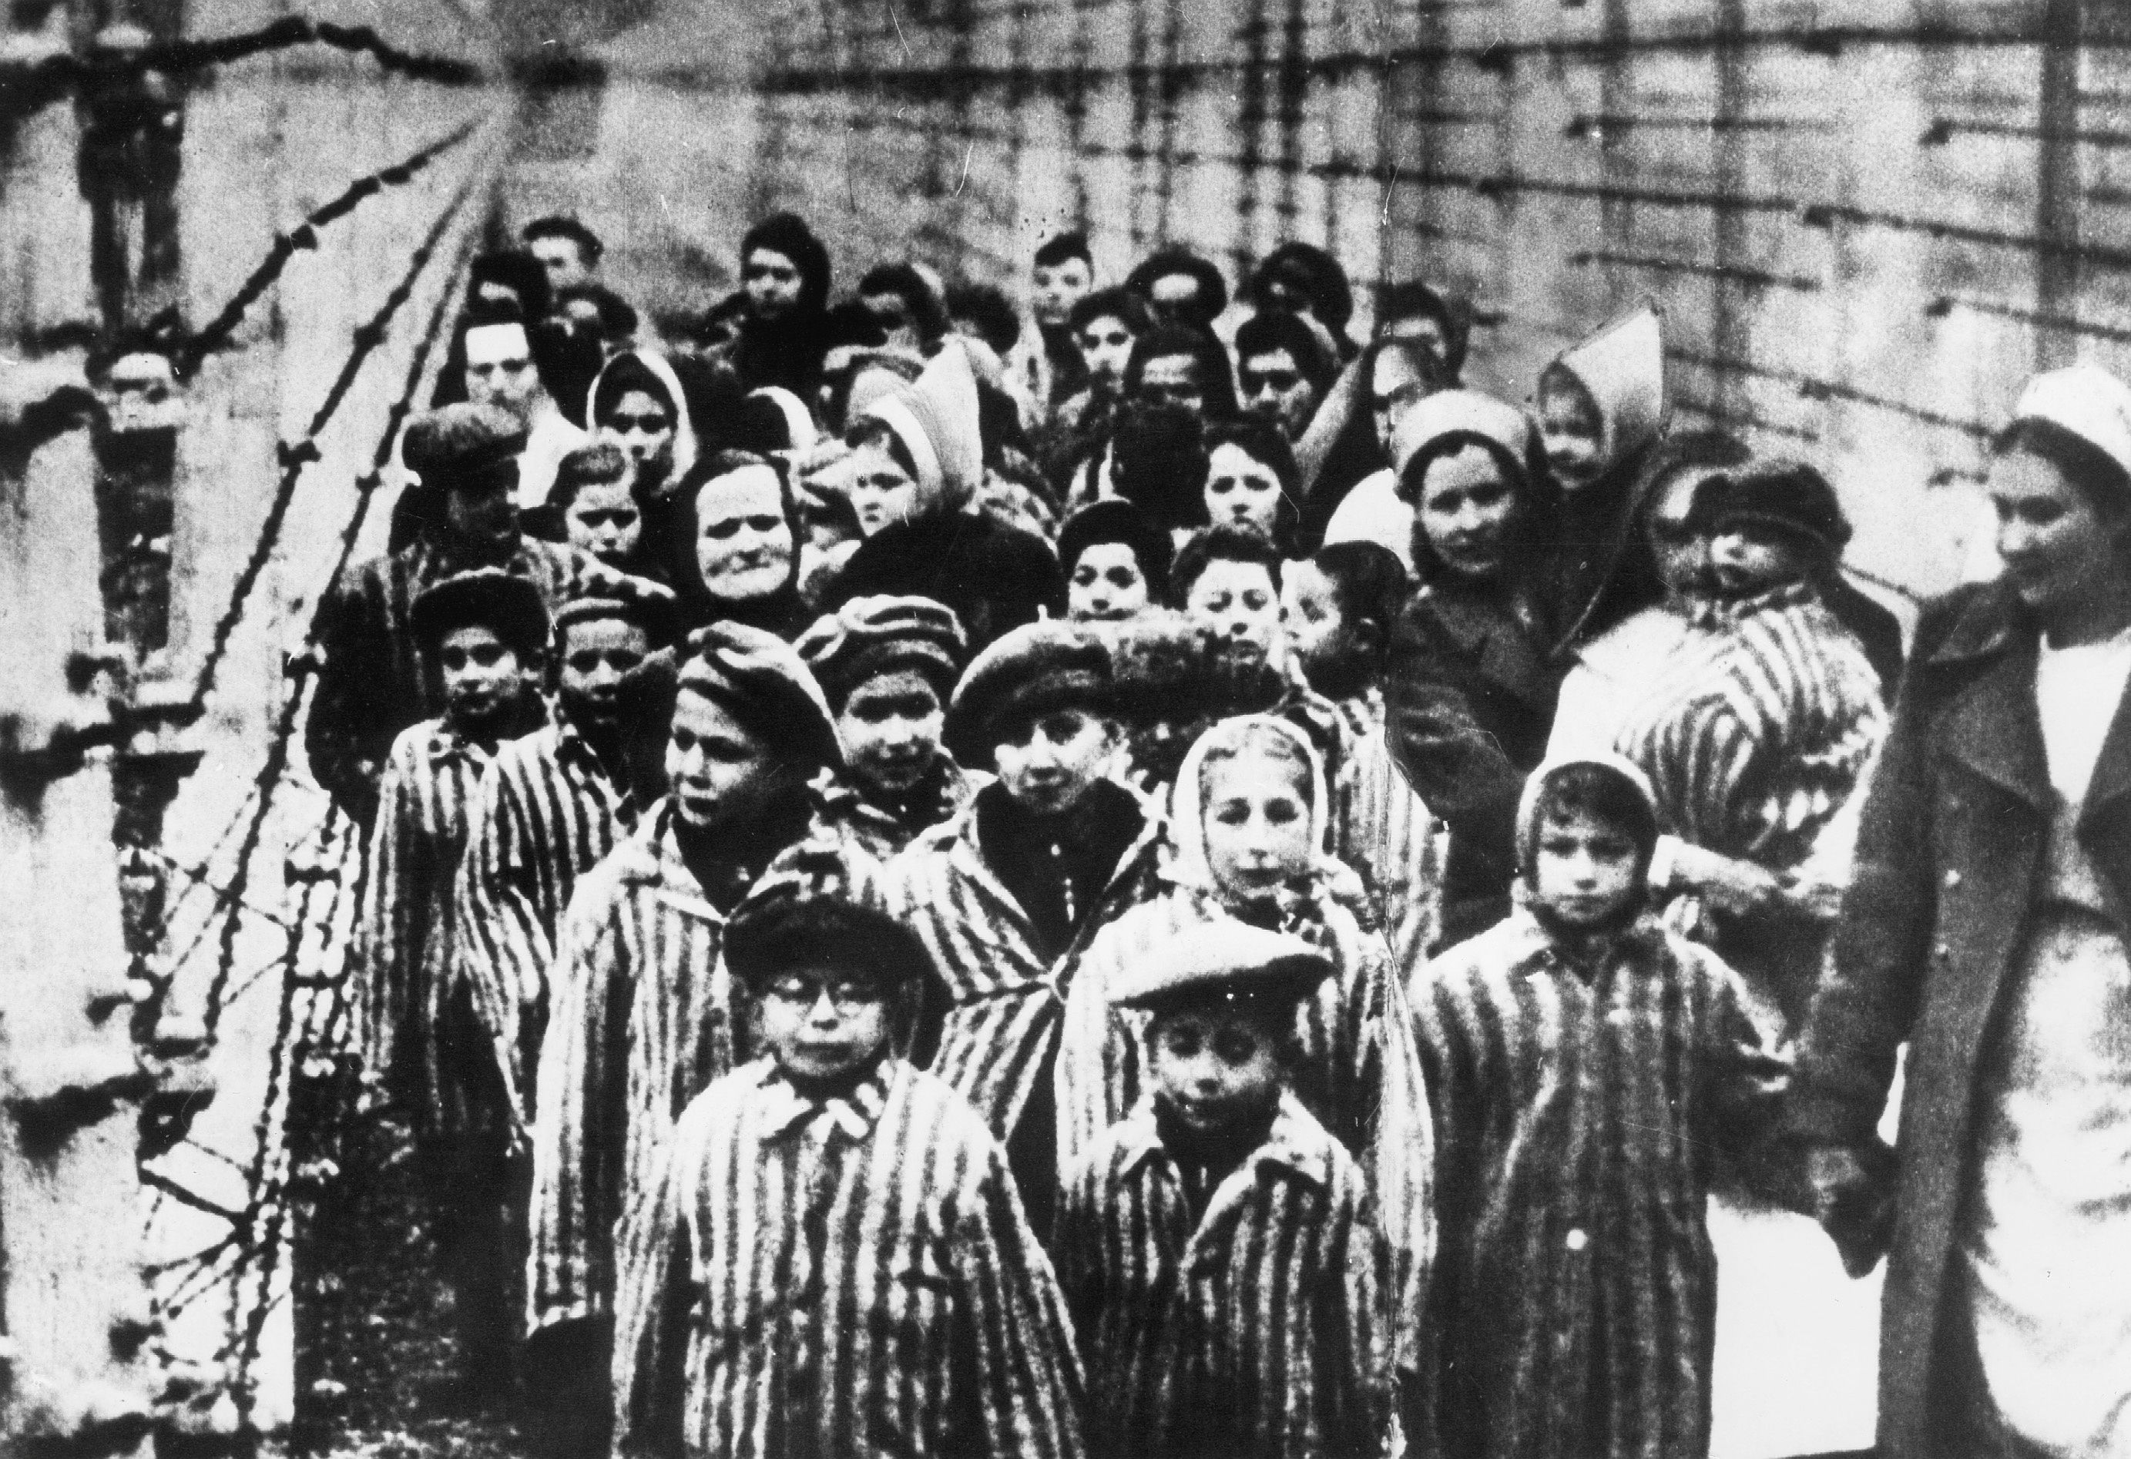
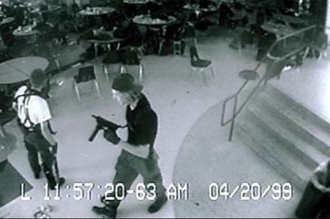
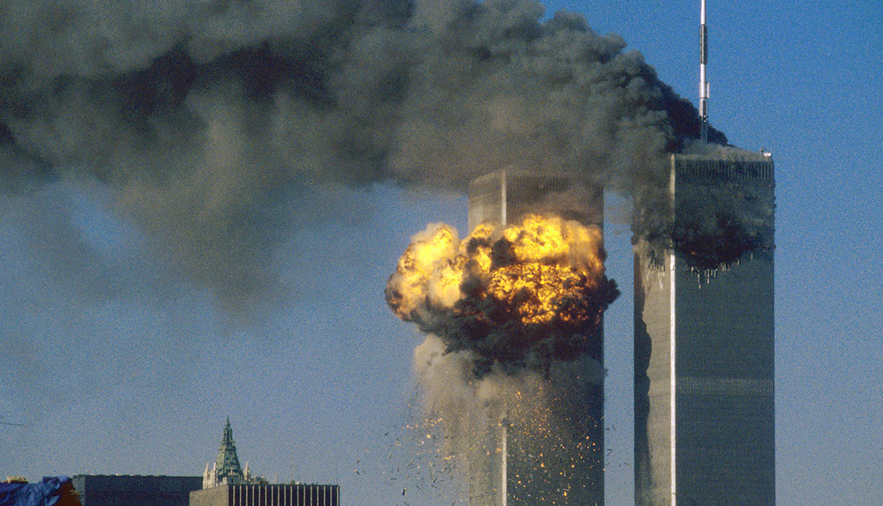
Were these things evil or simply one opinion vs. another

Slide 115
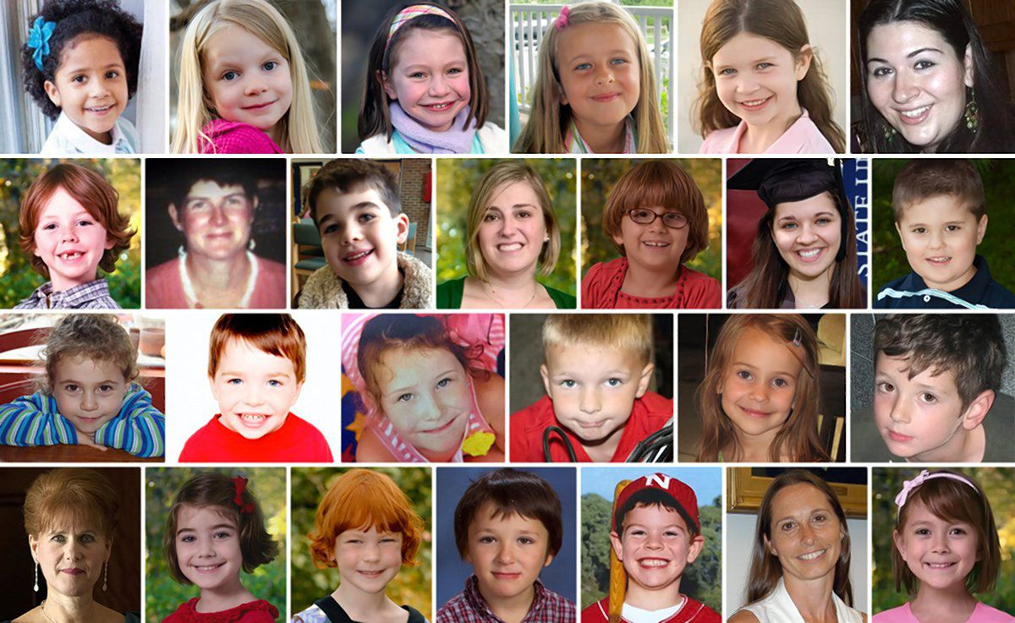
Sandy Hook Elementary School Shooting Victims
Was it Wrong?

Slide 116
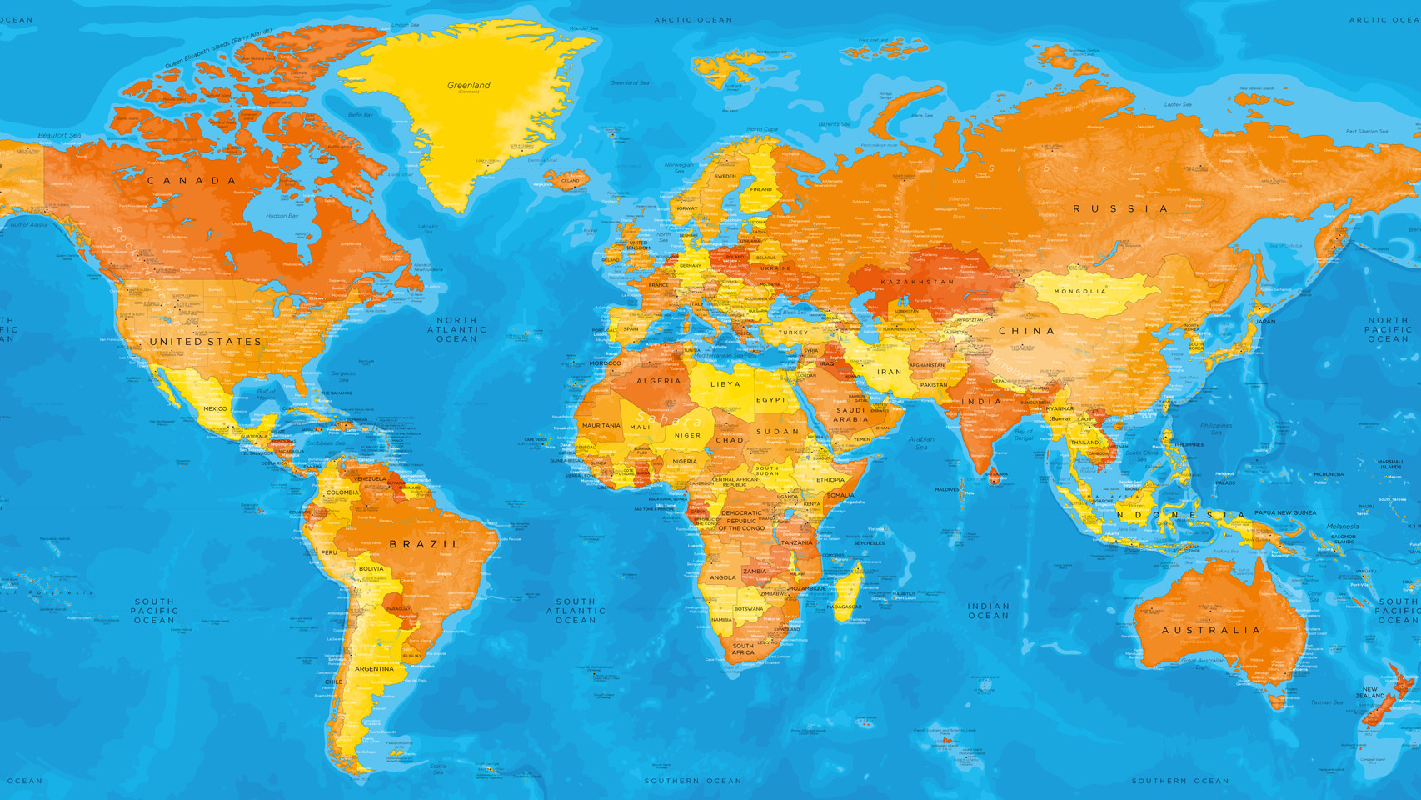
Is there anywhere in the world it would be right?

Slide 117
Is there any time in history it would be right?

Slide 118
If you say no… you now need an objective standards

Slide 119
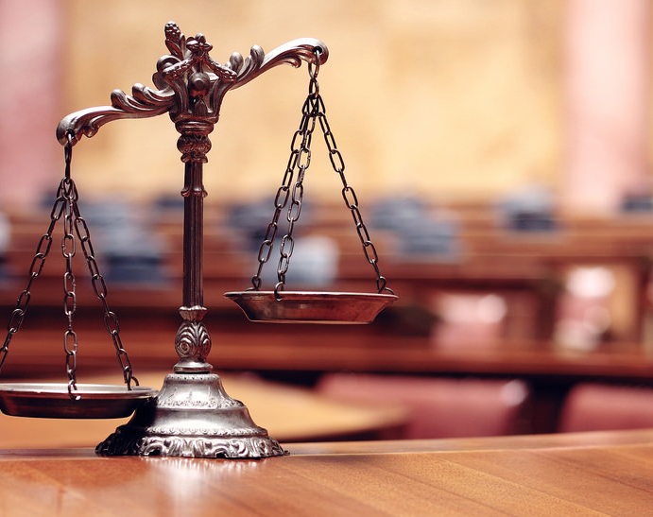
Objective Morality
Morality which is always the case, can never change, and applies to all people at all times.

Slide 120
Subjective Morality
Morality which is decided by a specific person or culture but is subject to change with time/culture.

Slide 121
Atheist and Agnostics tend to be subjective in thinking

Slide 122
They invent rules but have no justification for why people should follow their opinion
Subjective rules are only opinions and preferences

Slide 123
Subjectivism
If someone is abused and being hurt all you can say is your opinion is that’s wrong

Slide 125
If you want to say Hitler was wrong, you need objective morality

Slide 126
The Argument from Morality
Premise 1: If God does not exist, objective moral values do not exist.
Premise 2: Objective moral values do exist.
Conclusion: God Exists.

Slide 127
Why is God the Only Possibility?

Slide 128
Moral questions and objections always originate with or deal with people
Morality is tied to personhood

Slide 129
Forces don’t care about Morality

Slide 130
What we know about the source
Timeless Source
Universal Source
Personal Source
All Powerful
All Good

Slide 131
Why All Powerful?
He must be the moral judge

Slide 132
Why All Good?
He is the standard for good

Slide 133
Premise 1 must be the case…
Premise 1: If God does not exist, objective moral values do not exist.

Slide 134
Do Objective Morality Exist?

Slide 135
If anything is always right or always wrong, they do exist
Killing babies is always wrong?

Slide 136
The Argument from Morality
Premise 1: If God does not exist, objective moral values do not exist.
Premise 2: Objective moral values do exist.
Conclusion: God Exists.

Slide 137
Morality reflects the universal standard
God is the standard

Slide 138
Sin is going against God’s character and purpose

Slide 139
God Clearly Lays Out His Will/Purpose in Scripture

Slide 140
God Determines Right and Wrong

Slide 142
Arguments Against the Existence of the God of The Bible
One main argument

Slide 143
Evil and Suffering
If God is loving and in control, why would He allow all the evil and suffering?

Slide 144
Around 21,000 people die every DAY from starvation

Slide 145
December 26, 2004, 280k people died in an earthquake tsunami in India
Couldn’t God prevent it?

Slide 146
Nearly 3.0 million newborns die each year, while another 2.6 million die as stillborn children
“Why” is a question that makes sense

Slide 147
Millions are suffering from terminal illnesses right now
Why would God allow it?

Slide 148
Atheist David Hume
“Were a stranger to drop suddenly into this world, I would show him as specimen of its ills, a hospital full of diseases, a prison crowded with malefactors and debtors, a field strewn with carcasses, a fleet floundering in the ocean a nation languishing under tyranny, famine or pestilence. Honestly, I don't see how you can possibly square with an ultimate purpose of love.”

Slide 149
Hit Home
The picture here is taken on December 10th, 2013

Slide 150
One Day Later
She had a stroke that night, they flew her to Children’s hospital ICU to save her life, and found a liver disease

Slide 151
What’s the Argument
“Is God willing to prevent evil, but not able? Then he is not omnipotent. Is he able, but not willing? Then he is malevolent. Is he both able and willing? Then whence cometh evil? Is he neither able nor willing? Then why call him God?” ― Epicurus

Slide 152
Willing to Prevent Evil
Unwilling to Prevent Evil
Why is there evil in the world? | God is Malevolent and evil
God is not all powerful | Why Call Him God in this case?
Able to Prevent Evil
Unable to Prevent Evil

Slide 153
Jeremiah 10:6: “Inasmuch as there is none like You, O Lord (You are great, and Your name is great in might)”

Slide 154
1 John 4:8: “He who does not love does not know God, for God is love.”

Slide 155
Albert Camos
“It is not science that has led me to doubt the purpose of God. It is the state of the world. It is the pitiful unending struggle for existence among the nations. It is the collapse of our idealisms before the brute facts of force and chaos. It is the feeling that there is something demonic in the heart of things which is working against us; that there is a radical twist in the very constitution of the universe which will always defeat man's hopes. make havoc of his dreams and bring his pathetic optimism crashing in disaster. Purpose? Look at the world. That settles it.”

Slide 156
Proverbs 18:17: “The first one to plead his cause seems right, Until his neighbor comes and examines him.”

Slide 157
Willing to Prevent Evil
Unwilling to Prevent Evil
Why is there evil in the world? | God is Malevolent and evil
God is not all powerful | Why Call Him God in this case?
Able to Prevent Evil
Unable to Prevent Evil

Slide 158
Epicurus doesn’t provide a definition of evil
It requires God to exist

Slide 159
He makes a leap in logic from description to prescription
He says God is all loving and all powerful, and then says what that God would do.

Slide 160
What is the Difference?
Description: Describing the way a person or object is (factual)
Prescription: Drawing conclusions on how something ought to be

Slide 161
Why is there evil in the world if God exists?
The Bible says God created the world perfect (Genesis 1:28) and evil is the result of sin

Slide 162
God isn’t the source of evil
He does allow evil to exist once mankind sins

Slide 163
The Atheist Presents a Dilemma

Slide 164
The Argument Fades Away

Slide 165
God has more than two characteristics

Slide 166
Omniscience is another trait God has they don’t consider
God knows what’s best

Slide 167
I allow doctors to hurt my child for a purpose
I let them do it because I know things she doesn’t

Slide 168
I love my daughter and I control her medical treatments
Yet I allow her to be hurt

Slide 169
God is the one who decides what is best for us and for the world
God’s Ultimate Plan and Purpose is for Him to be Glorified and Us to Know Him

Slide 170
In the end God is the solution to the problem of evil and brings good in its midst
Evil and sin is the result of mankind

Slide 171
Revelation 21:4: “And God shall wipe away all tears from their eyes; and there shall be no more death, neither sorrow, nor crying, neither shall there be any more pain: for the former things are passed away.”

Slide 172
Good & Evil Require God
Only God provides the objective standard for what is good, and good is required for evil to exist as it’s opposite.

Slide 173
Evil Proves God
The atheist is left without reason to reject God. The main reason remains people don’t want rules

Slide 174
Romans 1:18
“For the wrath of God is revealed from heaven against all ungodliness and unrighteousness of men, who by their unrighteousness suppress the truth.”

Slide 175
Using evil to reject God to justify sin is a sad argument
Reason and Logic Prove God

Slide 177
How do you find the true God?

Slide 178
People Around the World Disagree

Slide 181
Knowing a few terms will help you as we discuss different views
Broad Ideas On “God”

Slide 182
Creator / Creation Distinction?
Pantheism is the Belief the Universe and God are one

Slide 183
Polytheism is the Belief there are many gods
Pantheon refers to these gods

Slide 185
Monotheism is the Belief there is only one true God
Christianity, Judaism, Islam

Slide 186
Deism vs. Theism
Deism states God created the universe but doesn’t interact with creation, whereas theism says God creates and stays involved.

Slide 187
Is there a distinction between creator and creation?

Slide 188
If there is a distinction, is there only one God or many gods?

Slide 189
If there is one God, is He involved or distant from His creation?

Slide 190
If there is one true, involved, God, can you show it’s the
God of the Bible?

Slide 191
What if everyone is right?

Slide 192
If Everyone is Right, Jesus was very Wrong
Jesus was exclusive

Slide 193
John 14:6
Jesus said to him, “I am the way, and the truth, and the life. No one comes to the Father except through me.

