Slide 1
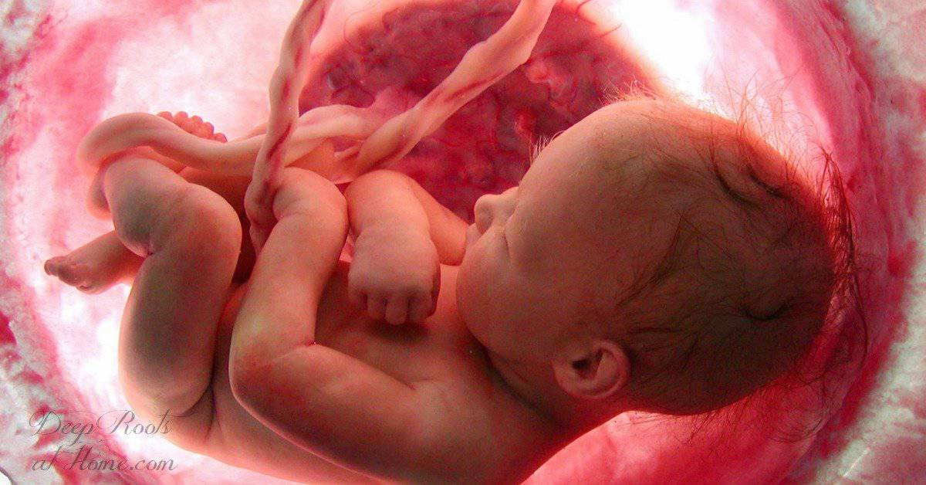
Do Babies Have Eternal Life?

Slide 2
How Should We Spiritually View Children
Where do they stand before God?

Slide 3
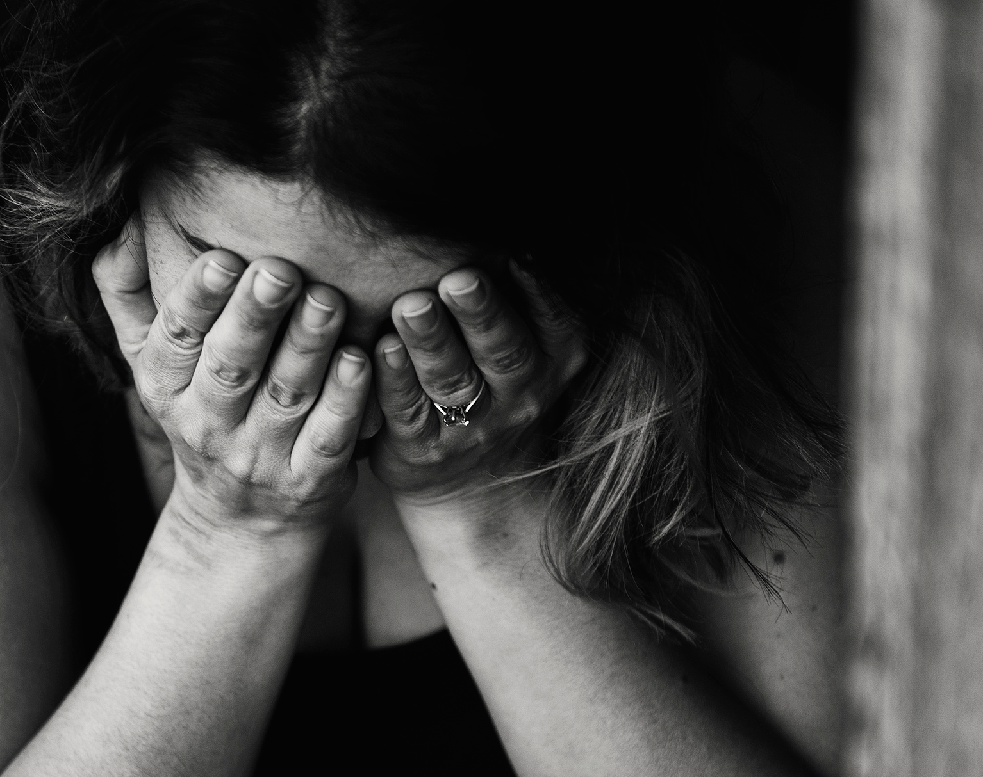
We live in a fallen, broken world where children die
What happens when they do?

Slide 4
Uncertainty Fills the Mind of Many Parents

Slide 5
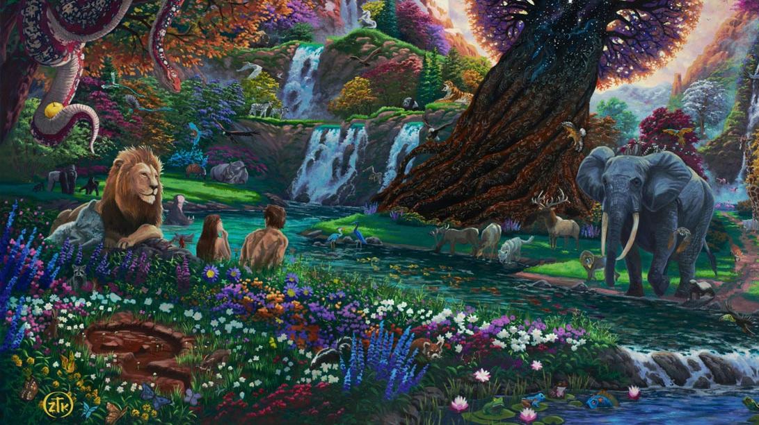
Mankind is Sinful by Nature Due to the Fall

Slide 6
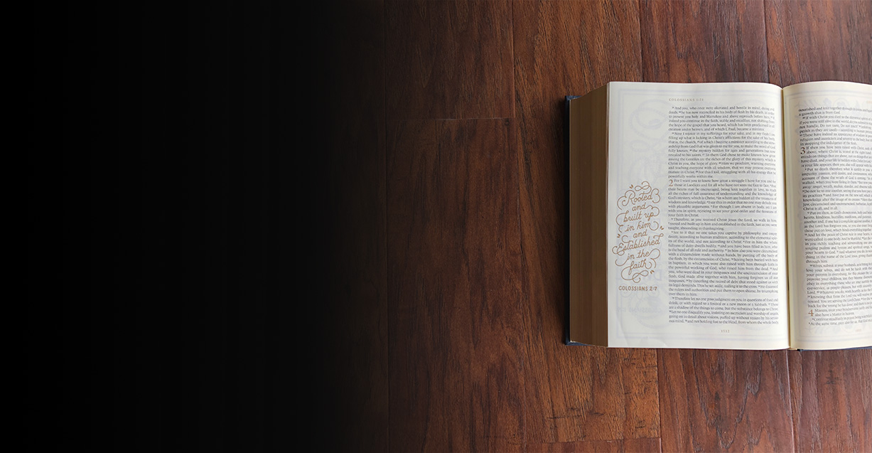
Psalm 51:5: “Behold, I was brought forth in iniquity, and in sin did my mother conceive me.”

Slide 7
Psalm 58:3 “The wicked are estranged from the womb; they go astray from birth…”

Slide 8
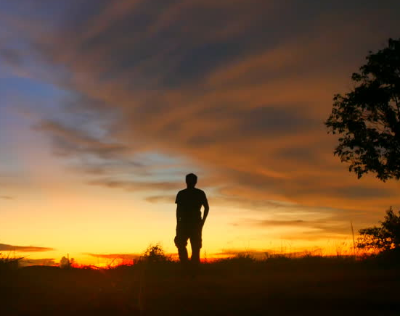
People are born into a sinful humanity and their nature is sinful to start
Original Sin is from conception

Slide 9
Then What Happens?

Slide 10
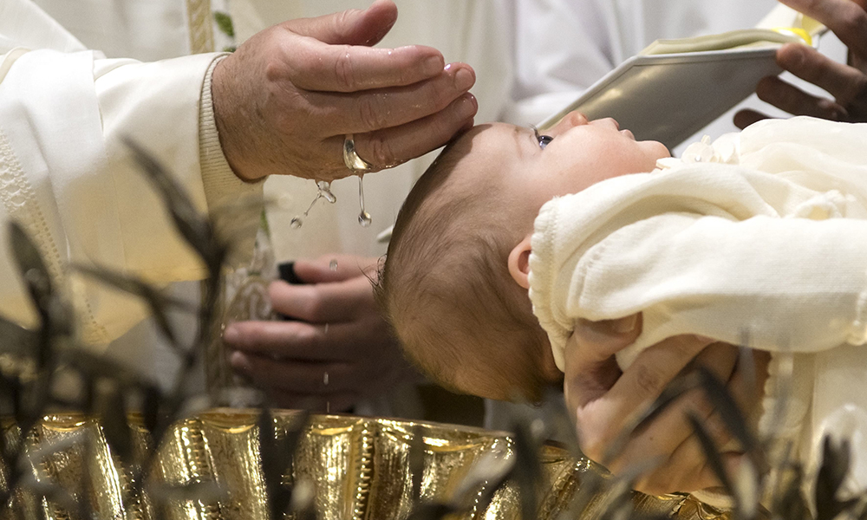
Catholics Baptize Babies to Remove Original Sin

Slide 11
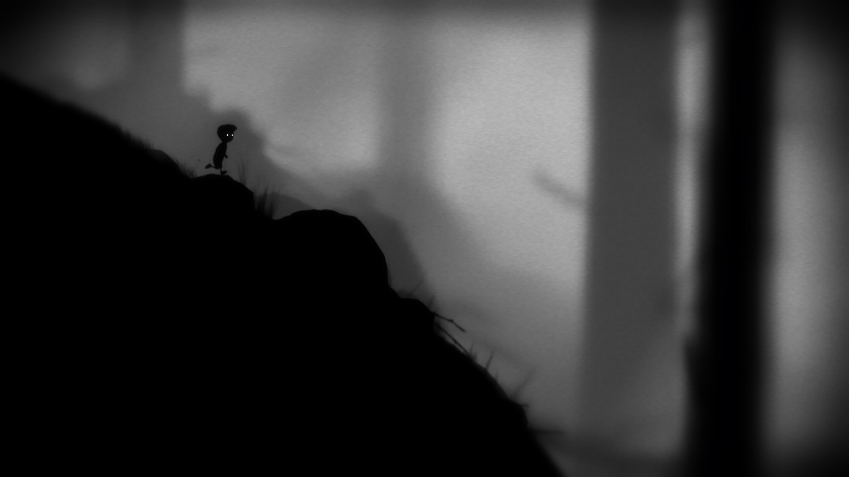
Limbo (not hell or heaven) is where unbaptized babies go

Slide 12
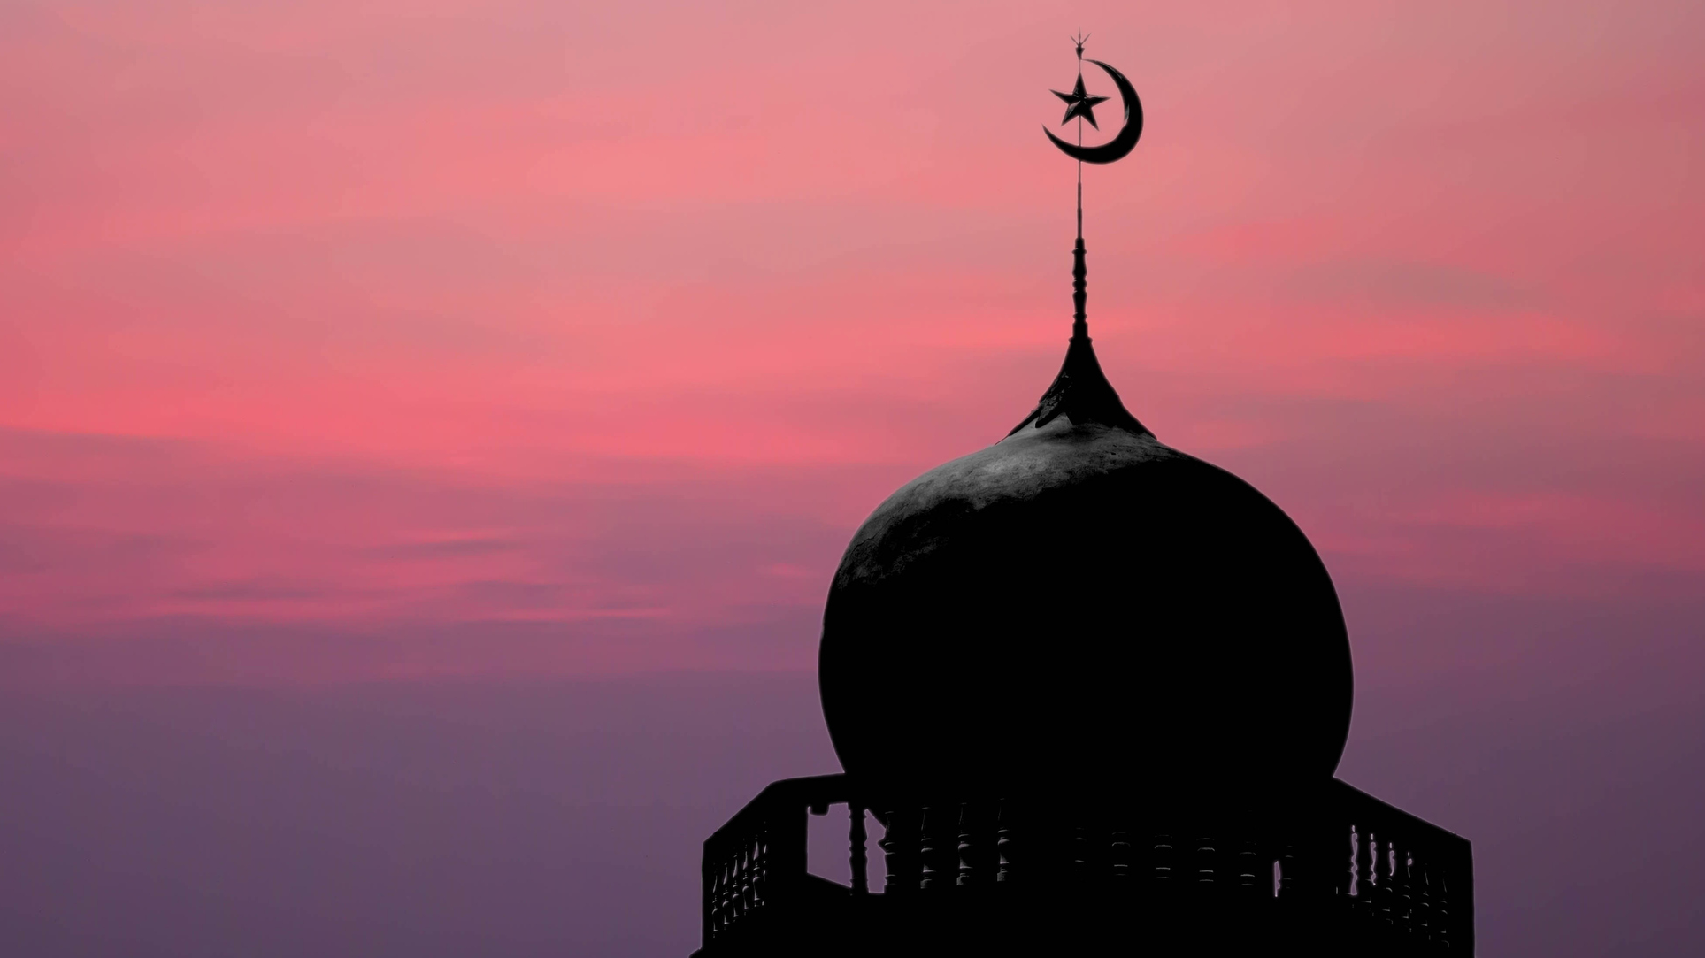
Islam has many views

Slide 13
What Does the Bible Say?

Slide 14
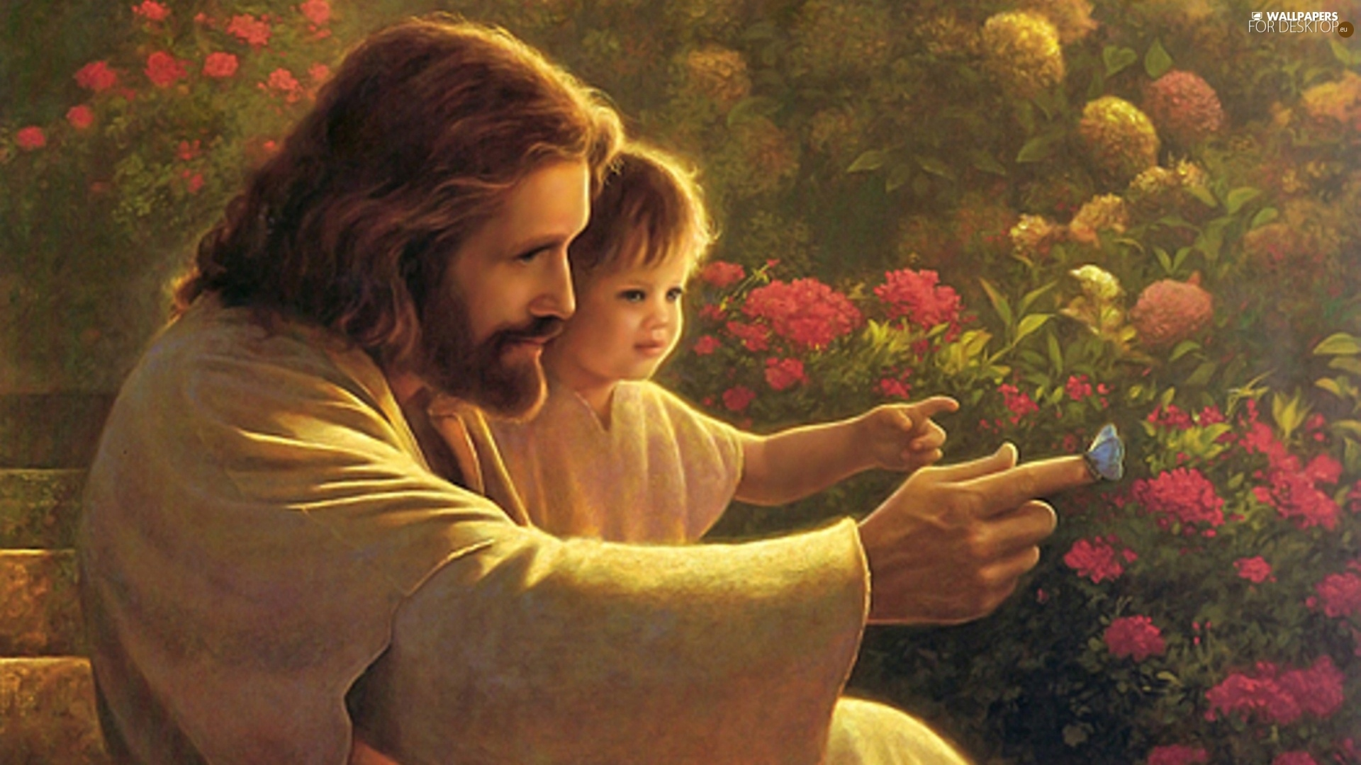
Children Who Die Immediately Go to Heaven

Slide 15
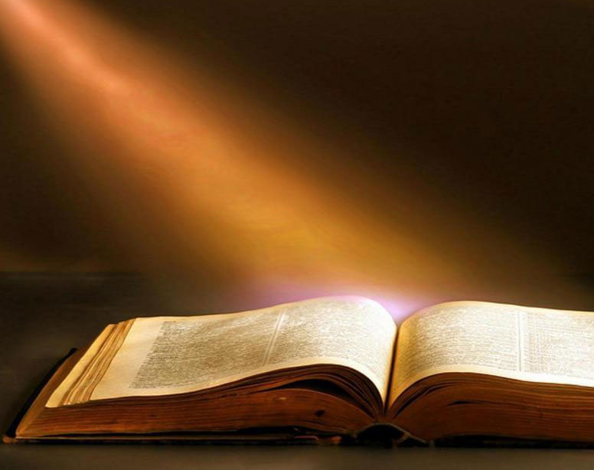
The Bible Gives Enough Details to Be Very Confident on This Issue
Five Evidences from the Bible

Slide 16
1. Contrasting the Death of David’s Sons

Slide 17
2 Samuel 12:23: “But now he is dead. Why should I fast? Can I bring him back again? I shall go to him, but he will not return to me.”

Slide 18
2 Samuel 18:33: “And the king was deeply moved and went up to the chamber over the gate and wept. And as he went, he said, “O my son Absalom, my son, my son Absalom! Would I had died instead of you, O Absalom, my son, my son!”

Slide 19
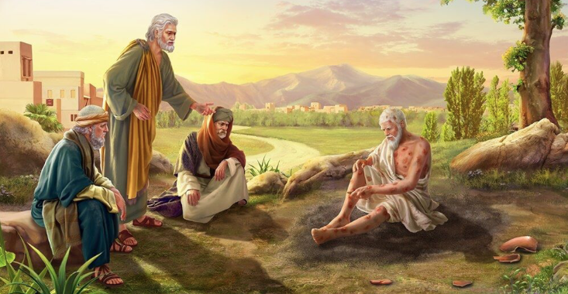
Same type of inference is made with Job’s reward

Slide 20
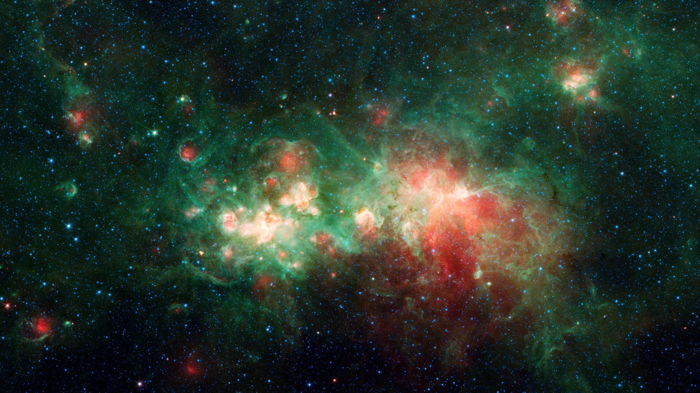
2. Condemnation is Based on Willful Rejection

Slide 21
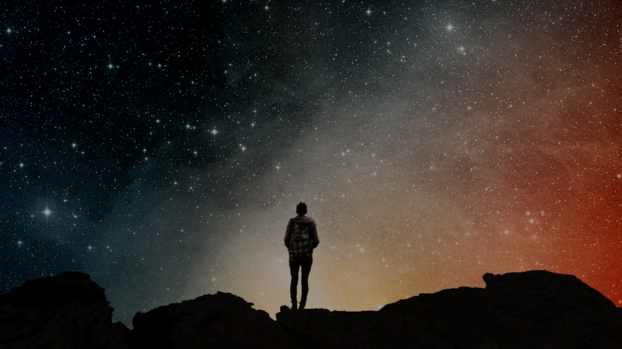
Romans 1 tells us people are without excuse due to suppressed knowledge

Slide 22
Romans 1:18-21: “For the wrath of God is revealed from heaven against all ungodliness and unrighteousness of men, who by their unrighteousness suppress the truth. ¹⁹ For what can be known about God is plain to them, because God has shown it to them. For his invisible attributes, namely, his eternal power and divine nature, have been clearly perceived, ever since the creation of the world, in the things that have been made. So they are without excuse. ²¹ For although they knew God…”

Slide 23
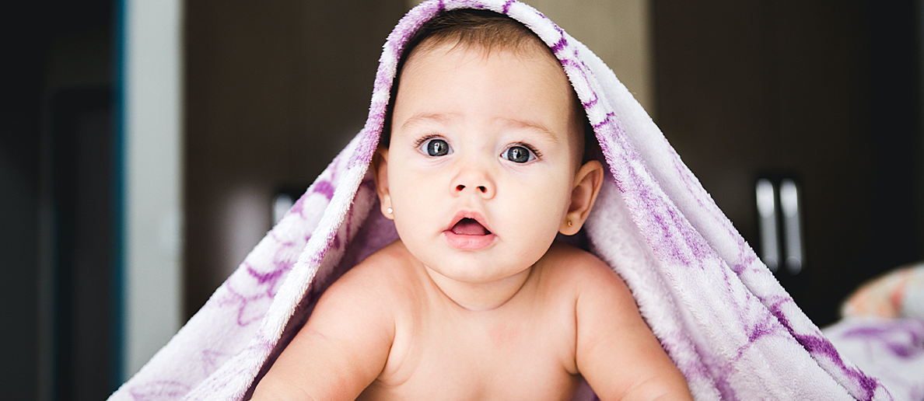
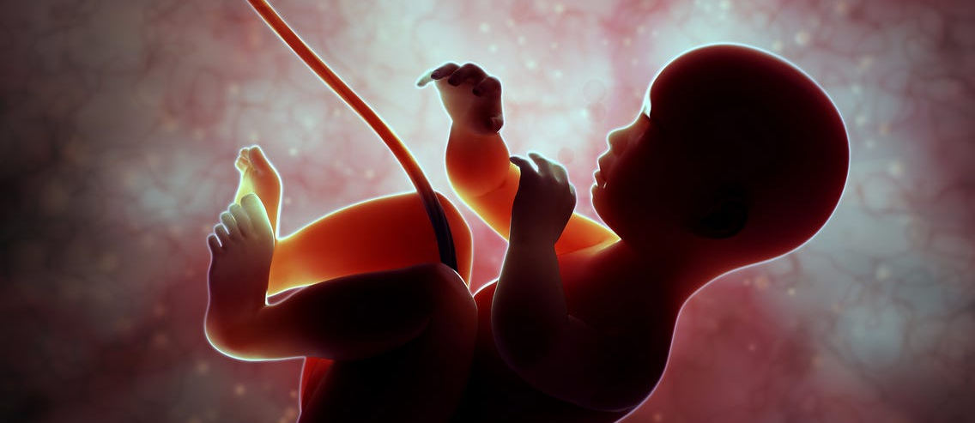
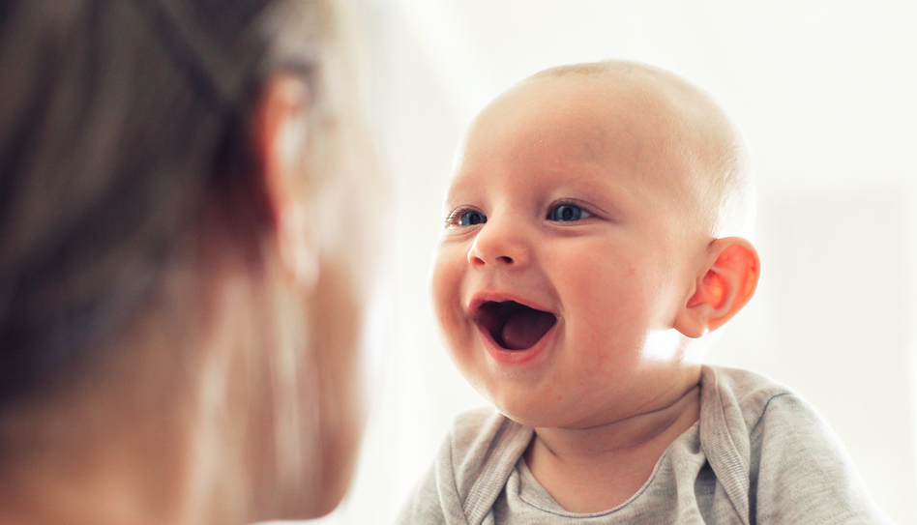

Slide 24
3. Jesus Has a High View of Children

Slide 25
Matthew 19:13-14: “Then children were brought to him that he might lay his hands on them and pray. The disciples rebuked the people, ¹⁴ but Jesus said, “Let the little children come to me and do not hinder them, for to such belongs the kingdom of heaven.”

Slide 26
4. The Bible Supports An Age of Accountability

Slide 27
Deuteronomy 1:39:
“And as for your little ones, who you said would become a prey, and your children, who today have no knowledge of good or evil, they shall go in there. And to them I will give it, and they shall possess it.”

Slide 28
Jeremiah 19:4: “Because the people have forsaken me and have profaned this place by making offerings in it to other gods whom neither they nor their fathers nor the kings of Judah have known; and because they have filled this place with the blood of innocents”

Slide 29
Jonah 4:11:
“And should not I pity Nineveh, that great city, in which there are more than 120,000 persons who do not know their right hand from their left, and also much cattle?”

Slide 30
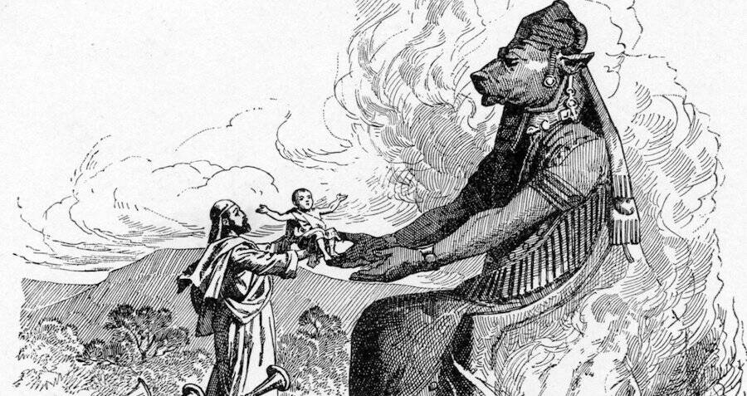
5. God Identified Children as His Own

Slide 31
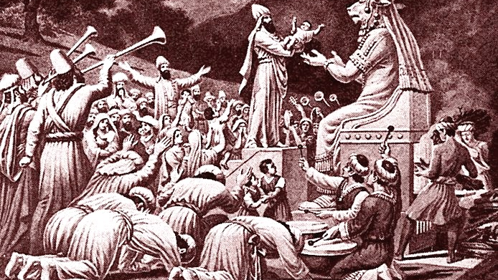
God Makes the Following Statement About Pagans

Slide 32
Ezekiel 16:20-21: “And you took your sons and your daughters, whom you had borne to me, and these you sacrificed to them to be devoured. Were your whorings so small a matter that you slaughtered my children and delivered them up as an offering by fire to them?”

Slide 33
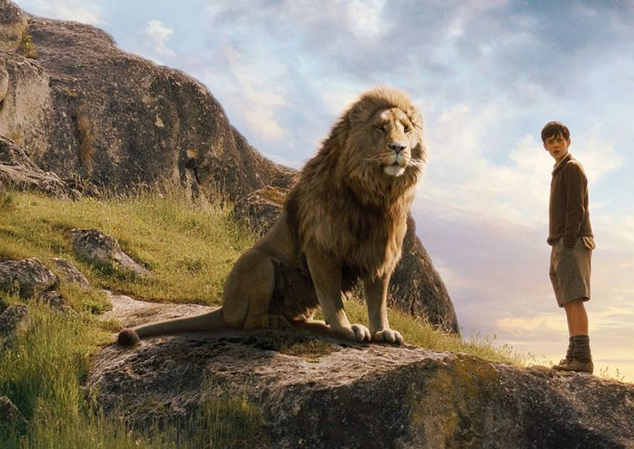
“And has He spoke He no longer looked to them like a lion; but the things that began to happen after that were so great and beautiful that I cannot write them. And for us this is the end of all the stories, and we can most truly say that they all lived happily ever after. But for them it was only the beginning of the real story. All their life in this world and all their adventures in Narnia had only been the cover and the title page: now at least they were beginning Chapter One of the Great Story, which no one on earth has read: which goes on forever: in which every chapter is better than the one before.”
– C.S. Lewis the Last Battle

Slide 34
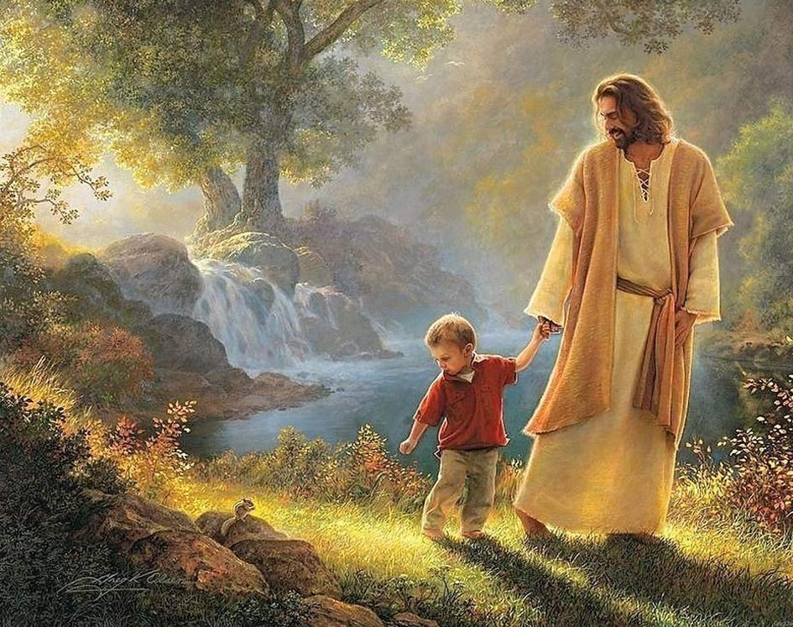
We will be surprised how many babies and children are in heaven

