Slide 1
Is it bad to be narrow in your views on religion and eternal life?

Slide 2
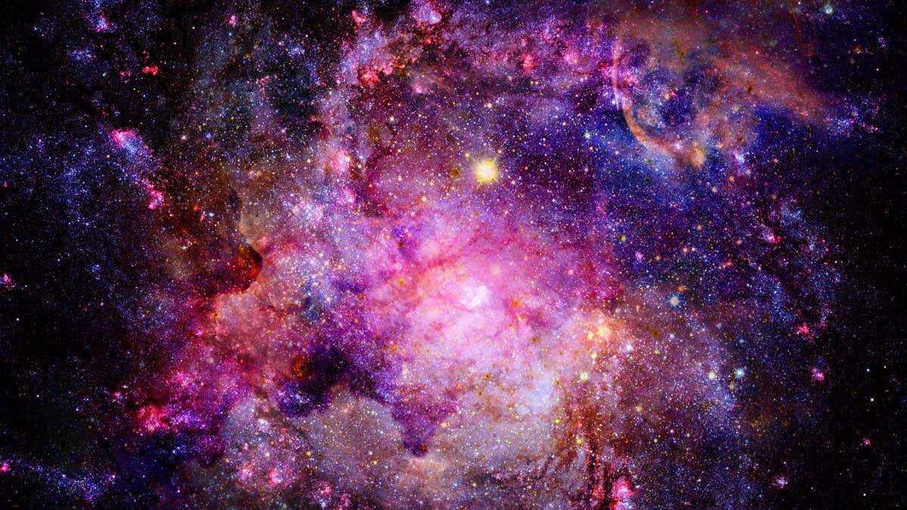
Many Claim to Be the Only Way

Slide 3
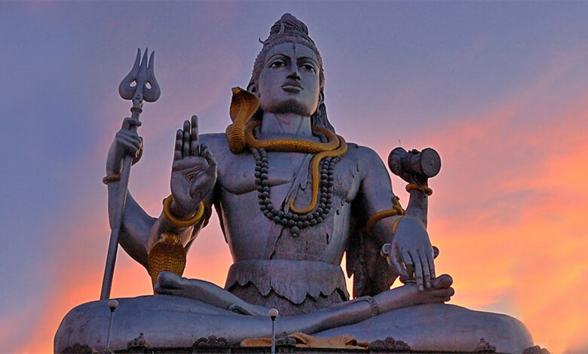
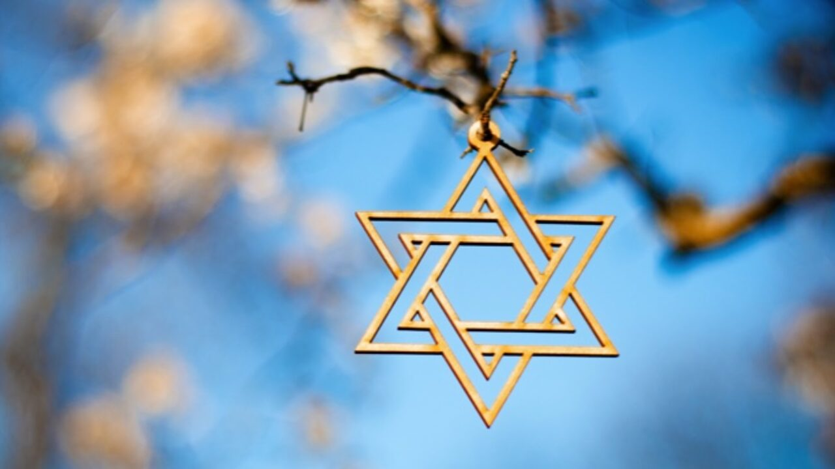
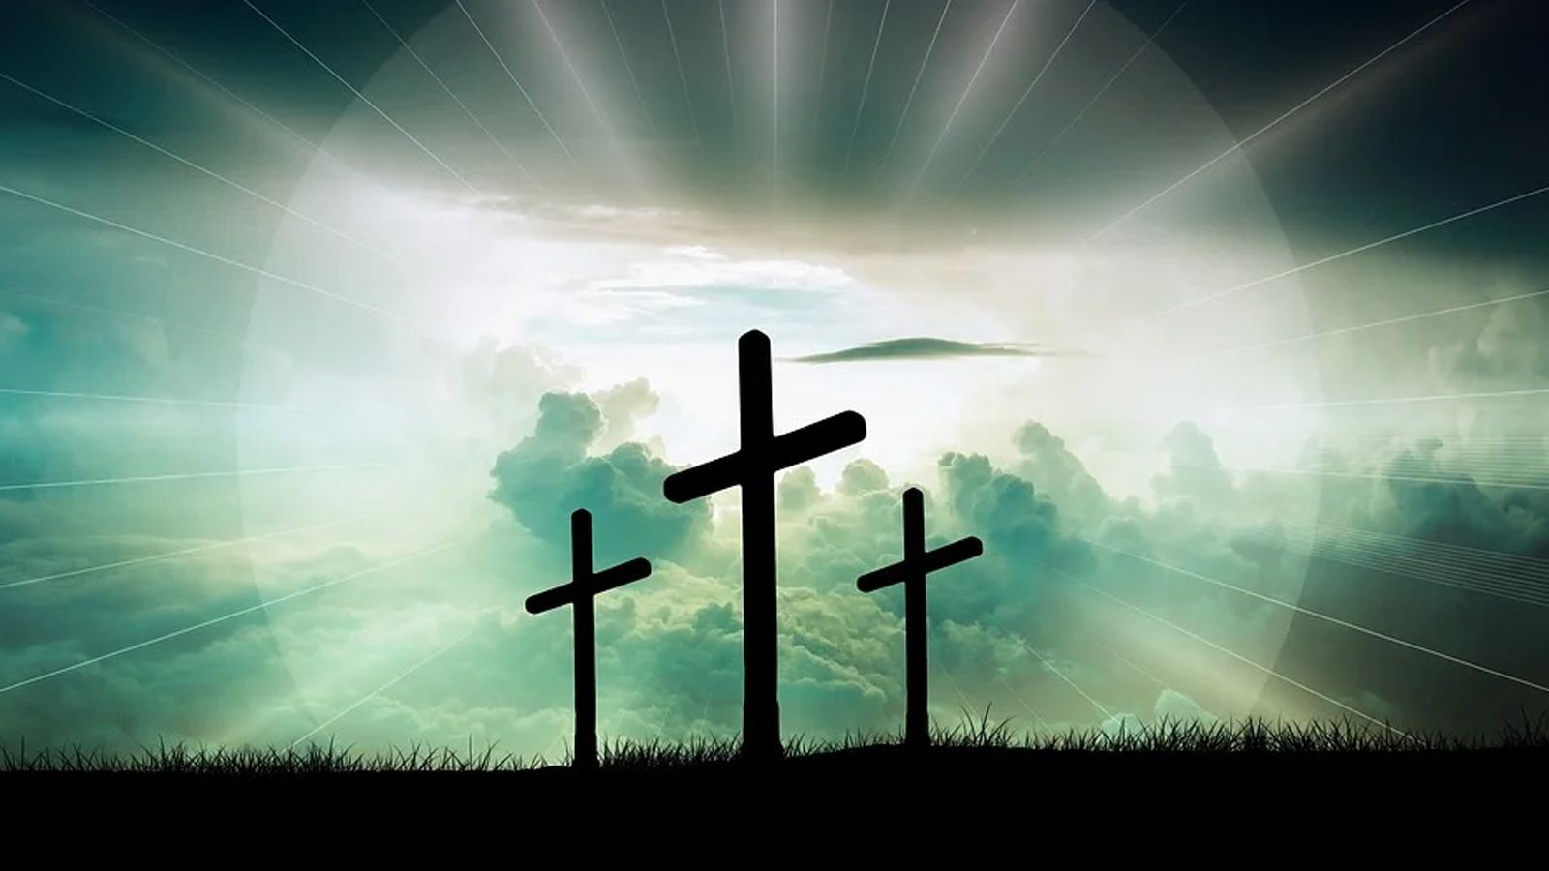
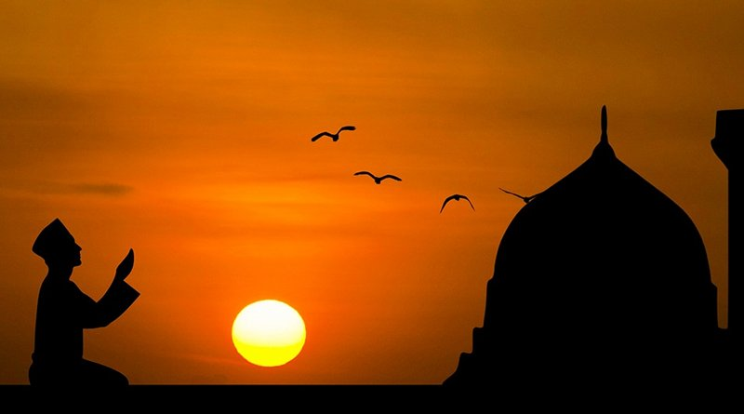

Slide 4
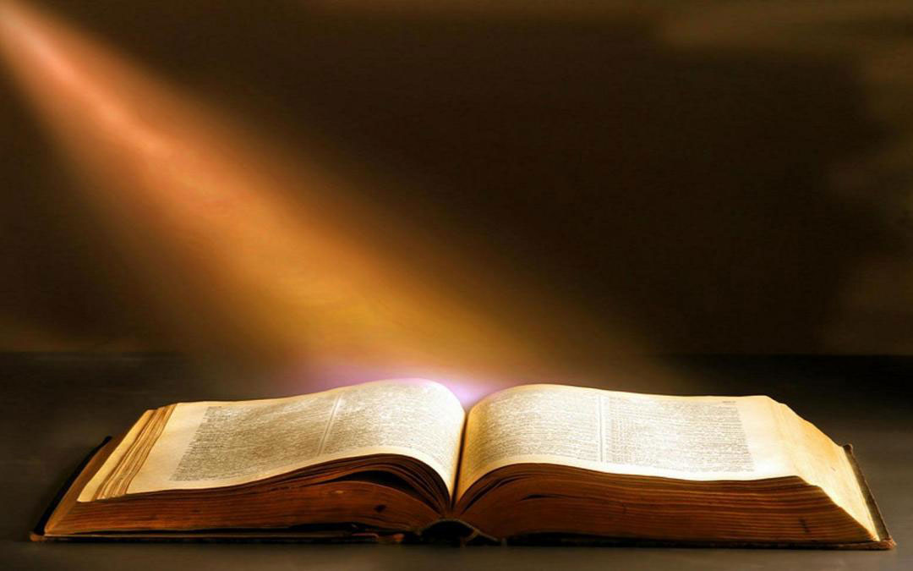
Matthew 7:14: “For the gate is narrow and the way is hard that leads to life, and those who find it are few.”

Slide 5
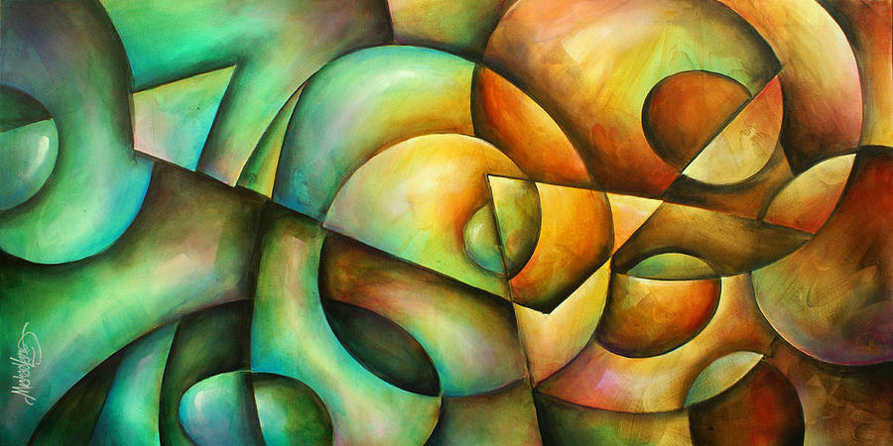
They can’t all be right… they contradict each other dramatically

Slide 6
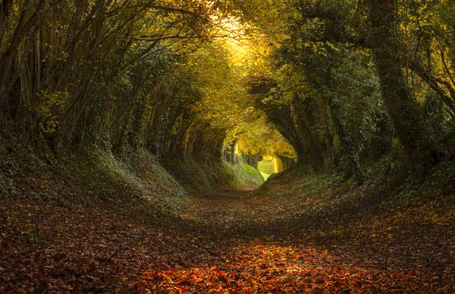
Atheism is also a Narrow Claim

Slide 7
You Live Your Life Everyday by Narrow Minded Decisions

Slide 8
Medical Choices are very narrow at times in order to save lives

Slide 9
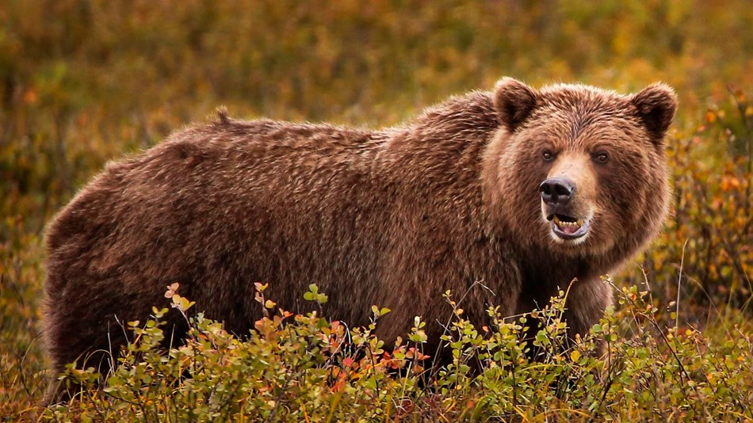
Are you narrow minded about petting bears?

Slide 11
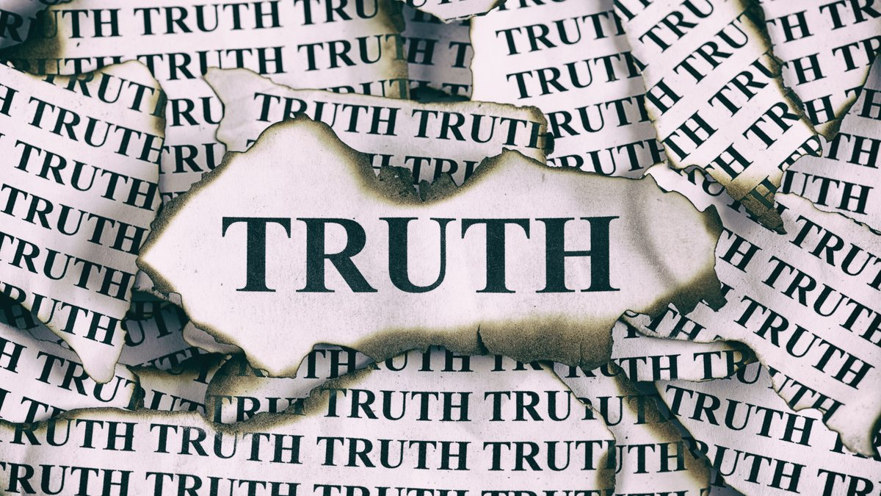

Slide 13
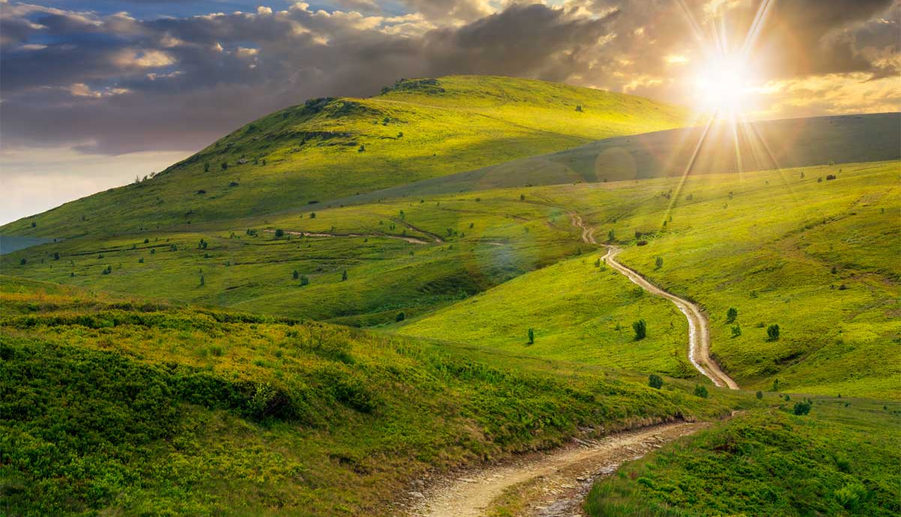
Being narrow isn’t wrong if you’re right and have the truth…

Slide 15
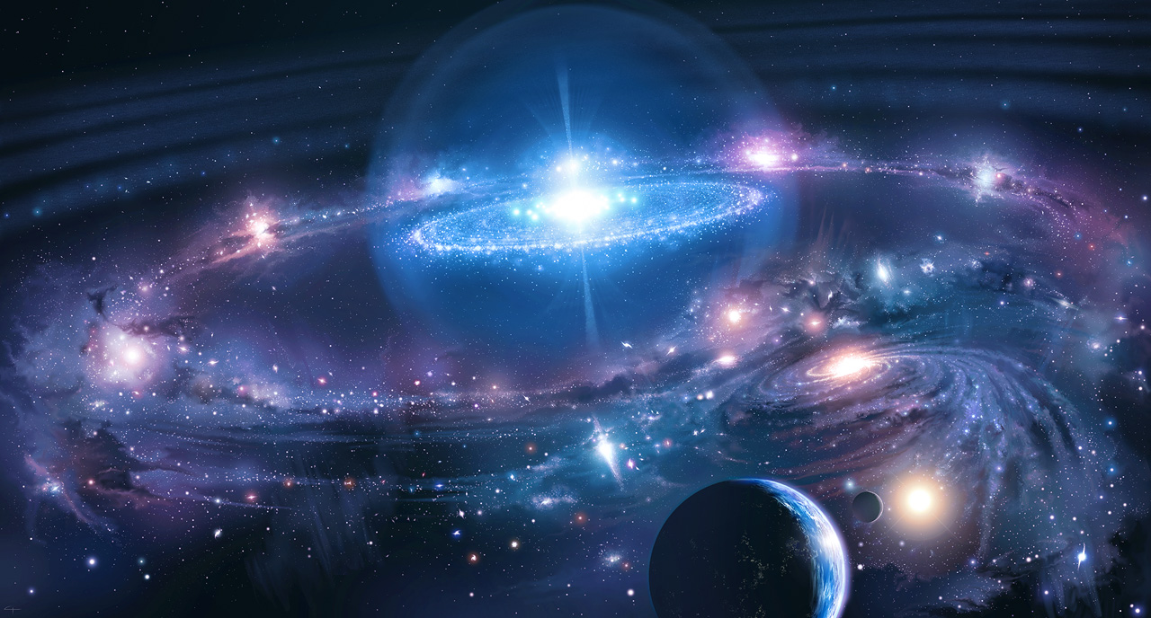
Eternity is On the Line: It’s Worth the Search

Slide 16
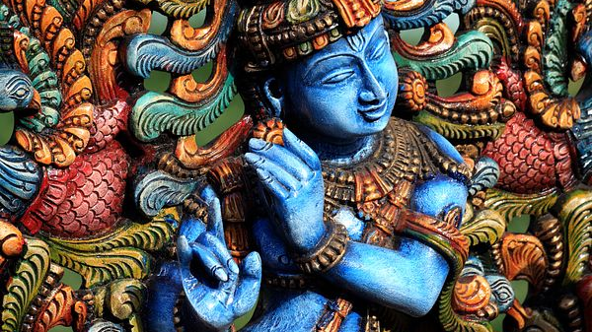
1. Hinduism

Slide 17
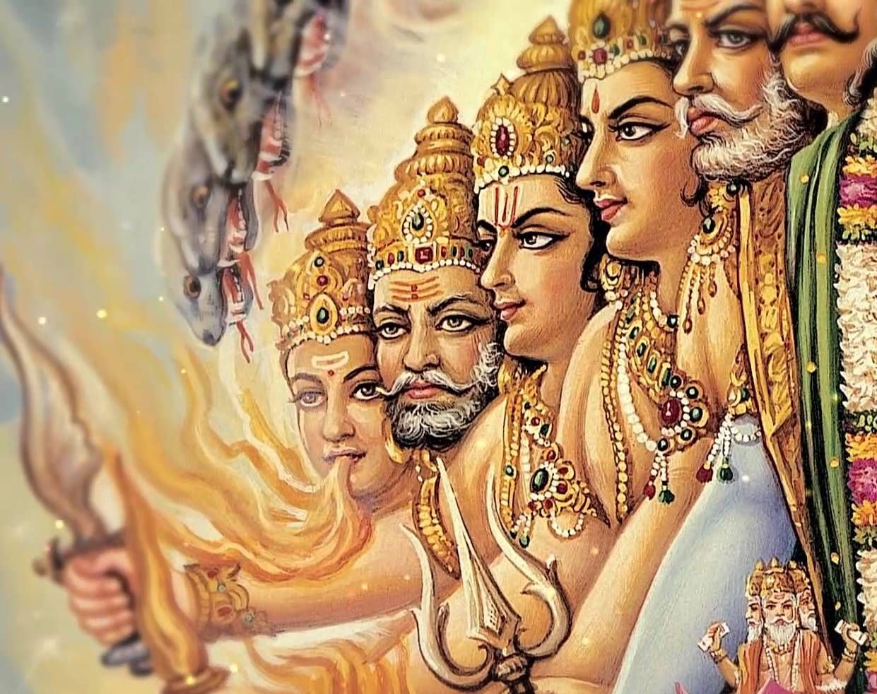
Began a few hundred years after the Tower of Babel 1,700 BC
Roughly the time of Abraham

Slide 18
Began in India, Largely Stayed in India

Slide 19
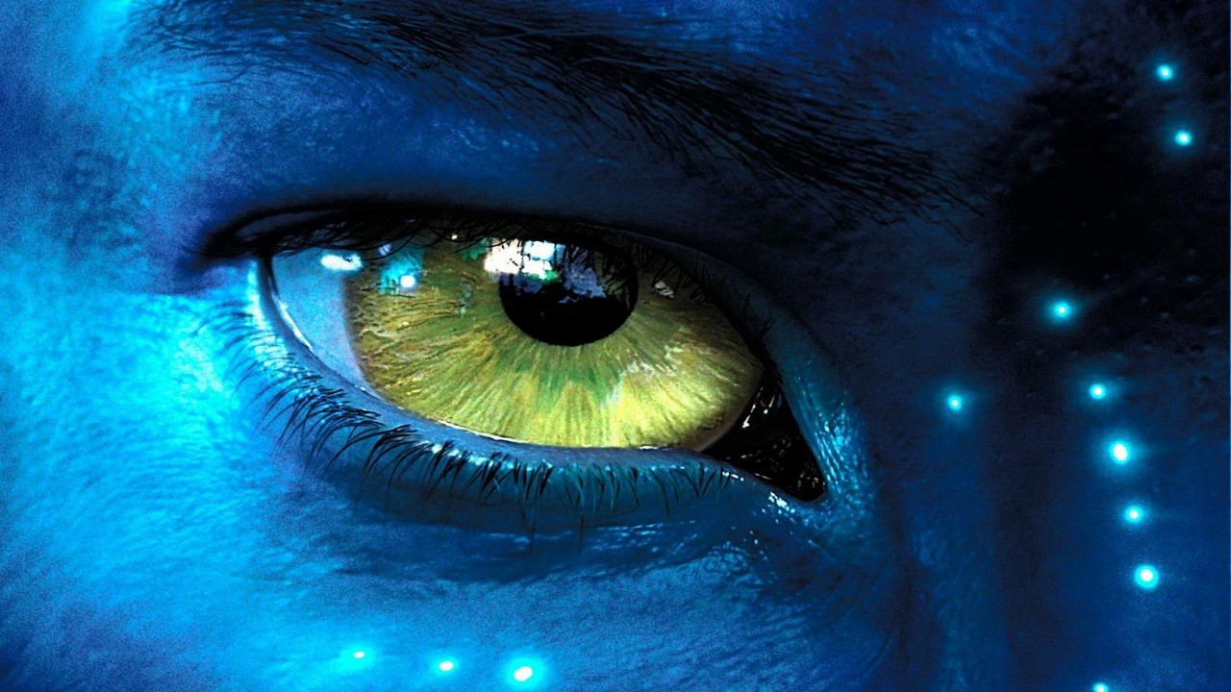
Pantheistic in Their Belief

Slide 20
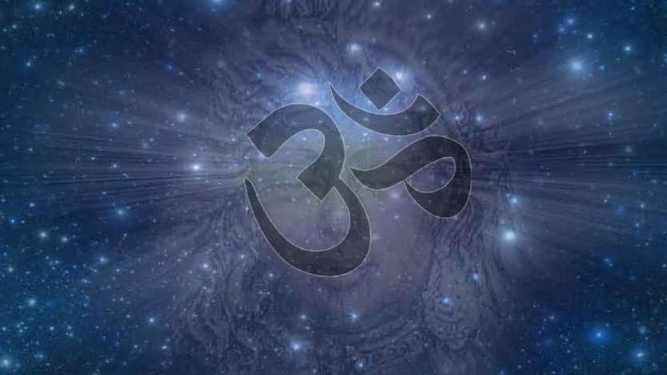
Brahman is the name of the impersonal “god”

Slide 21
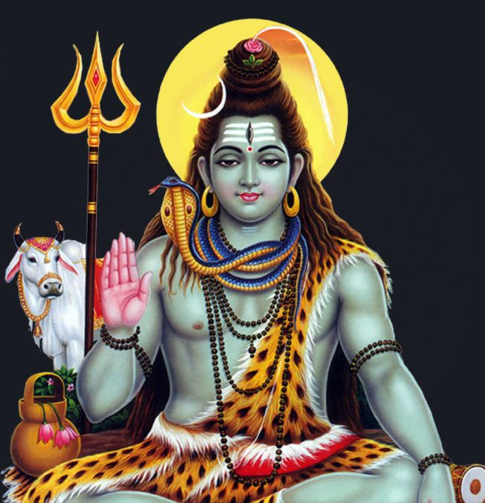
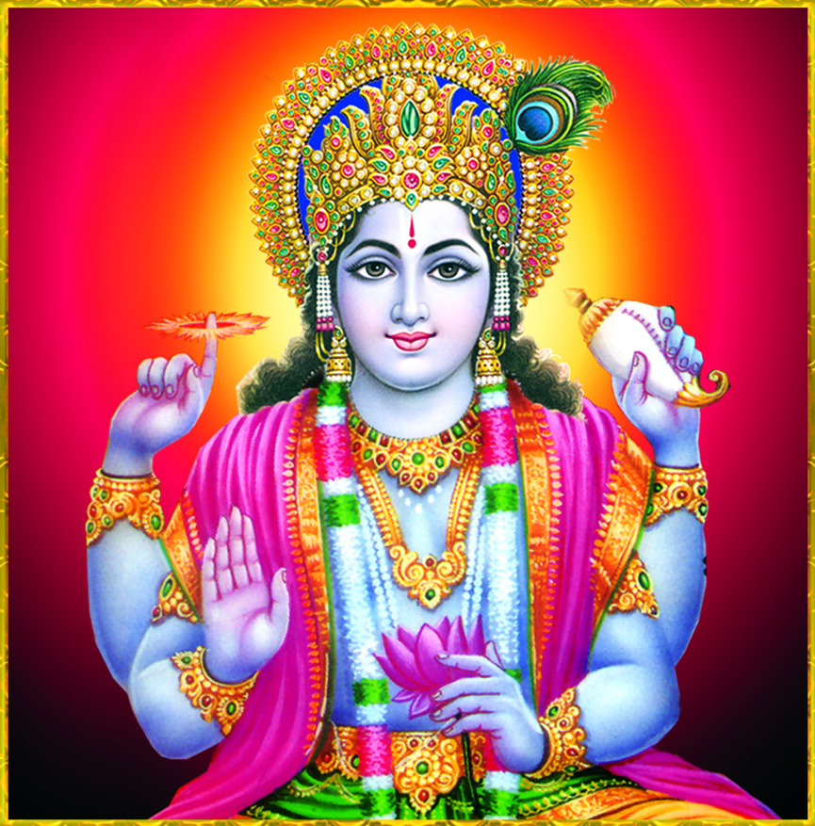
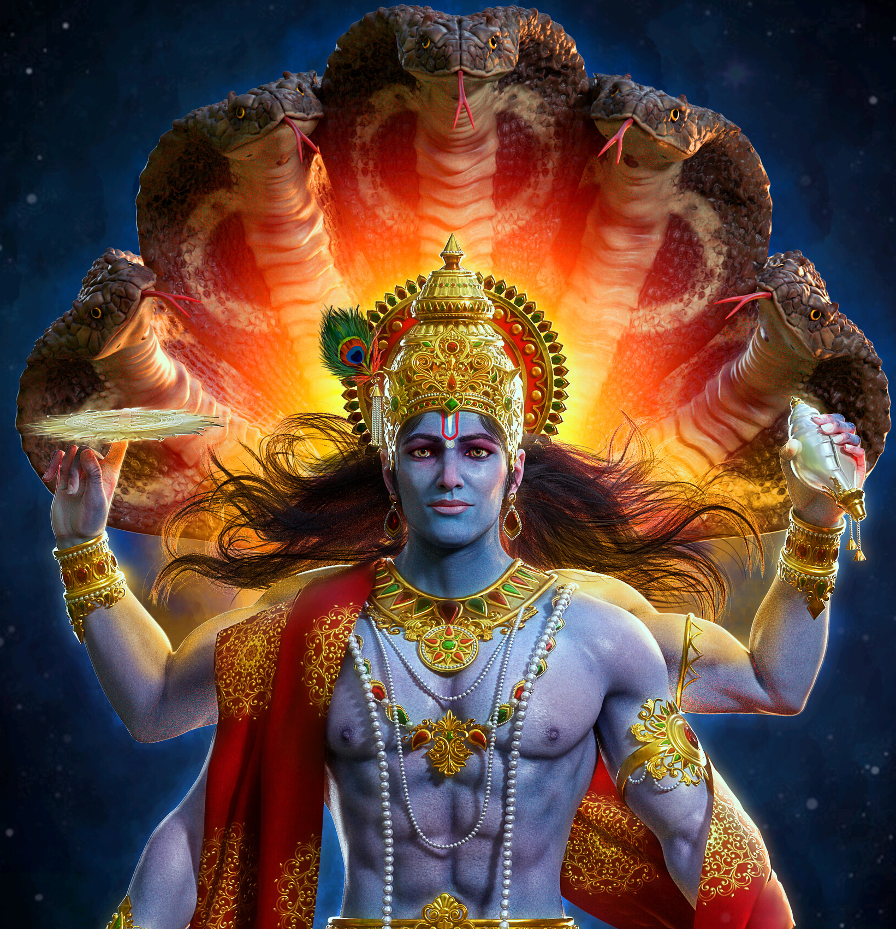
Brahman is Personified in Three “gods”
Vishnu, Shiva, and Brahma

Slide 22
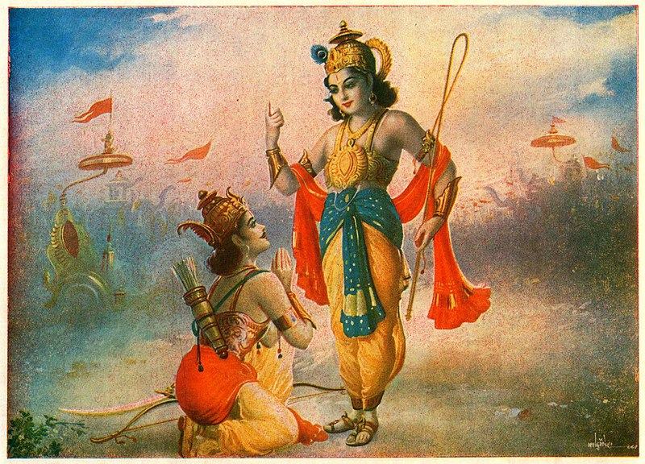
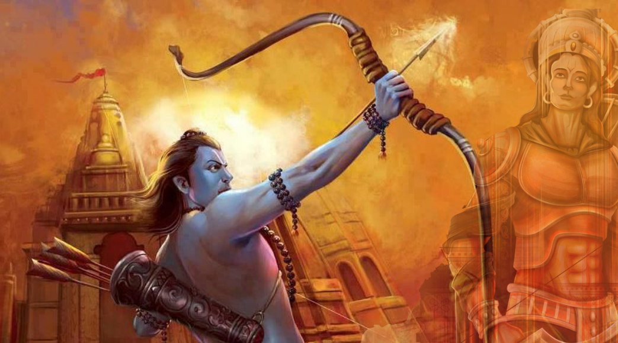
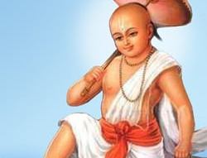

Slide 23
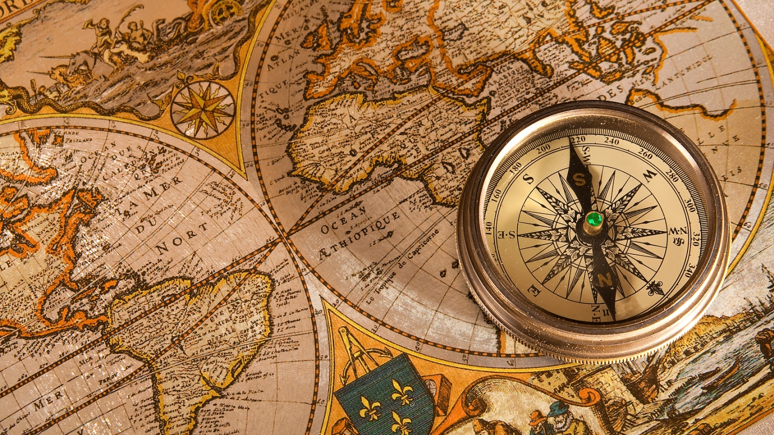
Myths Without Historical Support

Slide 24
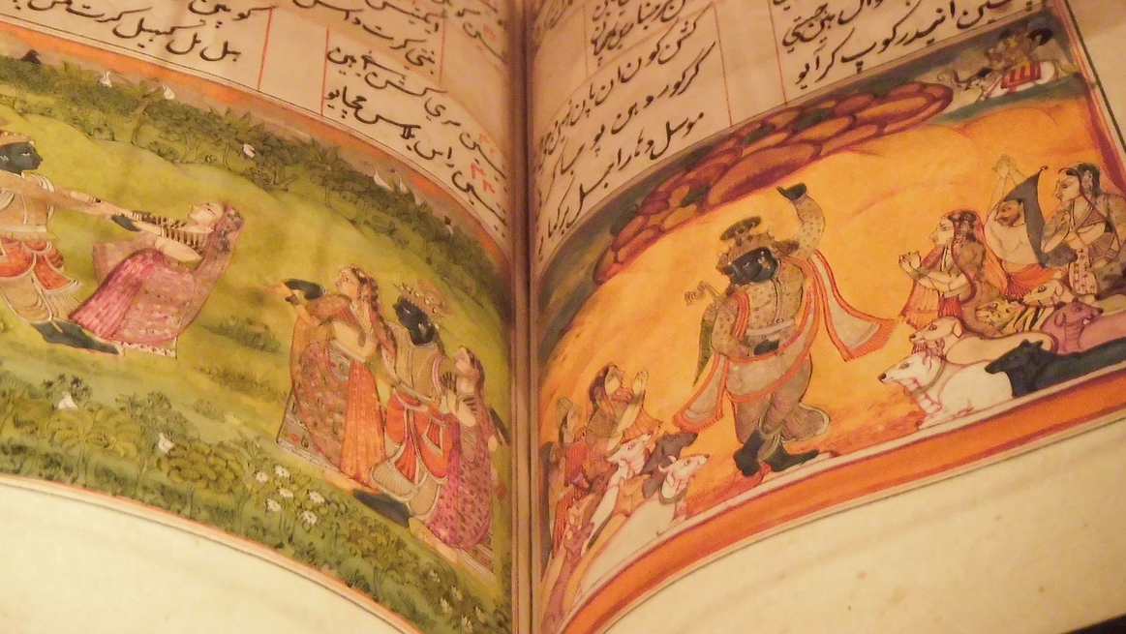
Just a Collection of Myths of Unknown Origins

Slide 25
What About Pantheism?

Slide 26
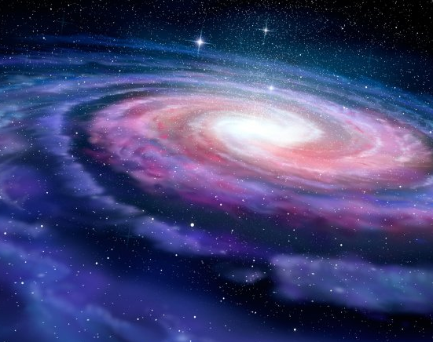
Pantheism Doesn’t Make Much Sense with Logic and Science
Cosmological Argument Contradicts Pantheism

Slide 27
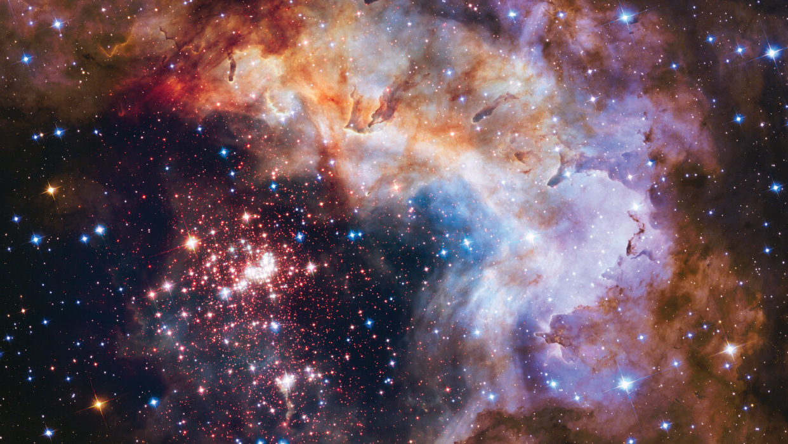
If the universe once didn’t exist and requires a cause, it can’t be divine

Slide 28
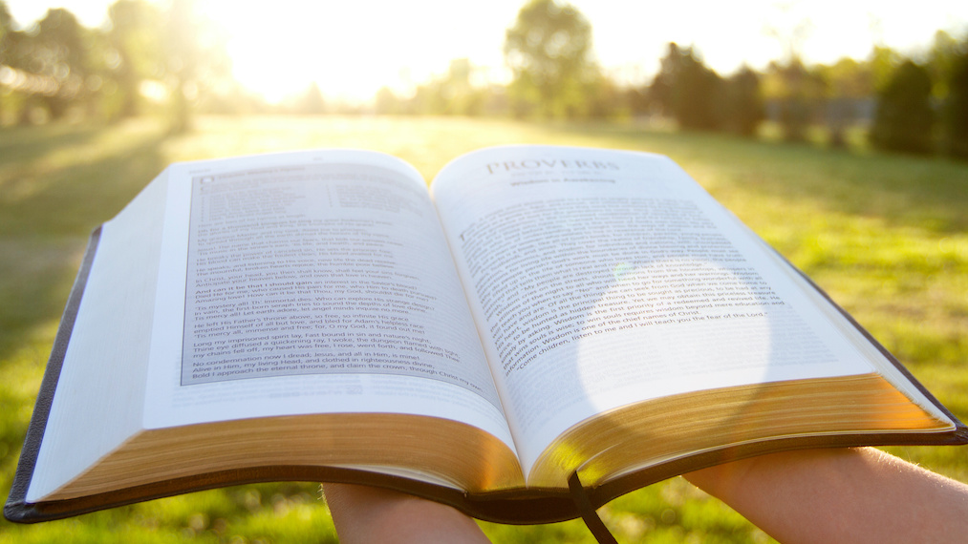
Hinduism is Contrary to the Biblical View

Slide 29
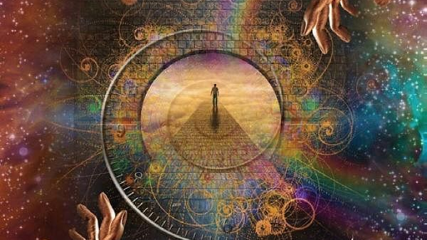
The Bible Speaks of a Personal God

Slide 30
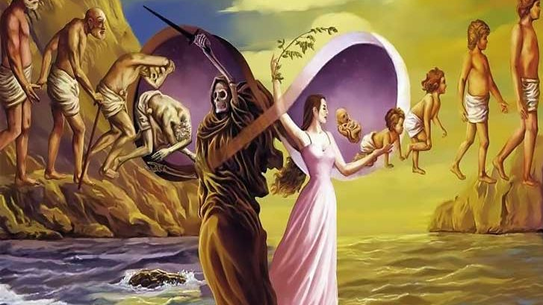
Hinduism Teaches Reincarnation

Slide 31
Hebrews 9:27: “And just as it is appointed for man to die once, and after that comes judgment”

Slide 32
Hinduism Says Afterlife is Based on Karma in this life…

Slide 33
Ephesians 2:8: ”For by grace you have been saved through faith. And this is not your own doing; it is the gift of God”

Slide 34
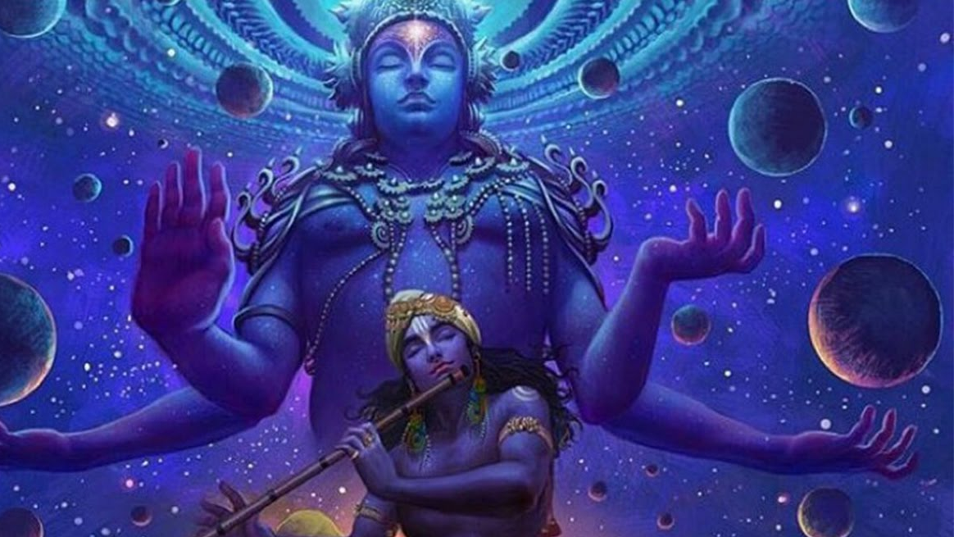
Hinduism Says the Personal Identity is an Illusion, because all is one

Slide 35
The Bible Says the World is Real and Exists

Slide 37
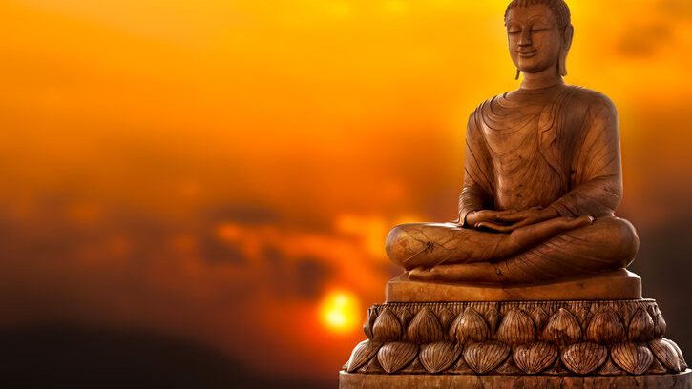
Hundreds of Years After Hinduism
Began it Gave Rise to Buddhism

Slide 38
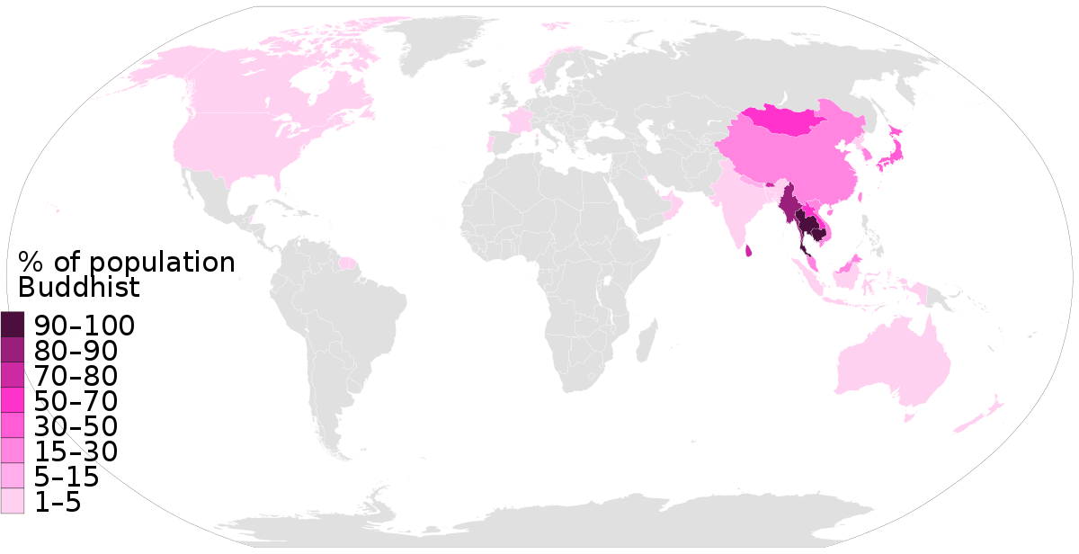

Slide 39
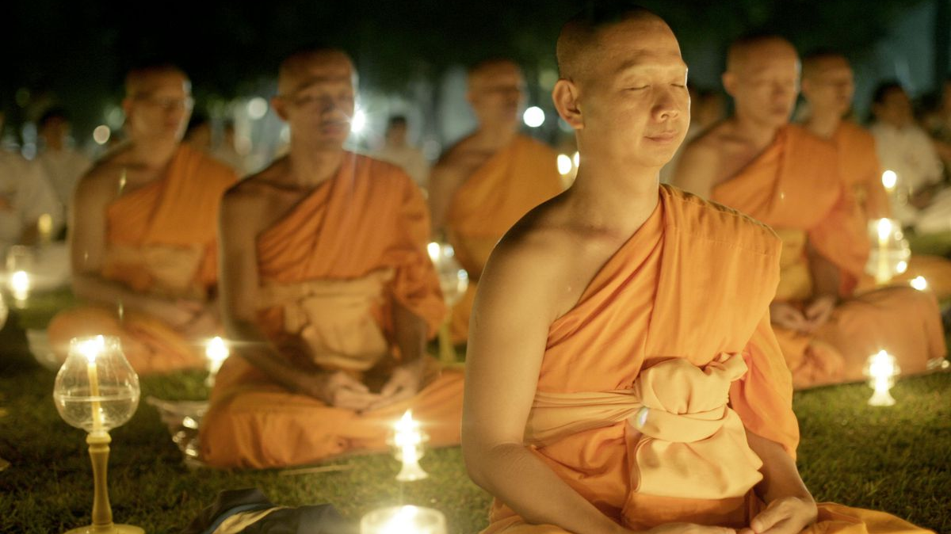
500,000,000 + Buddhists Worldwide

Slide 40
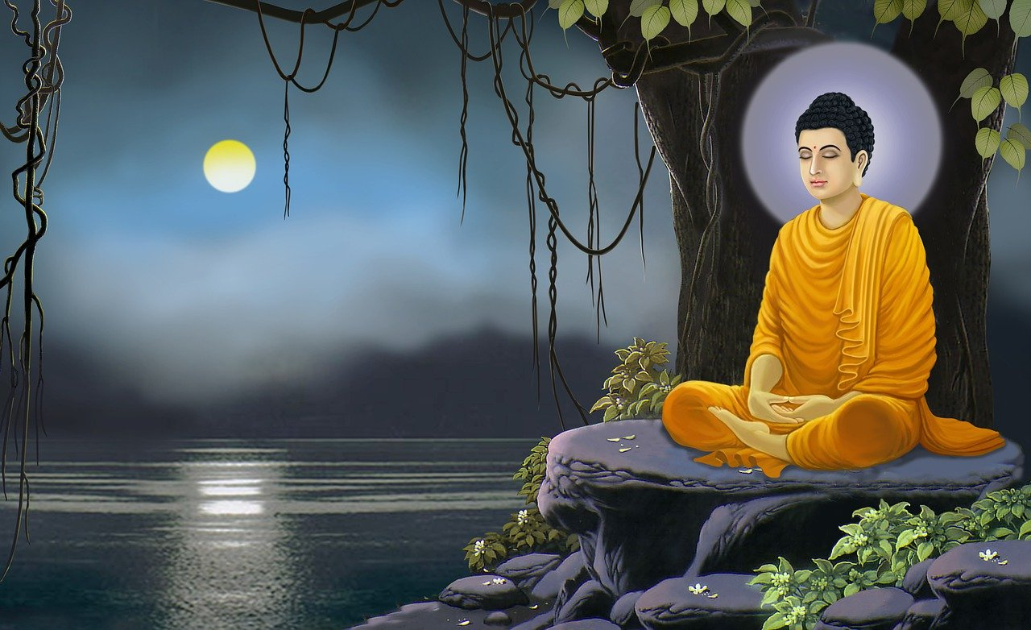
Not All Buddhist Are the Same: Three Major Divisions Exist…

Slide 41
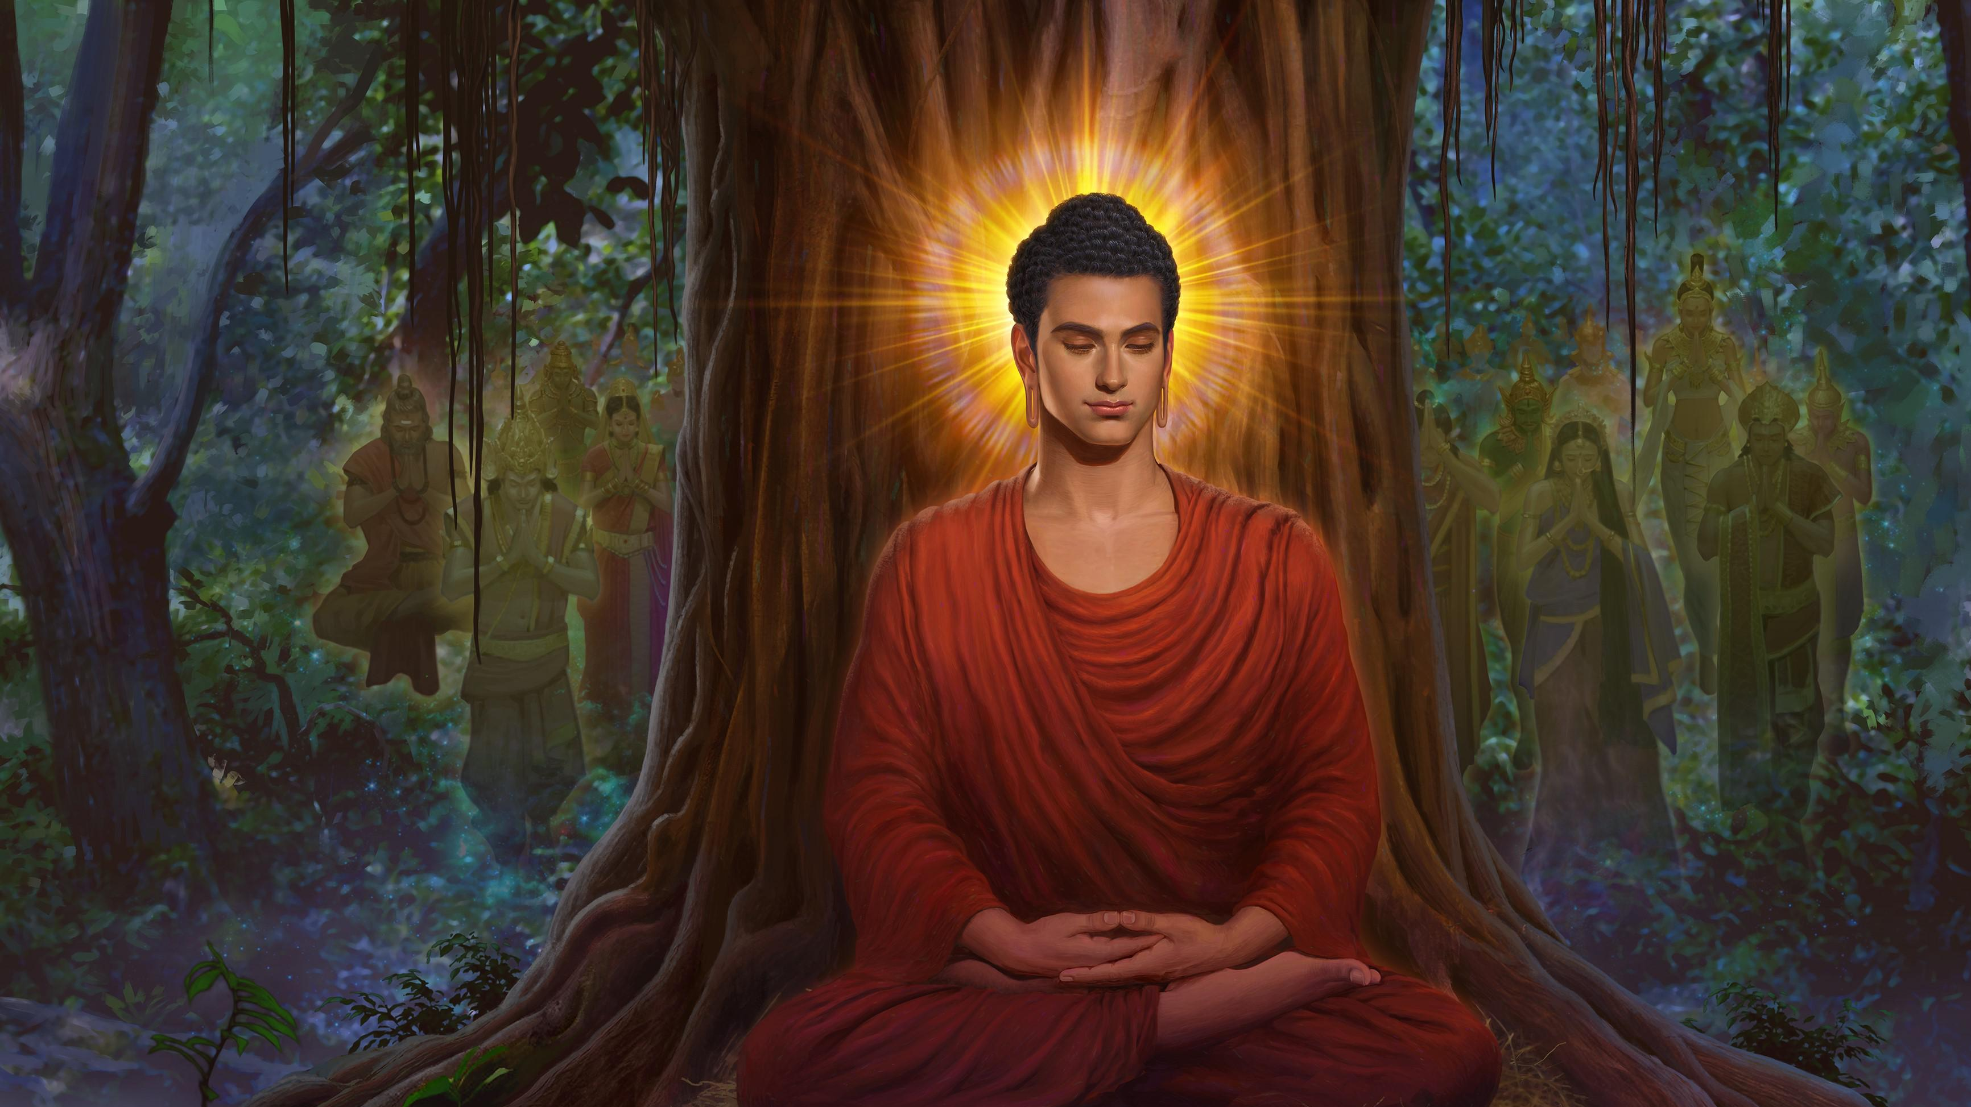
Siddhartha Gautama (Buddha) lived 563-483 B.C. and started out a Hindu

Slide 42
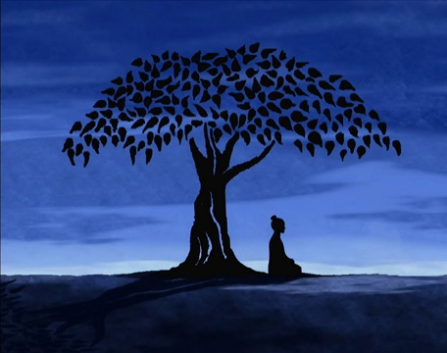
Beliefs…
Buddhism is Similar but Different than those of Hindu’s

Slide 43
Siddhartha was born into a warrior cast and was sheltered by his father from the suffering of the world beyond his wealthy tribe and the home where he lived

Slide 44
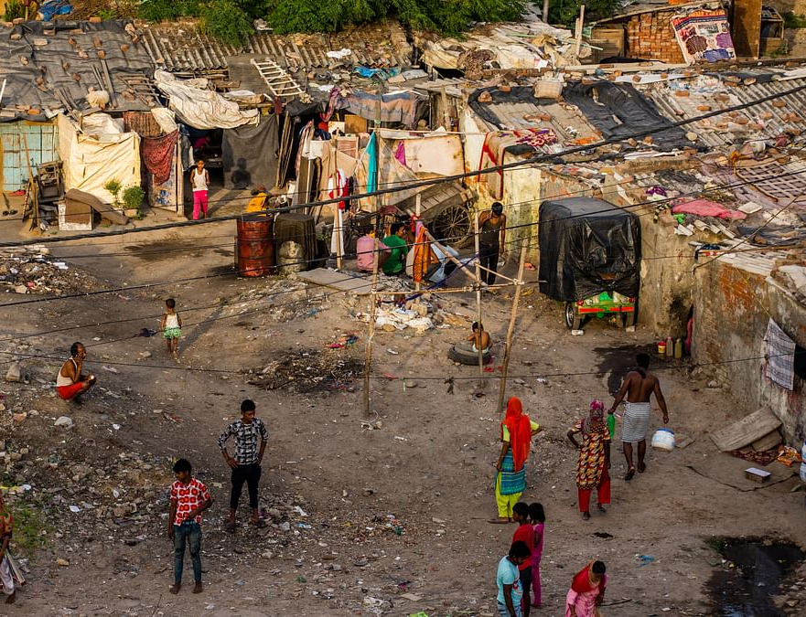
Eventually he ran off exploring
When away, he saw the suffering many people faced, and began to struggle with the idea…

Slide 45
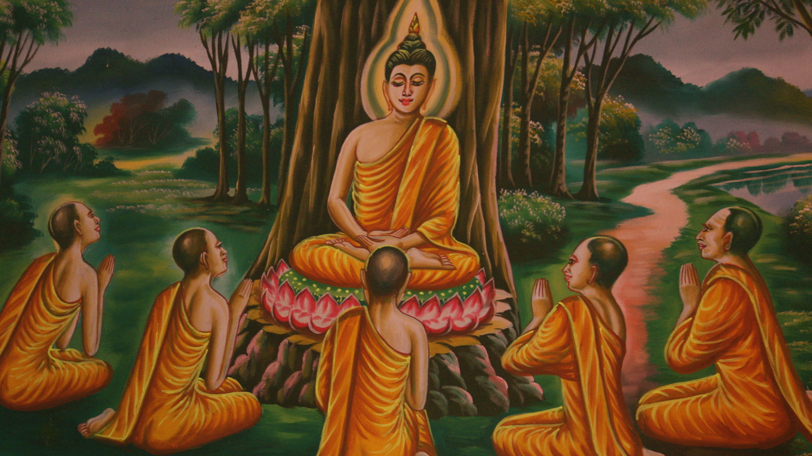
He Abandoned His Wealth and Family to Live a Life of Aestheticism

Slide 46
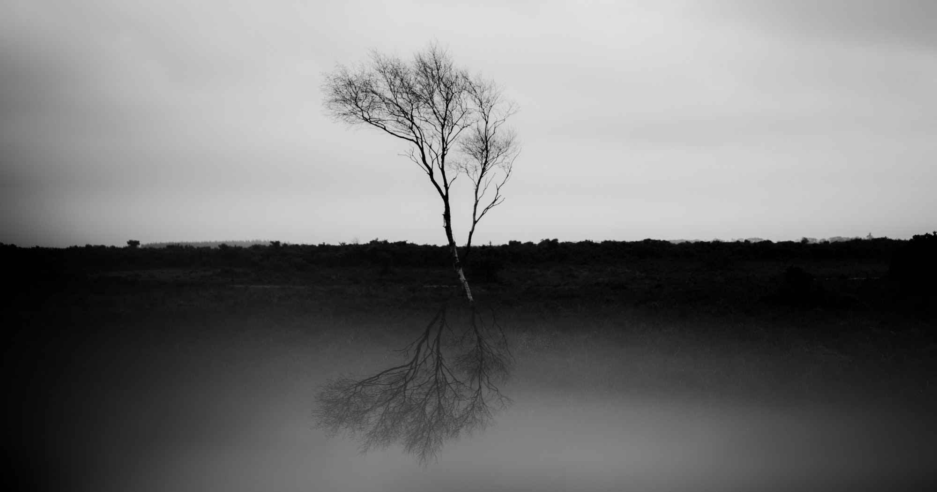
His Goal was to Discover the Source of Suffering

Slide 47
He then sat under a tree and said he wouldn’t rise until he solved it

Slide 48
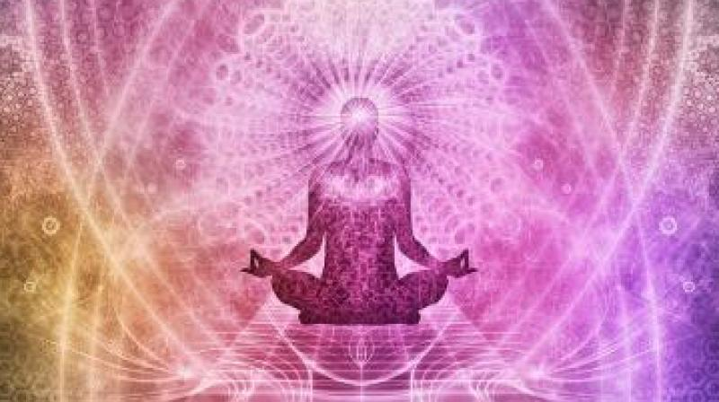
Buddha called the solution to suffering the Middle Way

Slide 49
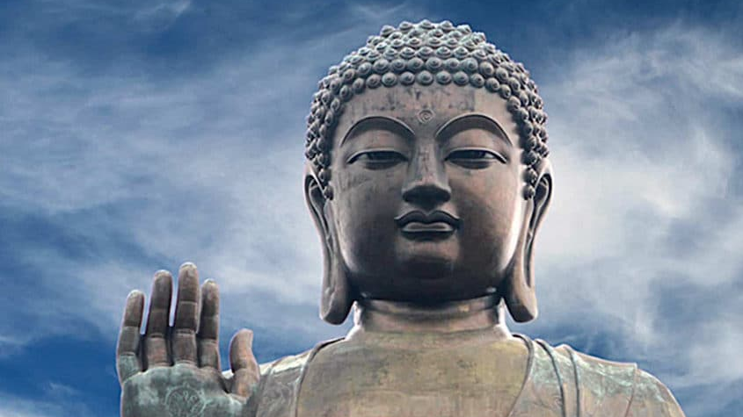
Buddha teaches the “Four noble truths”
1 - Life is suffering
2- Suffering is caused by desire.
3 - The cessation of desire eliminates suffering.
4 – The stopping of desire comes by following “The Middle Way” between the extremes of sensuousness and asceticism

Slide 50
Buddhist must follow the eight-fold path

Slide 51
Right view (Understanding the four noble truths)

Slide 52
Right resolve (Decision to observe and follow them)

Slide 53
Right speech (Practical actions to avoid the desires in this life that produce suffering)

Slide 54
Right action (Practical actions to avoid the desires in this life that produce suffering)

Slide 55
Right livelihood (Practical actions to avoid the desires in this life that produce suffering)

Slide 56
Right effort (Emptying of your mind, directing your attention towards final liberation)

Slide 57
Right concentration (Involved a higher state of mind and body control)

Slide 58
Right Ecstasy (This is obtained when all the sense experiences cease, and universal knowledge is obtained. This is release or final liberation; there is no more reincarnation now

Slide 59
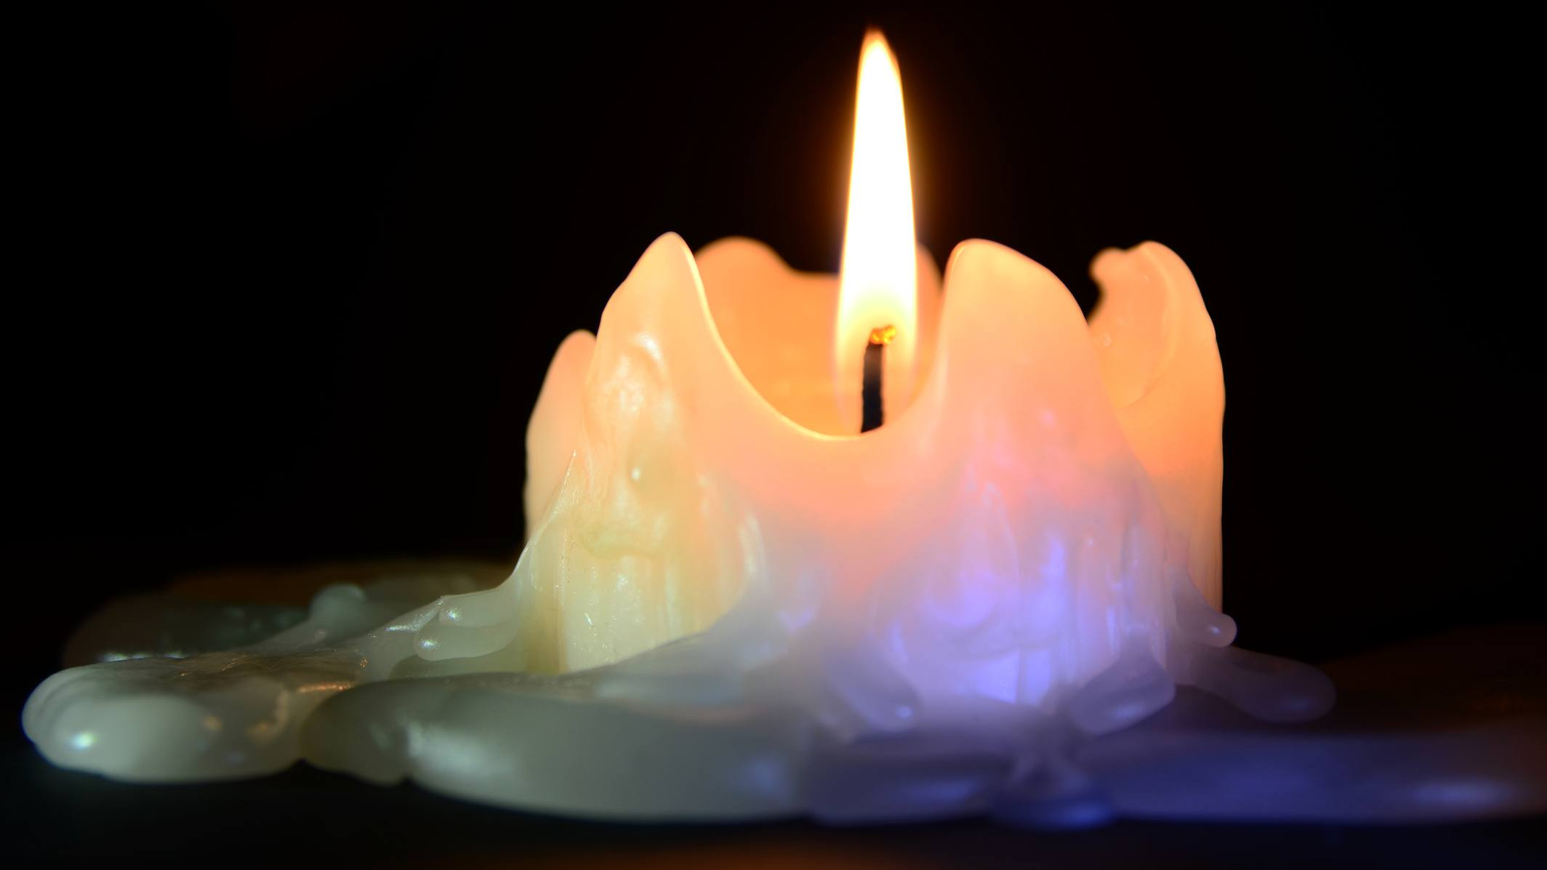
Enlightenment and Nirvana is Attained Through These Steps

Slide 60
“There is a sphere which is neither earth, nor water, nor fire, nor air, which is not the sphere of the infinity of space, nor the sphere of the infinity of consciousness, the sphere of nothingness, the sphere of perception, or non-perception, which is neither this world, neither sun nor moon. I deny that it is coming or going, enduring, death, or birth. It is only the end of suffering.” Buddha

Slide 61
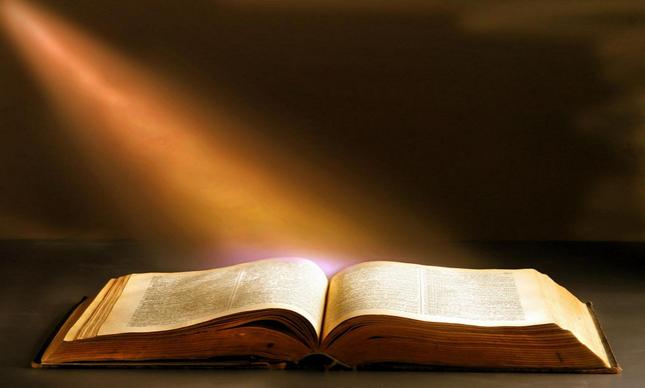
How Does Buddhism Compare to Christianity?

Slide 62
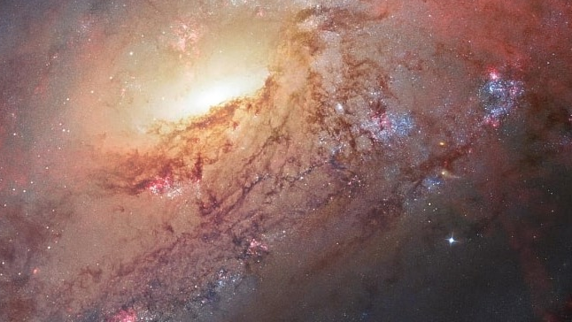
The Scientific (Cosmological) Arguments Still Apply

Slide 63
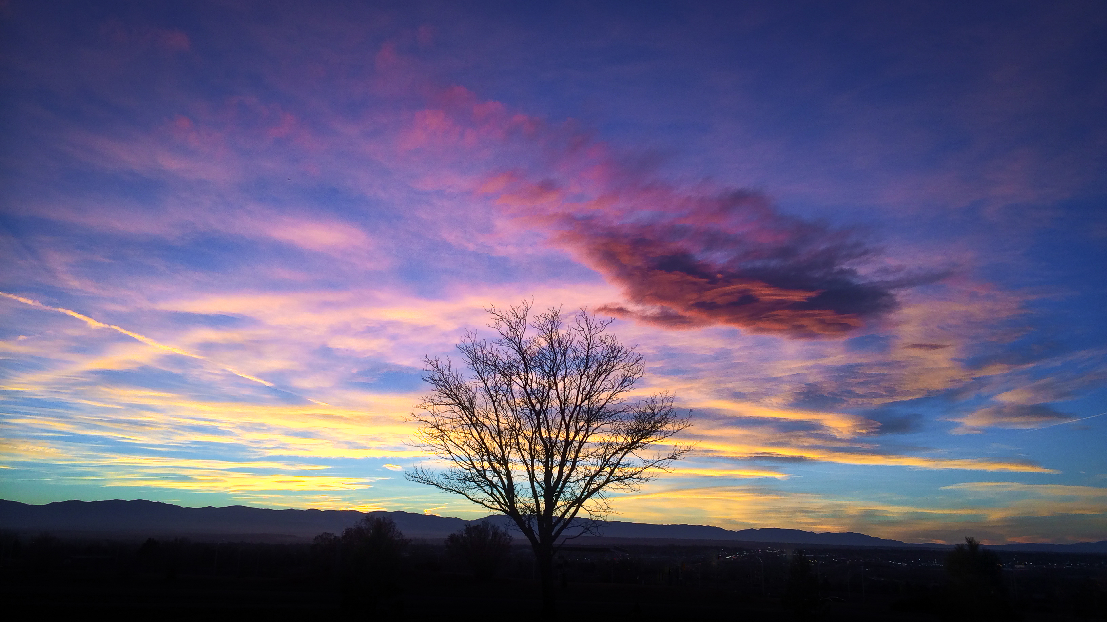
Complete Different Views on Desire

Slide 64
Desiring Not to Desire is Circular

Slide 65
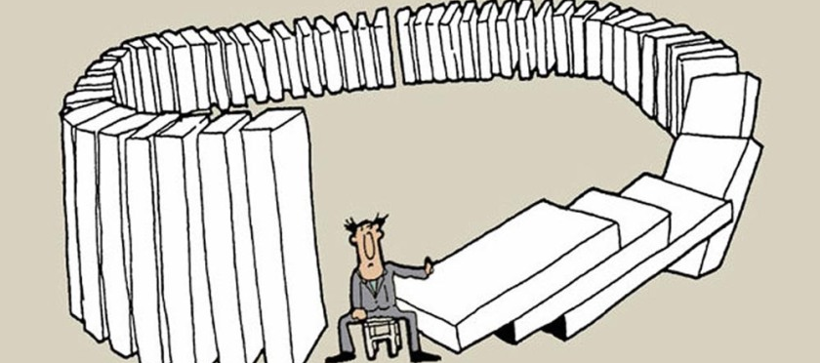
Karma and Biblical Morality are Different

Slide 66
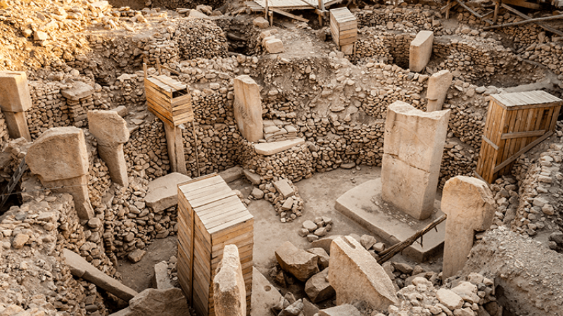
The Bible is Based on Historical Evidence, Buddhism Has None

Slide 67
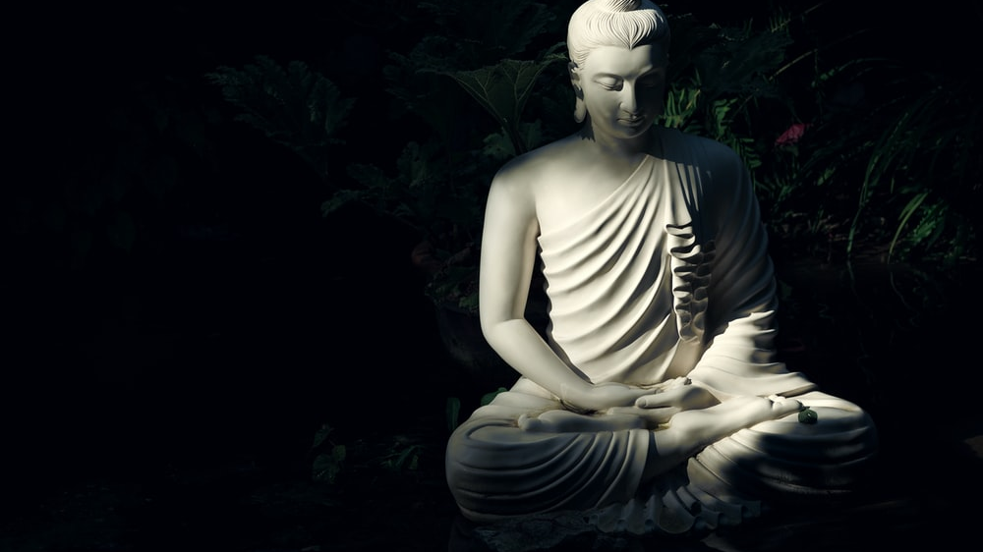
Buddhism Requires Blind Faith: Buddha is Still in the Grave

Slide 68
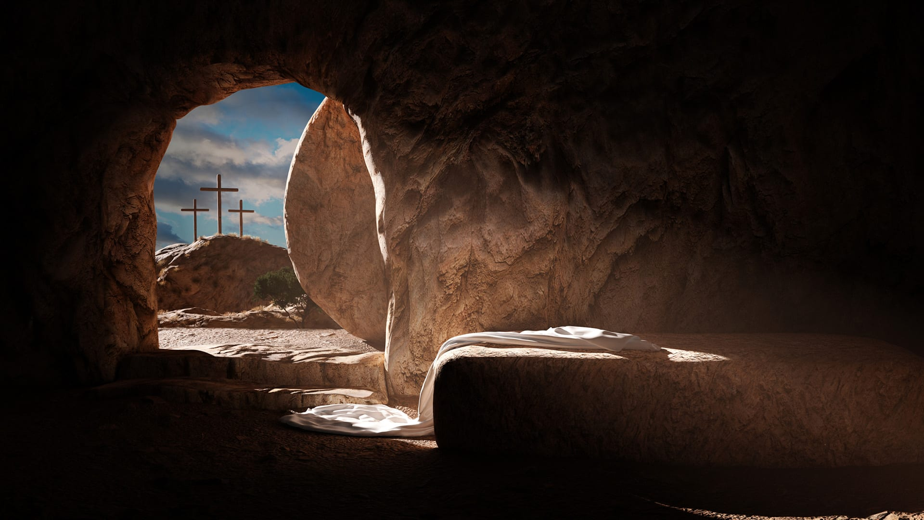
Buddhism Has No Empty Tomb

Slide 69
Jesus said: “I am the way, the truth, and the life, no one comes to the Father but by me” Jn.14:6

Slide 71
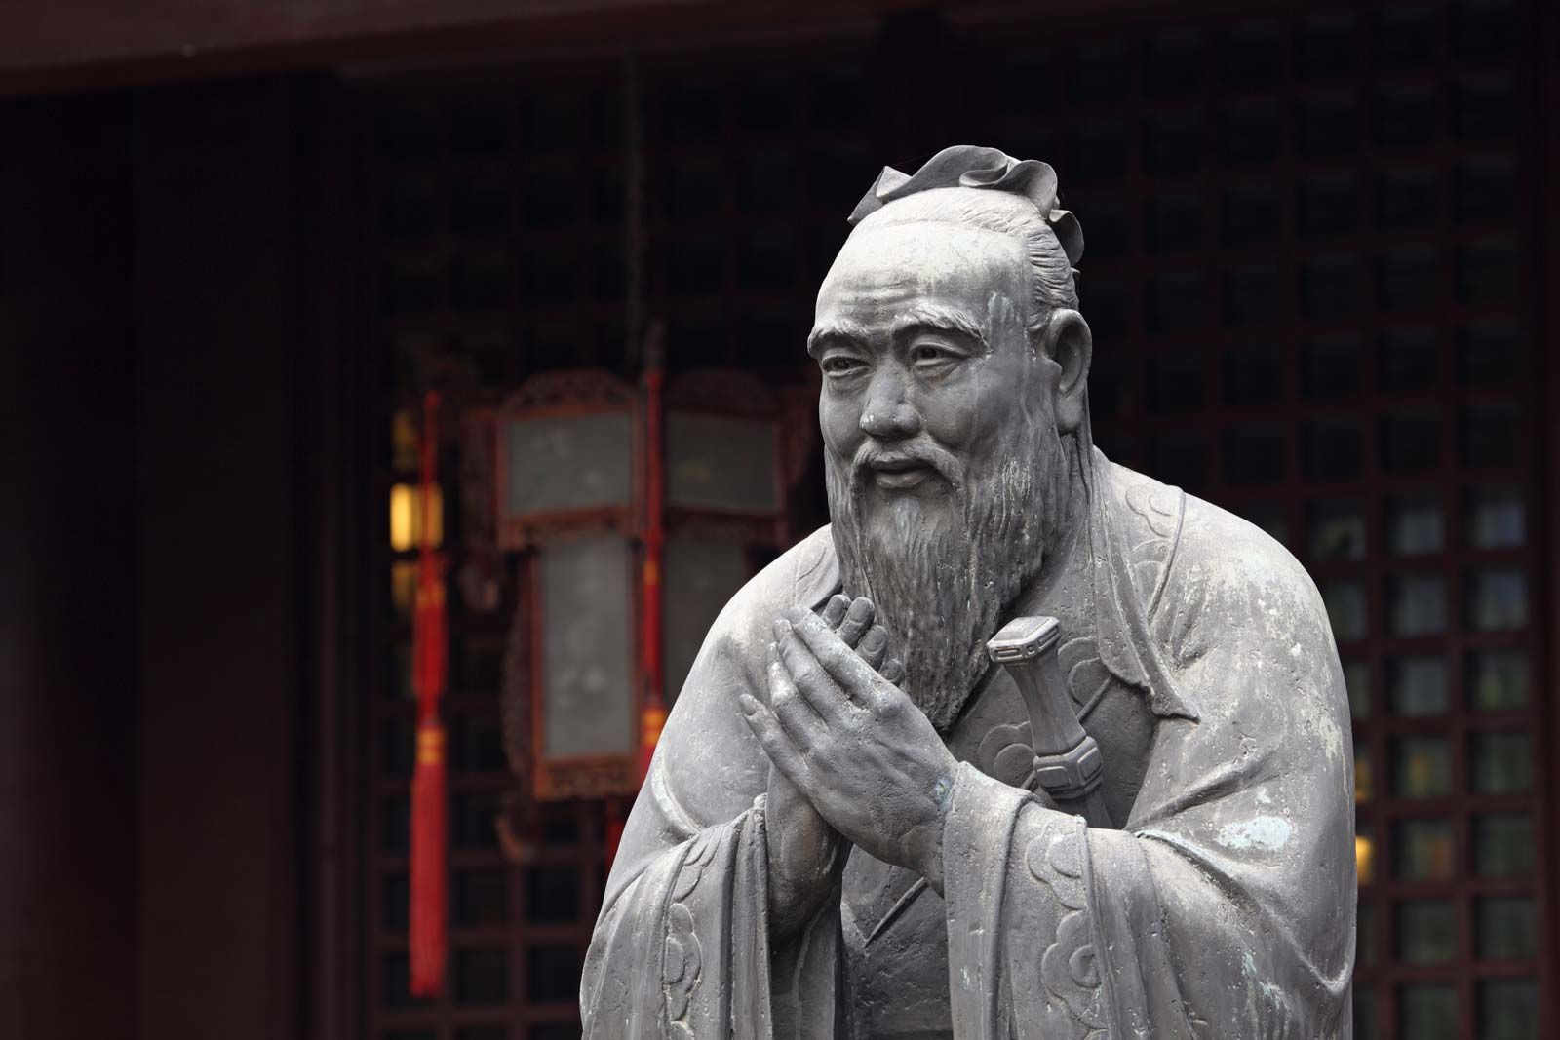
Confucianism Is a Large Religion

Slide 72
Not a Normal Religion, but a Philosophy

Slide 73
Affects Roughly One Billion People

Slide 74
Most Affected People Groups are Chinese, Japanese, Korean, and Vietnamese

Slide 75
First Aspect of (Work) Ethic is Loyalty to Family in this Life but they carry into the next life

Slide 76
The Second Aspect is a strong moral ethic of virtue, giving wisdom, good works, respect, etc.

Slide 77
They have a lot of focus on the “Eternal” (Future Generations)

Slide 78
Confucius Wanted to United the Tribes of China (500 B.C.)

Slide 79
Confucius asked: “What is the foundation of virtue and goodness in an age of confusion?”
Believed Moral Responsibility Existed in the Moral Consciousness of people (Jen)
Jen (Humanity) refers to ideal goodness (Good nature) of mankind

Slide 80
All Virtue Flows from this Good Nature

Slide 81
Three Aspects to Jen
Goal: Moral Perfection
Process: Self Reflection, Cultivation & Responsibility.
Foundation: Jen is the True Nature in Each Person

Slide 82
After Confucius, Mencius Developed it Further

Slide 83
Heaven is found in your heart-mind, it’s not a place you go after death

Slide 84
In the second century B.C., the emperor Han Wu-Ti adopted Confucianism as the official ideology of China

Slide 85
Imperial Confucianism made the literate elite the rulers of China.
Buddhism entered China and challenged these ideals from 500-850 B.C.
Today, the ideas of Confucius governor the minds of hundreds of millions.

Slide 86
What Did Confucius Change in the Religion Sense?
The formerly personal idea of God (Shang-Ti) became a “reality” called T’ien, which had the less personal meaning of “Heaven”

Slide 87
The Central Idea is to Affirm the Inherent Goodness of Mankind

Slide 88
The good human nature is actualized through education, self reflection, self-cultivation, and behaving by the established norms of the culture

Slide 89
Chinese people once worshipped “God”, but God was too far away they believed. They then turned their focus to ancestors, and this developed over the years.

Slide 90
Many believe their ancestors control their prosperity and blessings, so they worship (superstitiously) to appear them.

Slide 92
Problems with Confucianism

Slide 93
Doesn’t Have A Personal, All-Powerful
God Required by the Cosmological Argument

Slide 94
“There was something formless yet complete that existed before heaven and earth, without sound, without substance, dependent on nothing, unchanging, all-pervading, unfailing. One may think of it as the mother of all things under Heaven. Its true name we do not know. Tao is the bi-name we give it.” –Taoism

Slide 95
More on the Taoist Perspective in the next session

Slide 96
There is no foundation for their moral system of right and wrong
Morality Requires An Objective Person to Work

Slide 97
Mankind is clearly not “good” by nature (Plus you can’t define “good”)
The Bible says the opposite

Slide 98
Jesus said only God was by nature good, so one of the two are wrong

Slide 99
Mark 10:18: “So Jesus said to him, “Why do you call Me good? No one is good but One, that is, God.”

Slide 100
Doesn’t Account for the Historical Resurrection of Jesus, why did He come back with a body?

Slide 101
The idea you can pray to your ancestors or speak with them once they’re dead is unbiblical

Slide 102
Jesus and the Bible speaks of heaven and hell as real places after death… not states of mind

Slide 103
Matthew 25:46: “And these will go away into eternal punishment, but the righteous into eternal life.”

Slide 104
Confucius doesn’t predict the future or do miracles etc. to prove his authenticity like the Bible and Jesus

Slide 105
Confucius is dead, how do you know what he said was accurate?

Slide 106
The Core Message is Radically Different

Slide 108
The Religion of Taoism

Slide 109
One Chinese Scholar Wrote: “No one can hope to understand Chinese philosophy, religion, government, art, medicine, or even cooking – without a real appreciation of the profound philosophy taught in the Tao Te Ching”

Slide 110
The History Begins at the Ritual Music Culture, same as Confucianism

Slide 111
Legend claims their society functions in unison with peace and harmony until the feudal divisions

Slide 112
Many tried to revive this culture, Confucius being the most famous

Slide 113
Another Man Lived at the Same Time, Lao Tzu

Slide 114
They had disagreements on how people should live

Slide 115
Confucius Believed External Laws Were Necessary, Lao Tzu Did Not

Slide 116
“When righteousness is lost, only then does the doctrine of propriety arise. Now, propriety is a superficial expression of loyalty and faithfulness, and the beginning of disorder”
– Tao Te Ching

Slide 117
Lao Tzu believed imposing morality would fail and what people need is the Tao

Slide 118
He believed in the principle called wu-wei, which is the idea of purposeful “inactivity”

Slide 119
Lao Tzu taught that to bring harmony we simply align ourselves with the Tao and let it work everything out

Slide 120
Chuang Tzu, who lived sometime between 399-295 B.C. took the ideas of the Tao Te Ching and emphasized the mystical aspect of the Tao

Slide 121
Over the years Philosophical Tao turned into Religious Tao and then Magical Tao

Slide 122
Te is the manifestation of Tao in the individual

Slide 123
The Writings of the Founders Began to be Taken Literal instead of figuratively
Everything is more mystical when it’s taken literal

Slide 124
Begins to Sound a Lot like Star Wars and the Force…
Ch’i is the “breath” or energy within that allows you to attain immortality.
Alchemy was practiced by Taoist.
P’eng-lai is a mystical island they sought.

Slide 125
Philosophical Taoism Makes a Come Back a Few Hundred Years Later
Today, the original form is most popular

Slide 126
The Tao: unknowable and indescribable according to the Tao Te Ching
The Tao is the force of all being and existence… yet it’s even more, because they believe nonexistence is more ultimate

Slide 127
The Te: The pattern that makes an object what it is, it gives us our individuality and our uniqueness
It acts as each person's connection to the universe (Tao) the Te is in all things, and they should be accepted as they are.

Slide 128
The Yin & Yang
The Tao Te Ching said that “The One produced the two” and the two are the yin and the yang in Taoism

Slide 129
The Yin & Yang are the balancing forces of reality

Slide 130
Problems with Taoism

Slide 131
The problems with Taoism are like those
of Confucianism and other Eastern Religions

Slide 132
Doesn’t Have A Personal, All-Powerful
God Required by the Cosmological Argument

Slide 133
Two Equal, Balancing Forces is Difficult for Objective Morality

Slide 134
You Have to Save Yourself in Taoism Still

Slide 135
Lao Tzu is Still Dead and Buried Here

Slide 136
Jesus Claims to be the Way,
and Rose from the Dead to Prove It

Slide 138
The Religion of Islam

Slide 139
Islam is the Second Largest Religion in the World

Slide 140
Islam is the Dominating Religion in 50 Countries

Slide 141
Many see Muslims as potential terrorists, which isn’t a fair profile

Slide 142
The Vast Majority of Muslims, Especially in America, Are Peaceful

Slide 143
The 10-15% radicals around the world give the rest the profile

Slide 144
What do Muslims Believe? Here are the basics

Slide 145
The Five Pillars Are Central to the Islamic Faith

Slide 146
1. Affirmation (Shahada): "There is no God but Allah, and Muhammad is his messenger."

Slide 147
2. Prayer
(As-Salah): Muslims are required to pray five times a day, kneeling and facing Mecca.

Slide 148
3. Almsgiving (Zakah): A worthy Muslim must give 2.5 percent of his income to the poor.

Slide 149
4. The Fast (Siyam): Faithful Muslims fast from dawn to dusk every day during the ninth month of the Islamic lunar calendar, Ramadan.

Slide 150
5. The Pilgrimage (Al-Hajj): Muslims are expected to journey to Mecca at least once in their lifetime.

Slide 152
Now that you have the overview, here are the details, beginning with history

Slide 153
History of Islam
Muhammad was born in A.D. 570 in the town of Mecca located in what we now call Saudi Arabia

Slide 154
Mecca is Central
They (incorrectly) believe Mecca was an ancient site of worship (Back to Abraham) for the true God

Slide 155
They believe Abraham and Ishmael established the Kabaa before they fell into idolatry

Slide 156
Muhammad was born to Abdullah & Amina of the Banu Hashim clan but was orphaned and raised by his uncle

Slide 157
He married and became upset with the polytheism of Mecca

Slide 158
He then goes to Mount Hira to meditate and seek answer and claims an angel appeared to him, but he thinks it’s a demon at first

Slide 159
Eventually the “Spirit” Convinced him

Slide 160
“there came to him an Angel in the form of a man. the Angel said to him: "Recite!" and he said: "I am not a reciter," whereupon, as he himself told it, "the Angel took me and whelmed me in his embrace until he had reached the limit of mine endurance. then he released me and said:' Recite! ‘I said: 'I am not a reciter,' and again he took me and whelmed me in his embrace, and again when he reached the limit of mine endurance…

Slide 161
he released me and said: 'recite!', and again I said 'I am not a reciter.' then a third time he whelmed me as before, then …released me and said: "Recite in the name of thy Lord who created! He created man from a clot of blood. recite; and thy Lord is the Most bountiful, He who hath taught by the pen, taught man what he knew not". (Quran Alaq :96)

Slide 162
“The inspiration ceased to come to the Messenger of God for a while, and he was deeply grieved. He began to go to the tops of mountain crags, in order to fling himself from them; but every time he reached the summit of a mountain, Gabriel appeared to him and said to him, ‘You are the Prophet of God.’ Thereupon his anxiety would subside and he would come back to himself.“ (History of Tabari [1155], translated by W. Montgomery Watt, vol. 6, p. 76.)

Slide 163
Muhammad becomes a messenger of Monotheism and People Begin to Follow him and his teachings

Slide 164
Isra comes soon after they claim Muhammad rode a winged steed to Jerusalem, then it took him from there to heaven.

Slide 165
Muhammad is said to have traveled through the 1st, 2nd, 3rd, 4th, 5th, 6th, and 7th Heaven

Slide 166
Who he meets in “Heaven”
First heaven = Adam
Second heaven = John the Baptist & Jesus
Third heaven = Joseph
Fourth heaven = Idris
Fifth heaven = Aaron
Sixth heaven = Moses
Seventh heaven = Abraham

Slide 167
Muhammad then ascends to The Lote Tree of the Utmost Boundary) there ran four rivers from there, two hidden (that were in paradise), two visible (The Nile and the Euphrates)

Slide 168
Muhammad is told to pray 50 times a day… but Moses keeps sending him back to get it lowered until it’s down to five times

Slide 169
The people of Mecca begin to turn on Muhammad for his teachings and he flees to Medina with his followers (Hijra)

Slide 170
Muhammad became known as the prophet of Medina

Slide 171
Muhammad and his followers begin to raid Meccan caravans

Slide 172
Three major battles were fought between Muhammad and Mecca: The Battles of Badr (AD 624) Uhud (AD 625) and Trench (AD 627)

Slide 173
They win some, lose some, and after a while Muhammad turns on the Jews and beheads almost all the Jewish men

Slide 174
In the end Muhammad takes over Mecca and clears the other idols from the city

Slide 175
Muhammad ends up with many wives
Several of them are questionable…
Aisha, Zaynab, etc.

Slide 176
The New Islamic Empire Grew as Muhammad Brought Tribes Under His Control

Slide 177
Muhammad later dies and the Islamic Empire is led by others

Slide 179
The Quran is the “Bible” of the Muslim Faith

Slide 180
Roughly Half the Length of the New Testament, written after the life of Muhammad
His teachings were originally memorized

Slide 181
The Quran was originally written in Arabic

Slide 182
Muhammad claims to have received the Quran, memorized it, taught it to others, and after he died, they wrote it down because people who memorized it began to die and they were worried they lose pieces.

Slide 183
Eventually the written Qurans start to disagree with each other…

Slide 184
Uthman then rules the Muslims and collects, burns, and creates a master copy
Muslims then used this copy

Slide 185
If Uthman may have got it right or wrong… we’re not sure.

Slide 186
We do know many who originally memorized it though died before it was written down

Slide 187
How do the books compare?

Slide 188
The Bible | The Qur’an
Revealed over 1,500 years by God | Revealed in 20 years by Allah
Revealed in three languages | Revealed in one language
Revealed through 40+ authors | Revealed through Muhammad
66 Books in one | Only one book

Slide 189
According to the Qur’an, in Surat 7:124 & 12:41, the Egyptians practiced crucifixion at the time of Joseph (Jacob’s son) which isn’t consistent with archeology

Slide 190
Correct Timeframe: Britannica reports the first historical record of Crucifixion at about 519 BC when "Darius I, king of Persia, crucified 3,000 political opponents in Babylon“ It didn’t exist 1,000 years prior

Slide 191
The Quran teaches the Christian view of the Trinity is Father, Son, and Mother, which has never been the case

Slide 192
The Bible accurately predicts the future, while the Quran doesn’t even try

Slide 193
The Quran says Allah’s Word will never change because God will prevent it from happening
It also says the Bible is God’s Word…

Slide 194
But the Bible says the Quran is wrong…
If the Quran is right, the Bible is right… If the Bible is right, the Quran is wrong. If the Bible has changed, the Quran is wrong because it says God’s Words don’t change

Slide 195
The Evidence Shows the Bible is Correct & The Quran Wrong

Slide 197
Christianity vs. Islam

Slide 198
Many Claim the Two Religions Worship the Same God

Slide 199
Islam claims to worship the God of Abraham, Isaac, and Jacob

Slide 200
“I stand in religious solidarity with Muslims because they, like me, a Christian, are people of the book. And as Pope Francis stated last week, we worship the same God.” - L. Hawkins

Slide 201
“I stand in religious solidarity with Muslims because they, like me, a Christian, are people of the book. And as Pope Francis stated last week, we worship the same God.” - L. Hawkins

Slide 202
Are they the same or different Gods? Is there a clear dividing line between them or enough similarities?

Slide 203
The Answer Lies in the Person of Jesus

Slide 204
“So believe in Allah and His Messengers. Do not say, Three gods: Allah, Isa, and his mother.” It is better than you stop saying these things. Affirming the Divine Unity [is] better. Allah is only One God. He is too Glorious to have a son!” Tafsir Al-Jalalayn

Slide 205
In Islam, Jesus is merely a prophet of Allah like Muhammad and others

Slide 206
Jesus is not the Son of God as the Bible teaches

Slide 207
The Bible, and Jesus Himself, takes a different stance

Slide 208
“I told you that you would die in your sins, for unless you believe that I am he you will die in your sins.” Jn. 8:24

Slide 209
Jesus says you must believe He’s God to be saved

Slide 210
Christianity and Islam are Opposites on Many Things

Slide 211
One says you’re saved by works, the other says by faith

Slide 212
One Says Jesus Died & Rose Again, the Other Denies Both Claims

Slide 213
All the historical evidence says Jesus died and rose from the dead though, like the Bible says

Slide 214
The Bible says God is a loving Father, Islam says the Allah is not…

Slide 215
At the end of the day, you can believe a dead prophet, or a living savior who claimed to be God.

Slide 217
The Religion of Judaism

Slide 218
Ancient Jews had the same view of creation and early history as Christians

Slide 219
The Jews are most clearly the descendent of Abraham

Slide 220
Abraham, Isaac, and Jacob are the Patriarchs

Slide 221
Joseph, Moses, Judges, Kings, Prophets, and other men God used in Judaism
The Jews had similar beliefs…

Slide 222
The core belief of Judaism is Monotheism
God gave them laws to guide / teach them

Slide 223
Israel went back and forth in their commitment to God

Slide 224
By the time of Jesus, Judaism had many “versions”

Slide 225
Pharisees
Sadducees
Essenes
Zealots
They were all astray by Jesus

Slide 226
Many Jews Chose to Follow Christ
Many Jews Rejected Their Messiah
Eventually they were dispersed around the world, but many stayed religious.
Today there are different forms of Judaism.

Slide 227
Orthodox Jews are Similar to the Pharisees in Jesus’ time
Claim to follow the Old Testament

Slide 228
They focus on the writings of Moses, minus the sacrifices because they have no temple.

Slide 229
The Talmud
However, the Talmud is what really leads them in their religion

Slide 230
The Talmud is Extremely Long

Slide 231
Reform Judaism is the most liberal denomination of modern Judaism.

Slide 232
Conservative Judaism (also known as Masorti Judaism outside the U.S.) is a moderate sect of Judaism that seeks to avoid the extremes of Orthodox and Reformed.

Slide 233
Hasidic Judaism
The movement had emphasis on asceticism and mystical experience

Slide 234
Judaism Originally was True
But they have missed their Messiah, and the way to eternal life

Slide 235
If Jesus Rose from the Dead, Judaism is Now Wrong

Slide 237
Why is Christianity True?

Slide 238
Showing others are wrong doesn’t mean we are right as Christians

Slide 239
John 14:6
Jesus said to him, “I am the way, and the truth, and the life. No one comes to the Father except through me.

Slide 240
Why Christianity is True?

Slide 241
Many Answers Could Be Given

Slide 242
A Few Key Reasons Come to Mind

Slide 244
1. Christianity Makes Sense of Reality

Slide 245
Parameters of Reality Limit Possible Worldviews

Slide 246
A. The Universe Must Have A Cause Because It Has A Beginning
The Cause Must Be:
Infinitely Powerful
Eternal in Nature
Transcendent in Nature

Slide 247
B. The Universe is Specifically Designed for Life to Exist

Slide 249
The Designer of the Universe/Life:
An Intelligent Designer
Infinitely Wise in Nature
Personable with Humans in Mind

Slide 250
Paul Says The Existence of Everything Proves the God, as described in Scripture, exists.

Slide 251
C. Objective Morality Written on Our Hearts Requires God

Slide 252
Objective Morality is Easily Proven: Was Hitler Wrong?

Slide 253
The Source of Morality Must Be:
Eternal in Nature
Objective in Nature
Personal in Nature
Moral in Nature

Slide 254
D. Logic and Right Thinking Requires an Objective Standard

Slide 255
General Revelation Confirms the Truth Claims:
God is All Powerful & All Knowing.
God is Transcendent to His Creation.
God is Personal with a Mind and Will.
God is Concerned Chiefly with Human’s in Creation.
God is the Source of Moral Truth and Logical Thinking.

Slide 256
2. The Truth of the Bible Proves Christianity

Slide 257
There is something different about this book

Slide 258
A. Most Reliable Historical Document in Ancient History

Slide 260
Did The Apostles/Prophets Make Up The Stories?

Slide 261
They all died
for their faith.
The apostles, Paul, James, etc. all died painful, horrible deaths because they would not recant their faith.

Slide 262
B. The Bible Accurately Predicts the Future

Slide 263
1. Jesus Would Be Born in the City of David (Bethlehem)
The Christmas story is familiar to everyone in America Today

Slide 264
Micah Written 720 B.C. Jesus Born Around 2 B.C.
Timeline: 720 Years

Slide 265
2. The Messiah Will Present Himself as King Riding a Donkey
Palm Sunday is the Holiday Celebrating it

Slide 266
Zechariah Written 480 B.C. Palm Sunday 32 B.C.
Timeline: 500 Years

Slide 267
3. The Messiah Will be Betrayed for Thirty Pieces of Silver
Judas Betrayed Jesus to the Pharisees

Slide 268
Zechariah Written 480 B.C. Betrayal Sunday 32 B.C.
Timeline: 500 Years

Slide 269
4. The Potter Will End Up with the Money in the Betrayal
Judas takes the money back due to guilt, but they can’t keep it

Slide 270
Zechariah Written 480 B.C. Betrayal Sunday 32 B.C.
Timeline: 500 Years

Slide 271
5. Announced by an Elijah-Like Herold
John the Baptist Proclaimed the Coming of Jesus like Elijah

Slide 272
Isaiah Written 700 B.C. Betrayal Sunday 30 B.C.
Timeline: 730 Years

Slide 273
6. He was accused of a capital crime and made no defense
Jesus was given a trial and did not speak

Slide 274
Isaiah Written 700 B.C. Betrayal Sunday 30 B.C.
Timeline: 730 Years

Slide 275
7. He Will Die with the Wicked and be Buried with the Rich
Jesus died on the cross with thieves but was buried with the rich

Slide 276
Isaiah Written 700 B.C. Betrayal Sunday 30 B.C.
Timeline: 730 Years

Slide 277
8. Crucified Without a Bone Broken
The Two Other Thieves Had Their Legs Broken While Christ Didn’t

Slide 278
Psalms Written 1,200 B.C. Betrayal Sunday 30 B.C.
Timeline: 1,230 Years

Slide 279
What are the Odds of Getting All Eight Prophecies

Slide 280
Here are the Odds: 1 in 100,000,000,000,000,000
Visualizing the odds is complicated but here is an example using states and money

Slide 281
3. History Shows Christianity is True

Slide 282
Historical Evidence for the Resurrection is our Example

Slide 283
1. Jesus died by crucifixion at the hands of the Romans
No ancient history for 500 years refutes it

Slide 284
2. The Disciples Sincerely Believed He Rose from the Dead & Appeared to Them
Whether or not He did, the disciples thought He did.

Slide 285
3. The conversion of Paul
Paul started off as a persecutor of the earliest Christians

Slide 286
4. The Conversion of the Skeptic James
James was the brother of Jesus

Slide 287
5. Empty Tomb
There is great historical evidence the
tomb was empty

Slide 288
6. Jesus Burial Story is Trustworthy
The inclusion of the famous Joseph of Arimathea shows they are not inventing the story

Slide 289
7. Broken Roman Seal
The Romans put the seal on the tomb, which is Roman “police tape”

Slide 290
8. The Roman Guards at the Tomb go Awol and Abandon Their Post
Roman Soldiers Were Fierce

Slide 291
9. The Large Stone was Removed
These stones weighed an average of 3-4k pounds

Slide 292
10. The Grave clothes are left behind at the tomb of Jesus
The Shroud of Turin might be it

Slide 293
11. Jesus appears to over 500 witnesses at one time
How does that make sense?

Slide 294
John 14:6
Jesus said to him, “I am the way, and the truth, and the life. No one comes to the Father except through me.

Slide 295
John 3:16: “For God so loved the world, that he gave his only Son, that whoever believes in him should not perish but have eternal life.”

Slide 297
Why Protestant Christianity?

Slide 298
The Protestant Belief has Five Distinctives

Slide 299
1. Sola Scriptura (Scripture Alone)
2 Timothy 3:16-17: “All Scripture is breathed out by God and profitable for teaching, for reproof, for correction, and for training in righteousness, that the man of God may be complete, equipped for every good work.”

Slide 300
2. Sola Fide (By Faith Alone)
Romans 5:1: “Therefore, since we have been justified by faith, we have peace with God through our Lord Jesus Christ.”

Slide 301
3. Sola Gracia (By Grace Alone)
Ephesians 2:8-9: “For by grace you have been saved through faith. And this is not your own doing; it is the gift of God, ⁹ not a result of works, so that no one may boast.”

Slide 302
4. Sola Christus (By Christ Alone)
John 14:6: “Jesus said to him, “I am the way, and the truth, and the life. No one comes to the Father except through me.”

Slide 303
5. Soli Deo Gloria (All for God’s Glory)
1 Corinthians 10:31: “So, whether you eat or drink, or whatever you do, do all to the glory of God.”

